Slide 1

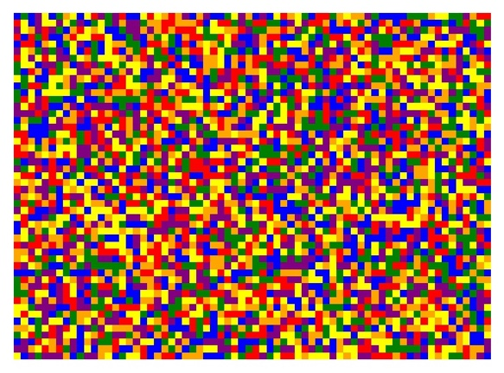

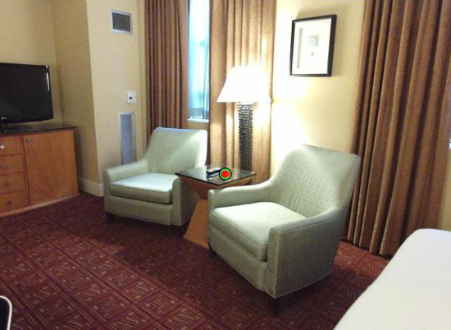
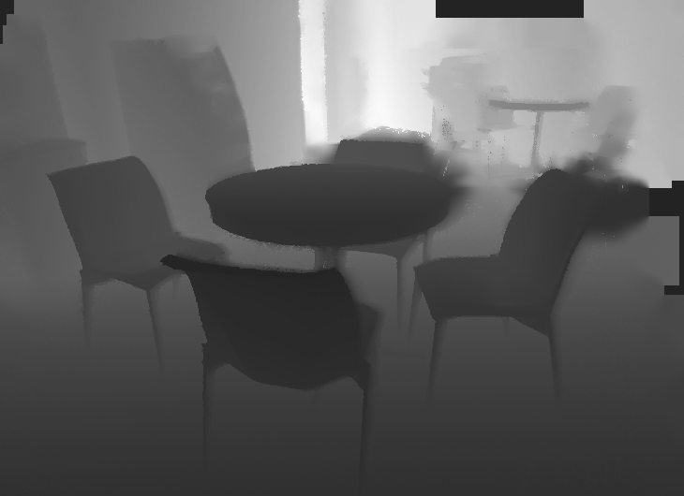
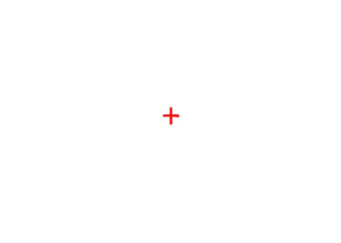
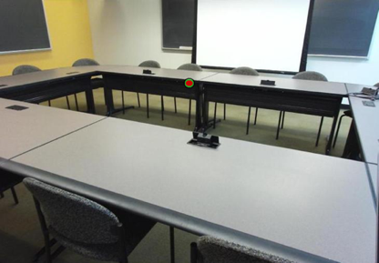


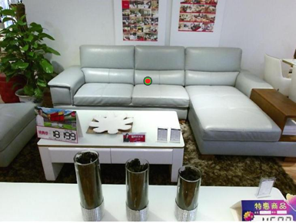

A.
B.
How far away was the target, in meters?
Target Image
125, 250, or 1000 ms
500 ms
time
- 0.25 m
500 ms
Depth Image
- 2.6 m
- 5 m
C.
Respond which target was closer
125, 250, or 1000 ms
500 ms
time
500 ms
500 ms
500 ms
125, 250, or 1000 ms
500 ms
Notes:
DONE

Slide 2
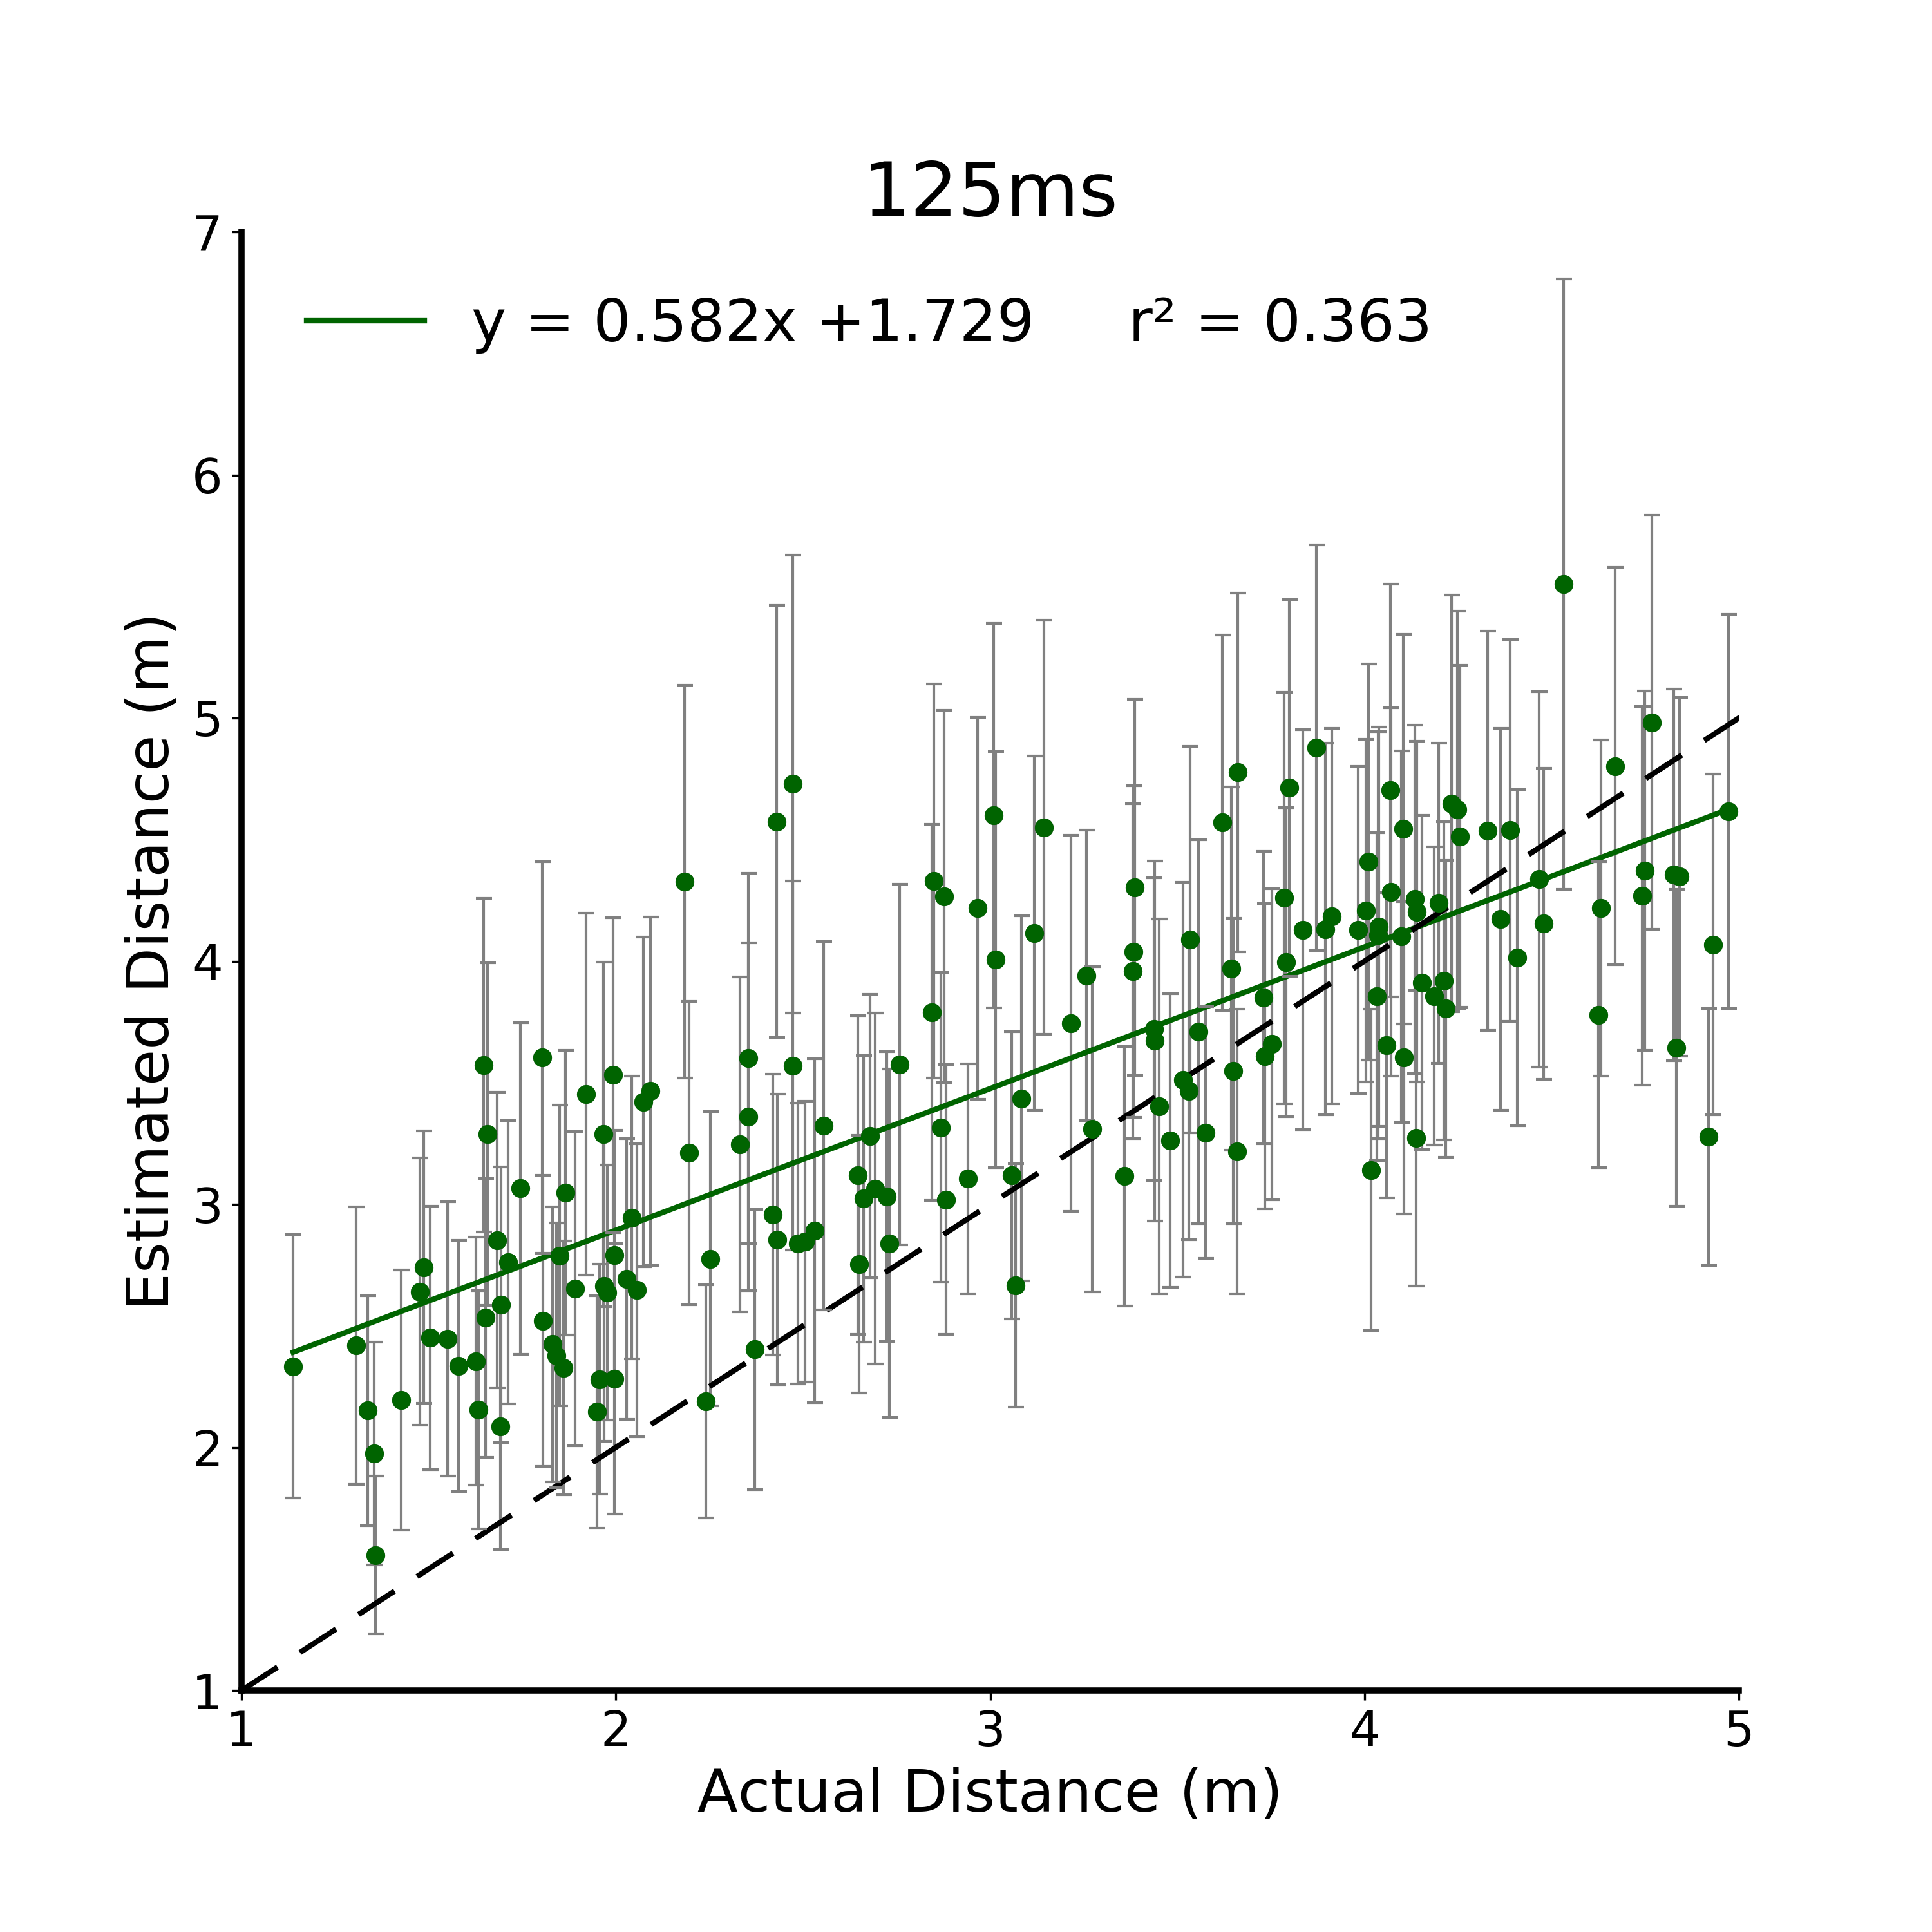
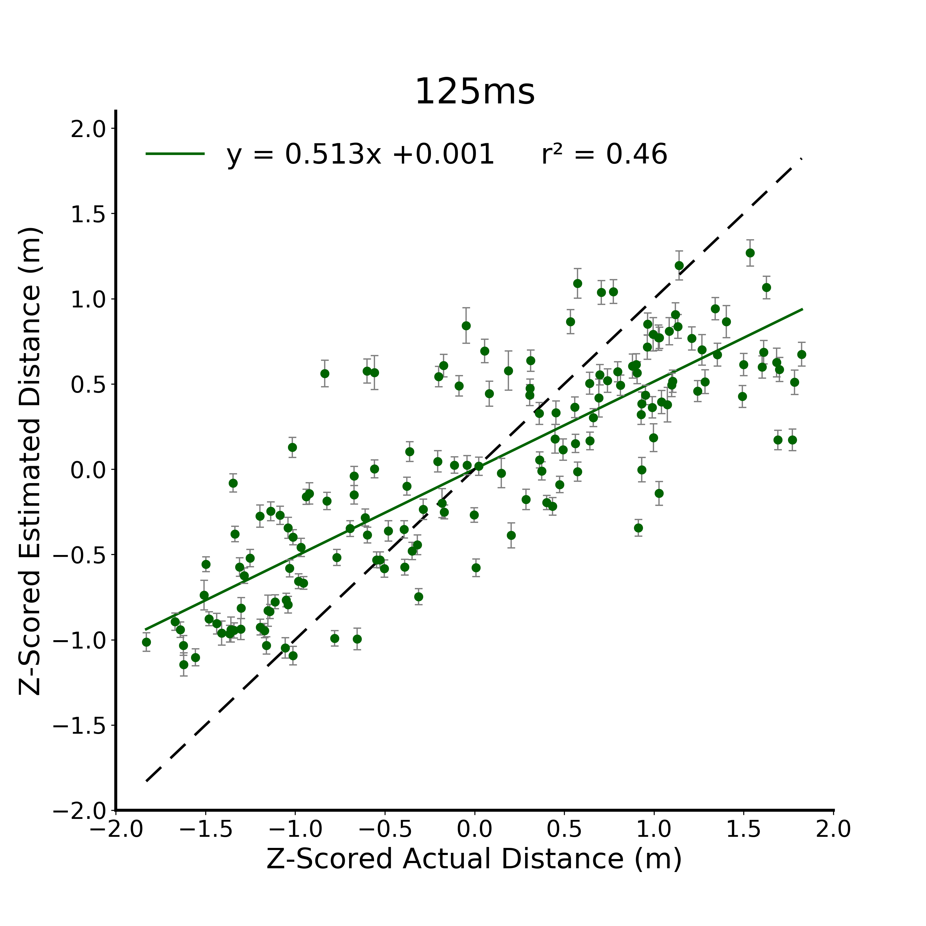
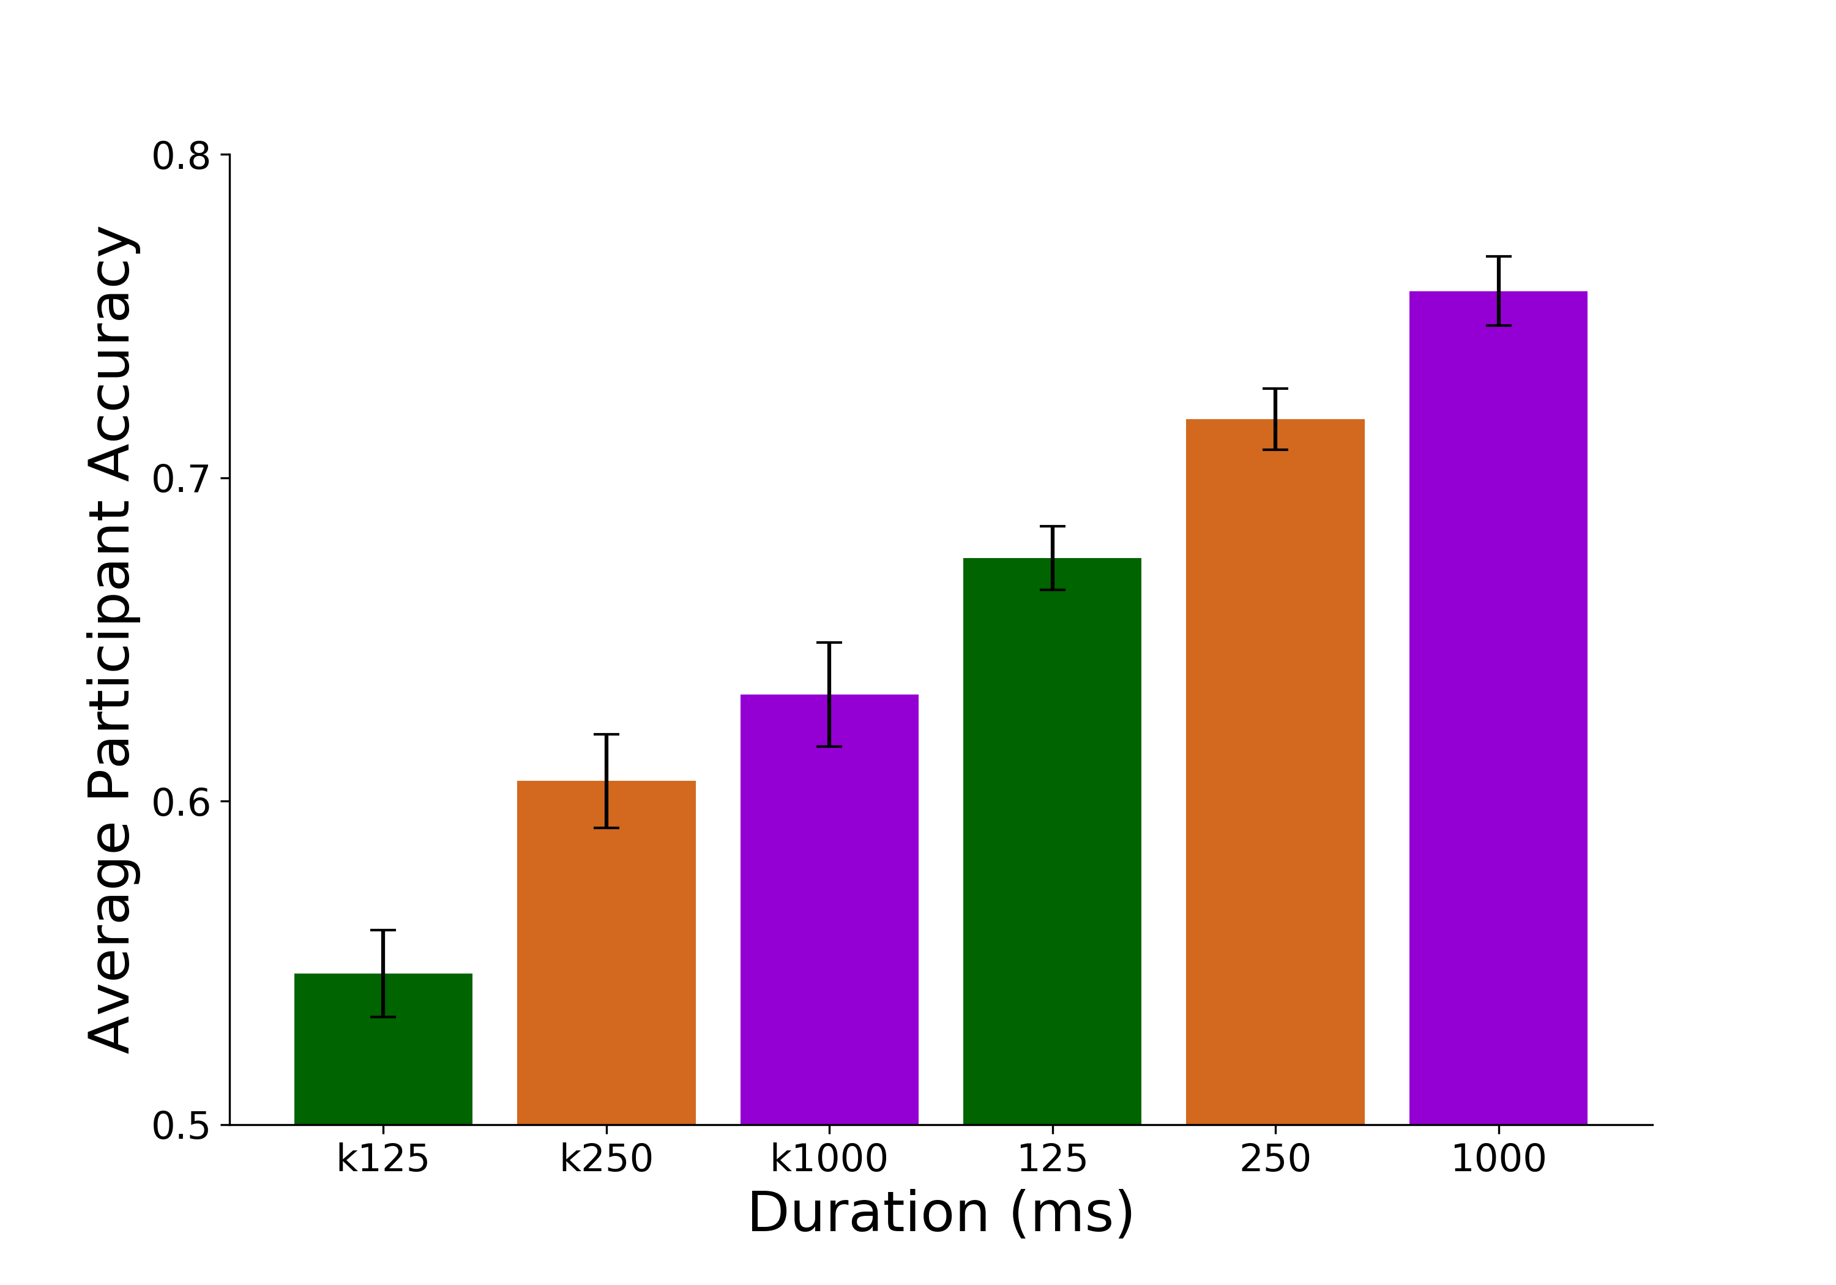
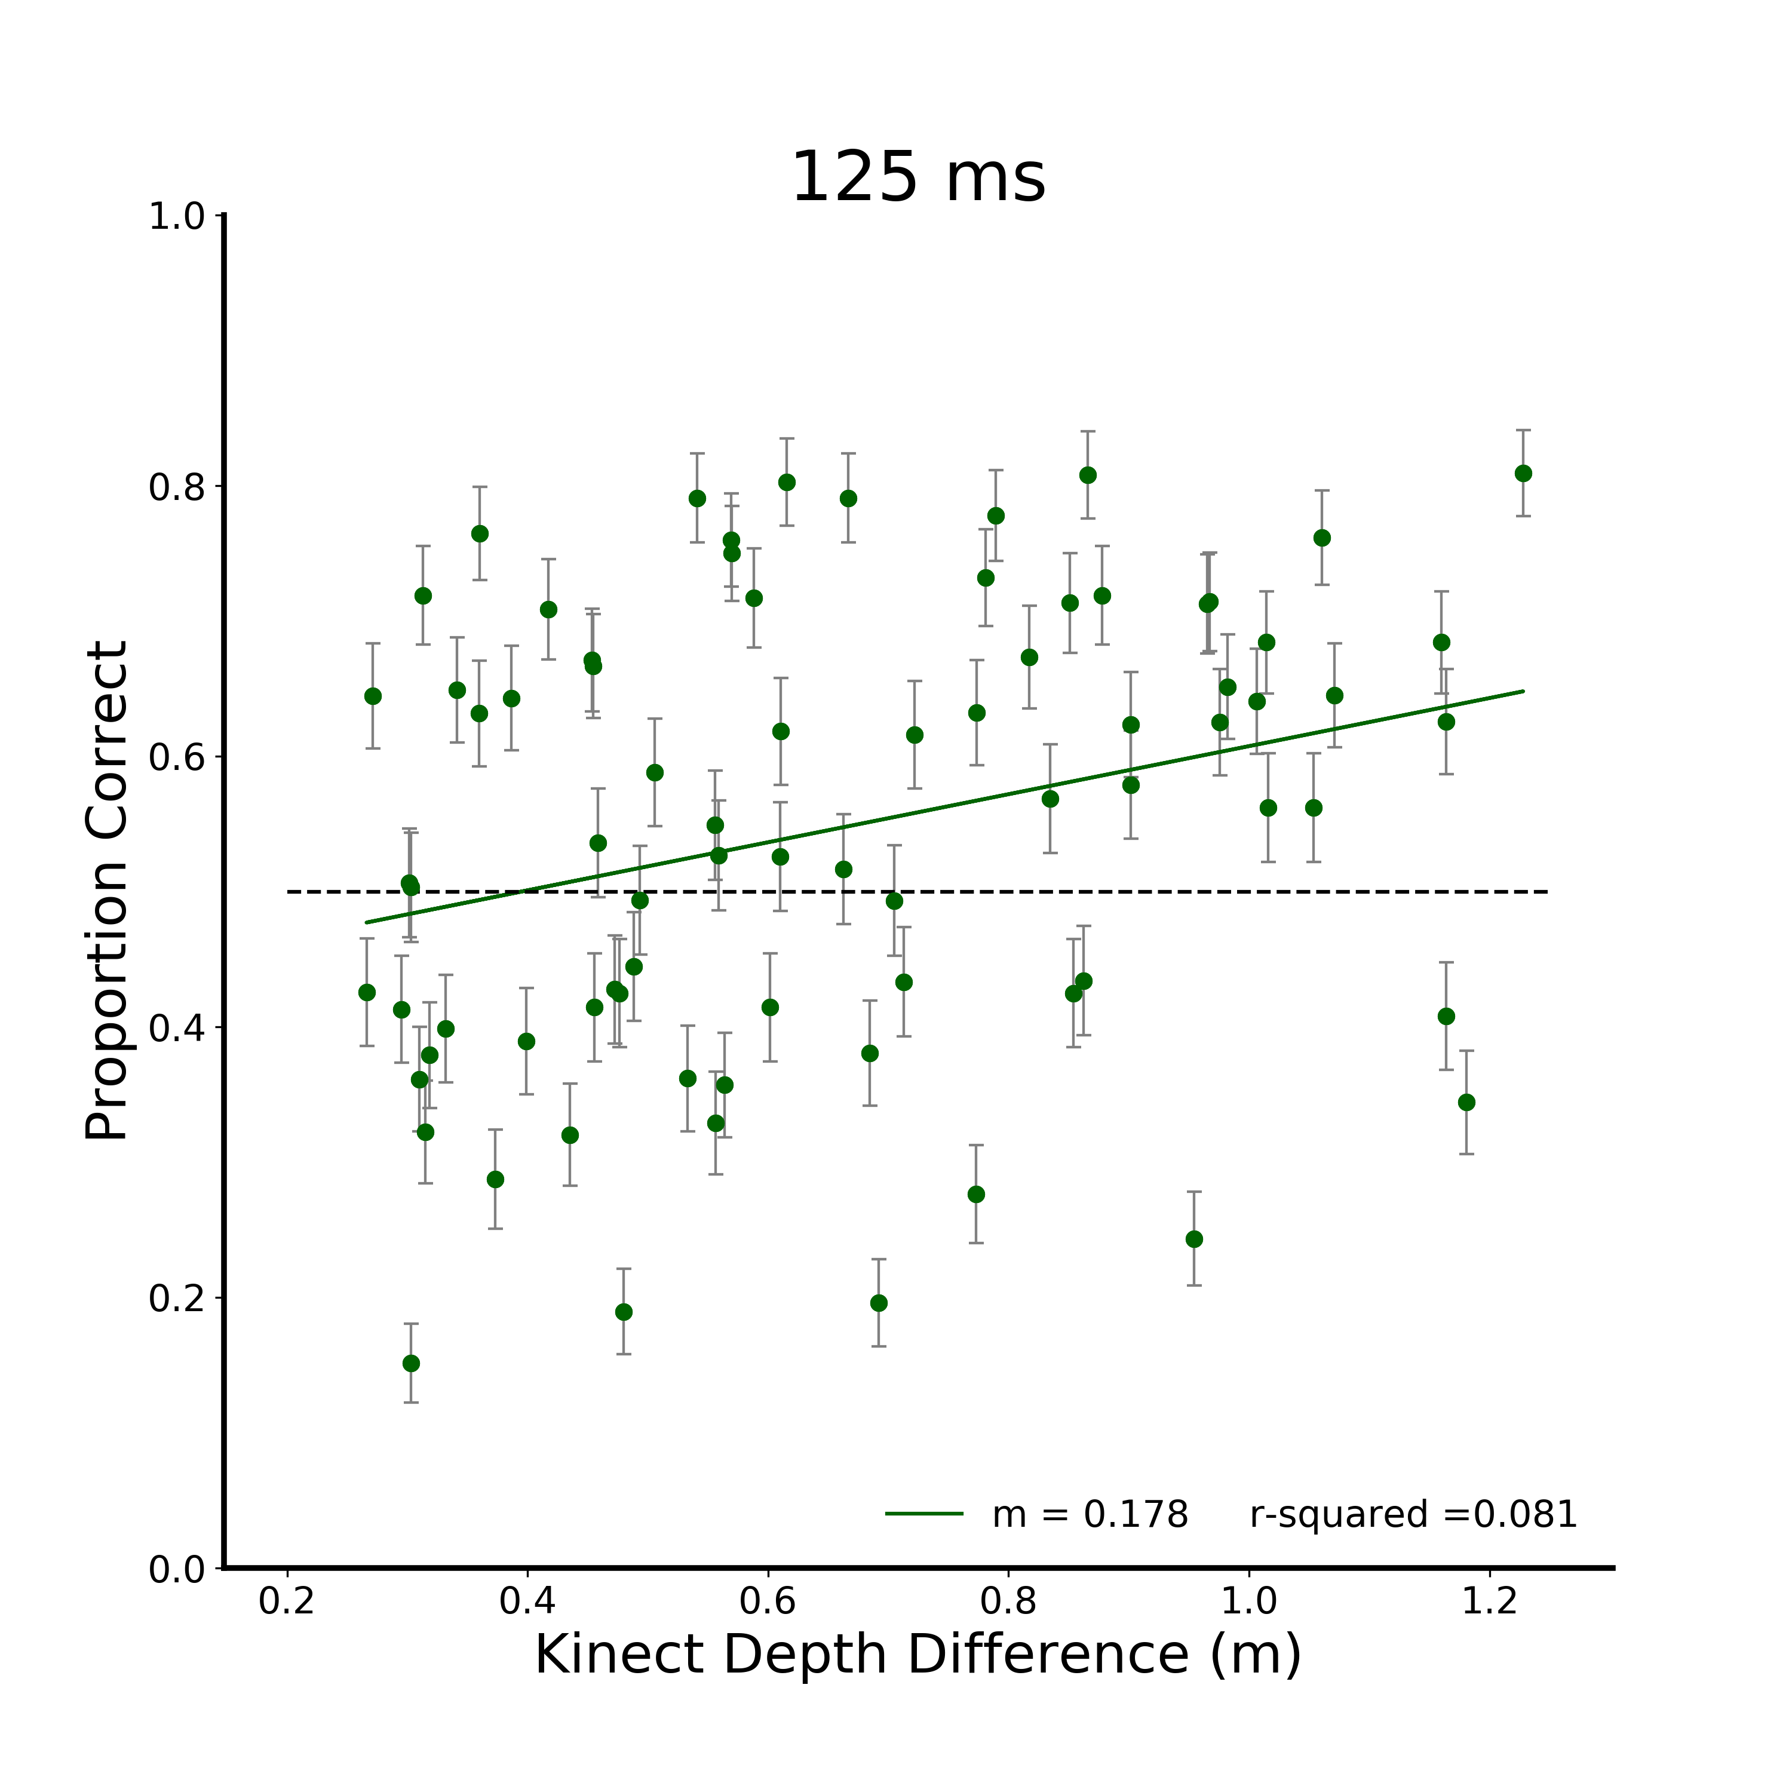
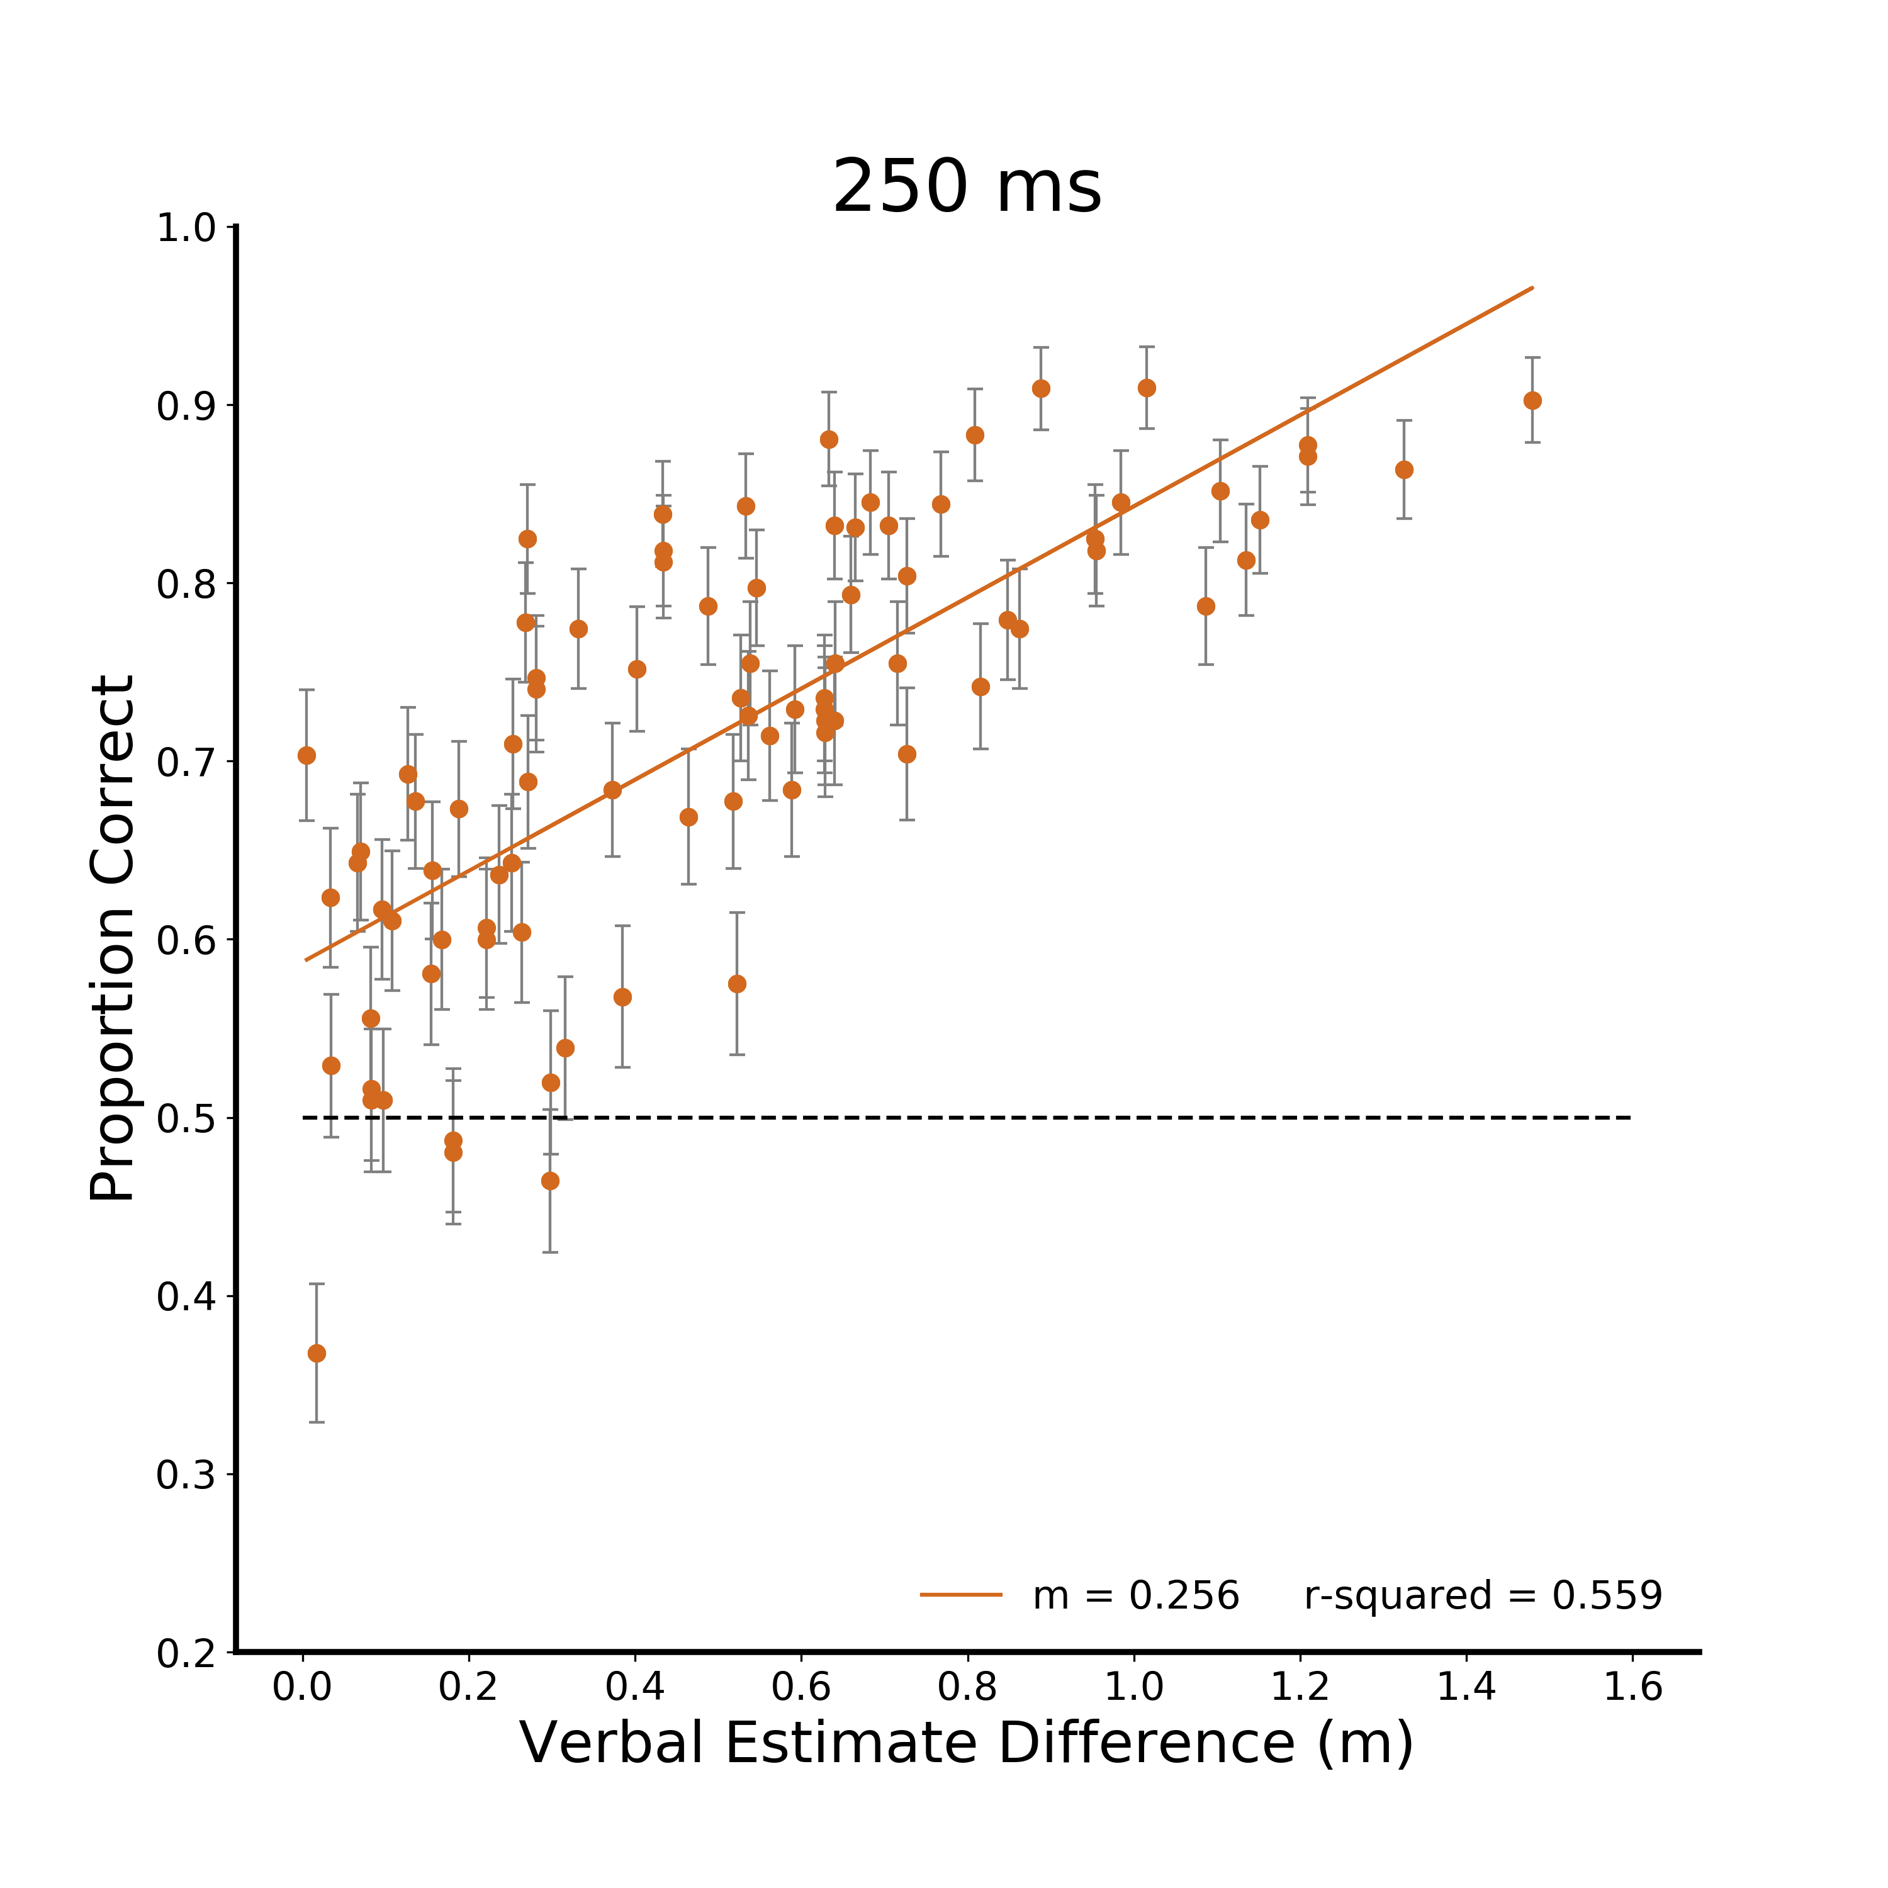
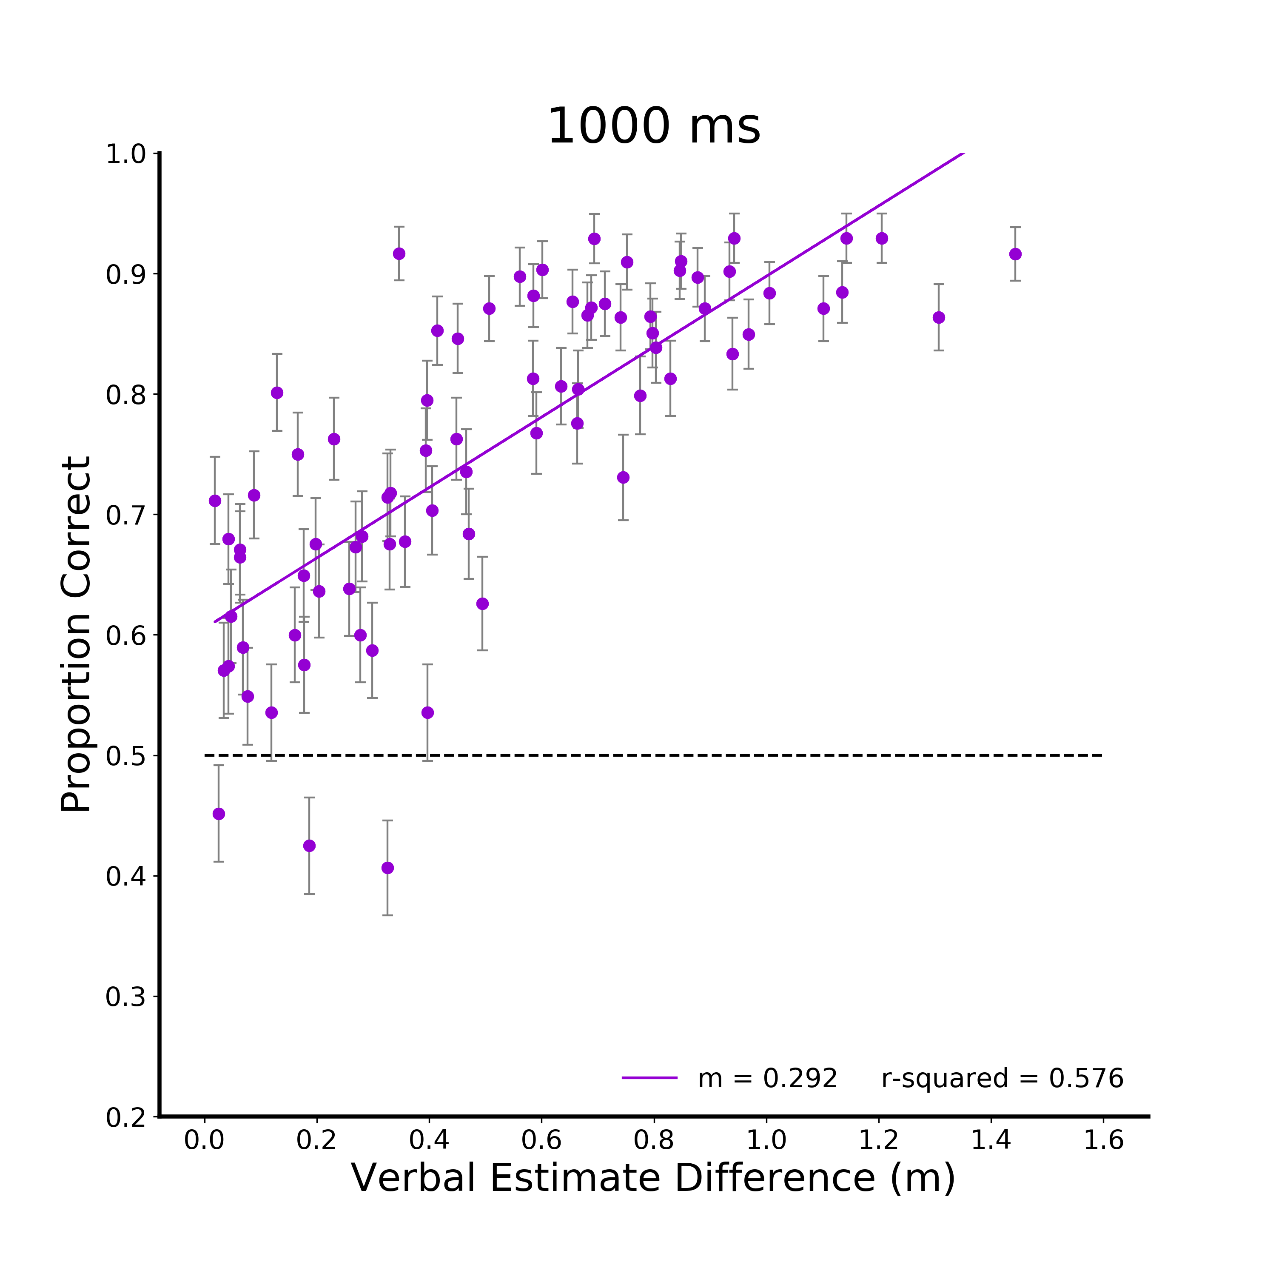
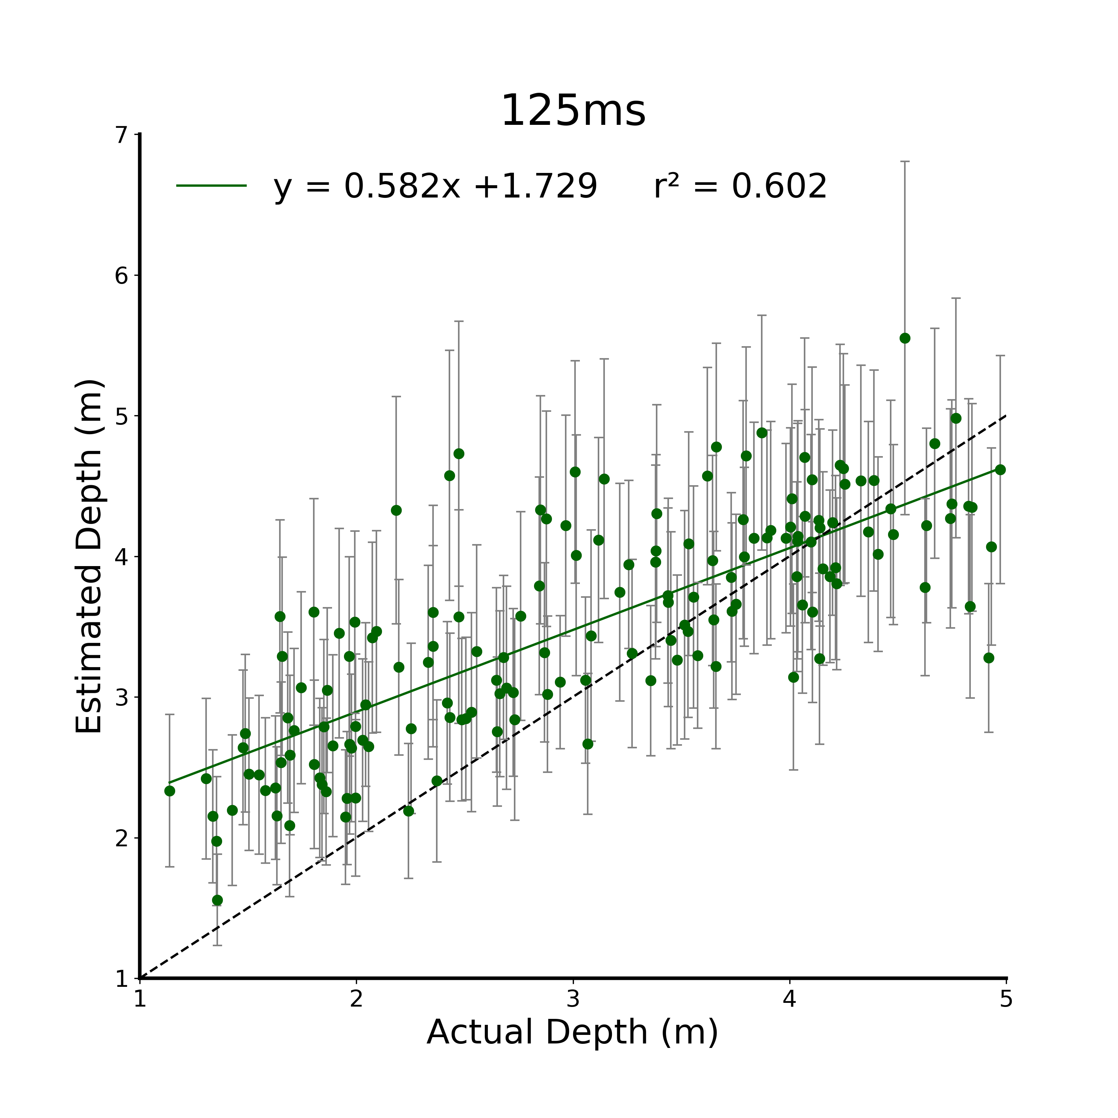
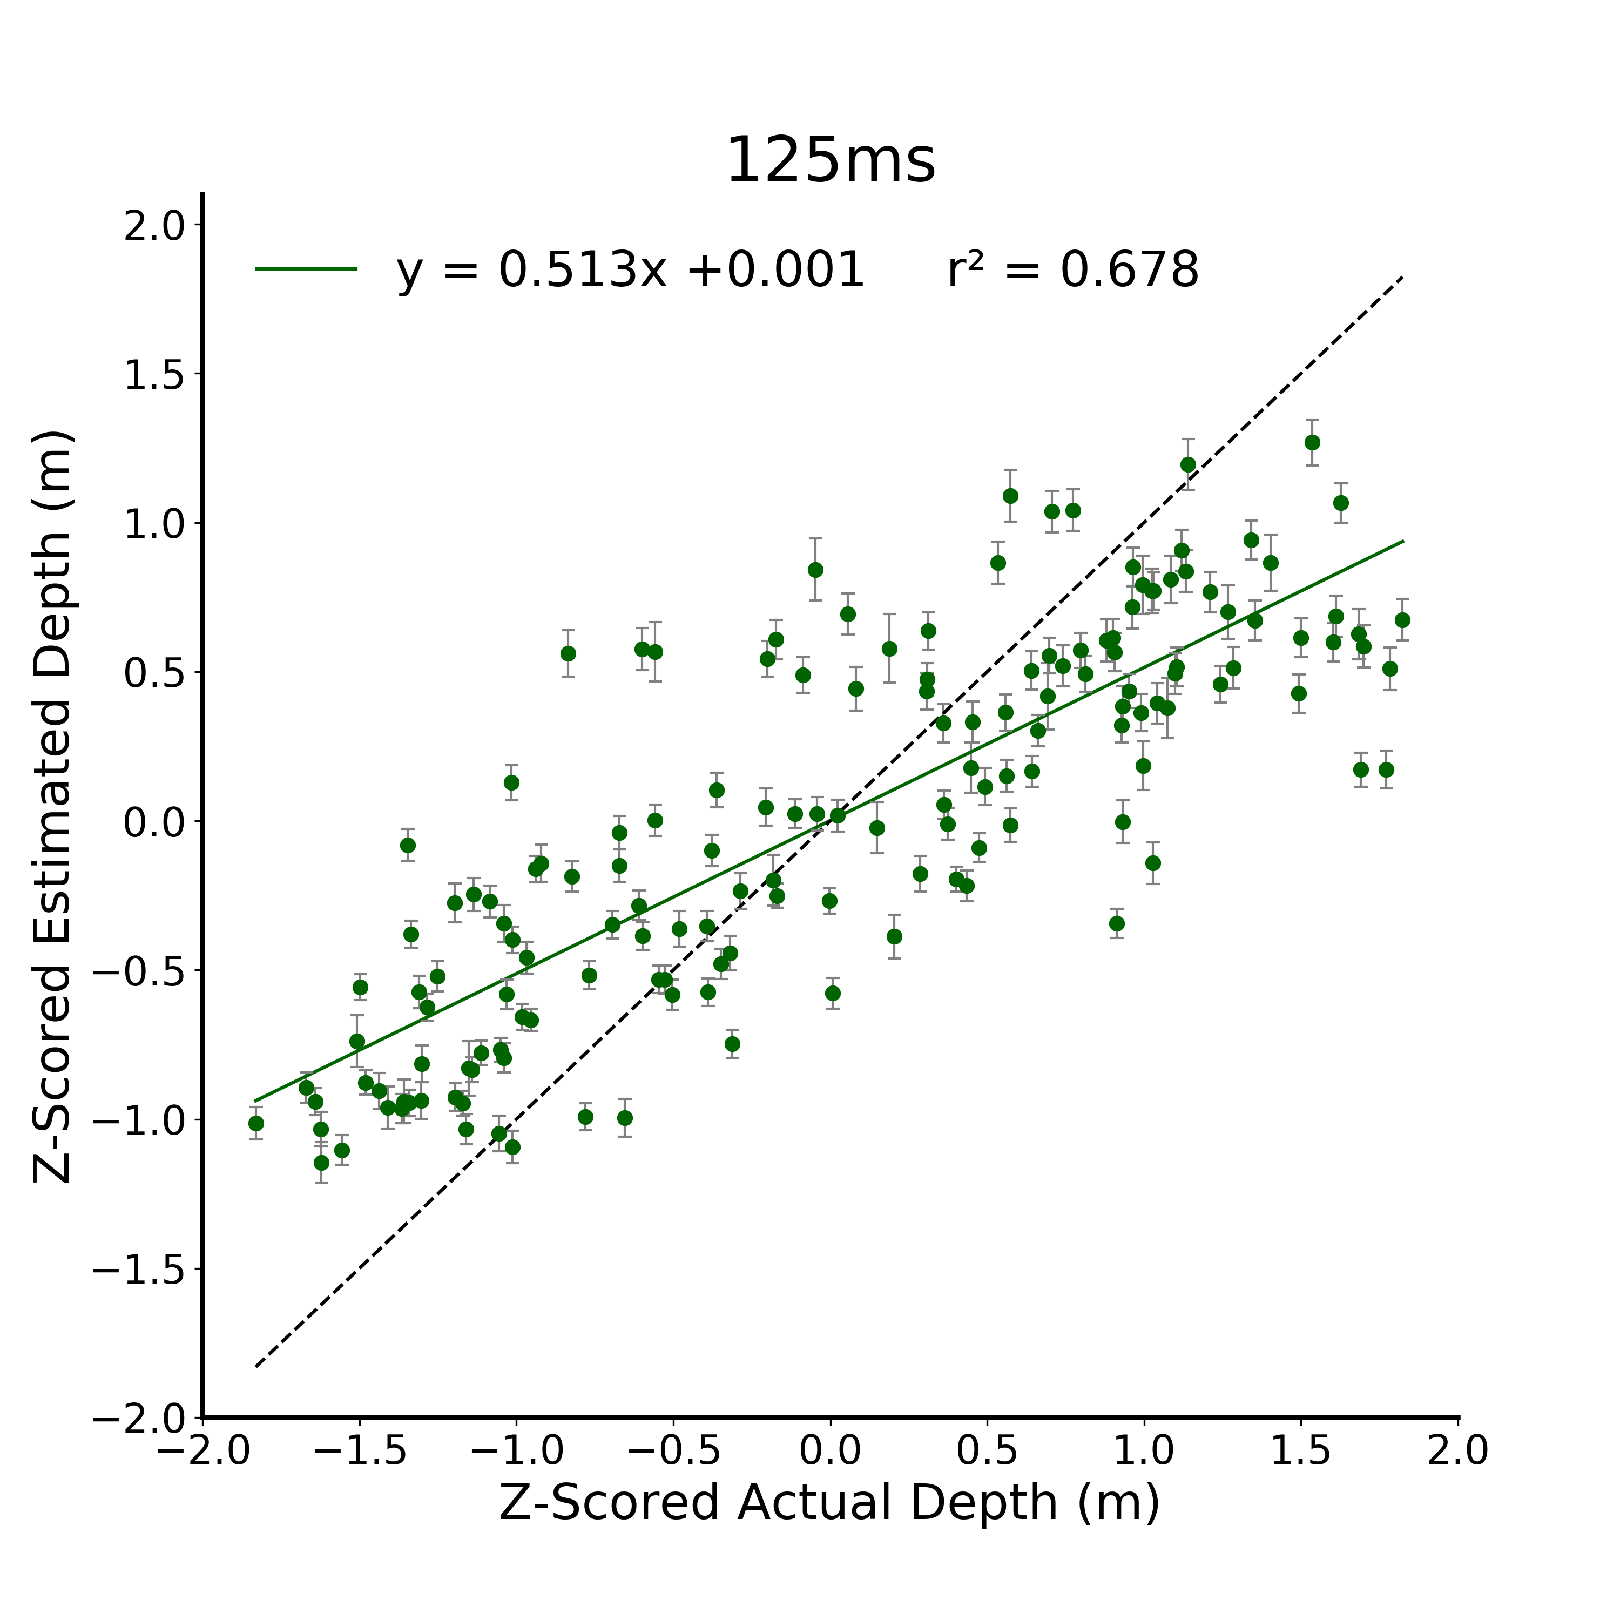

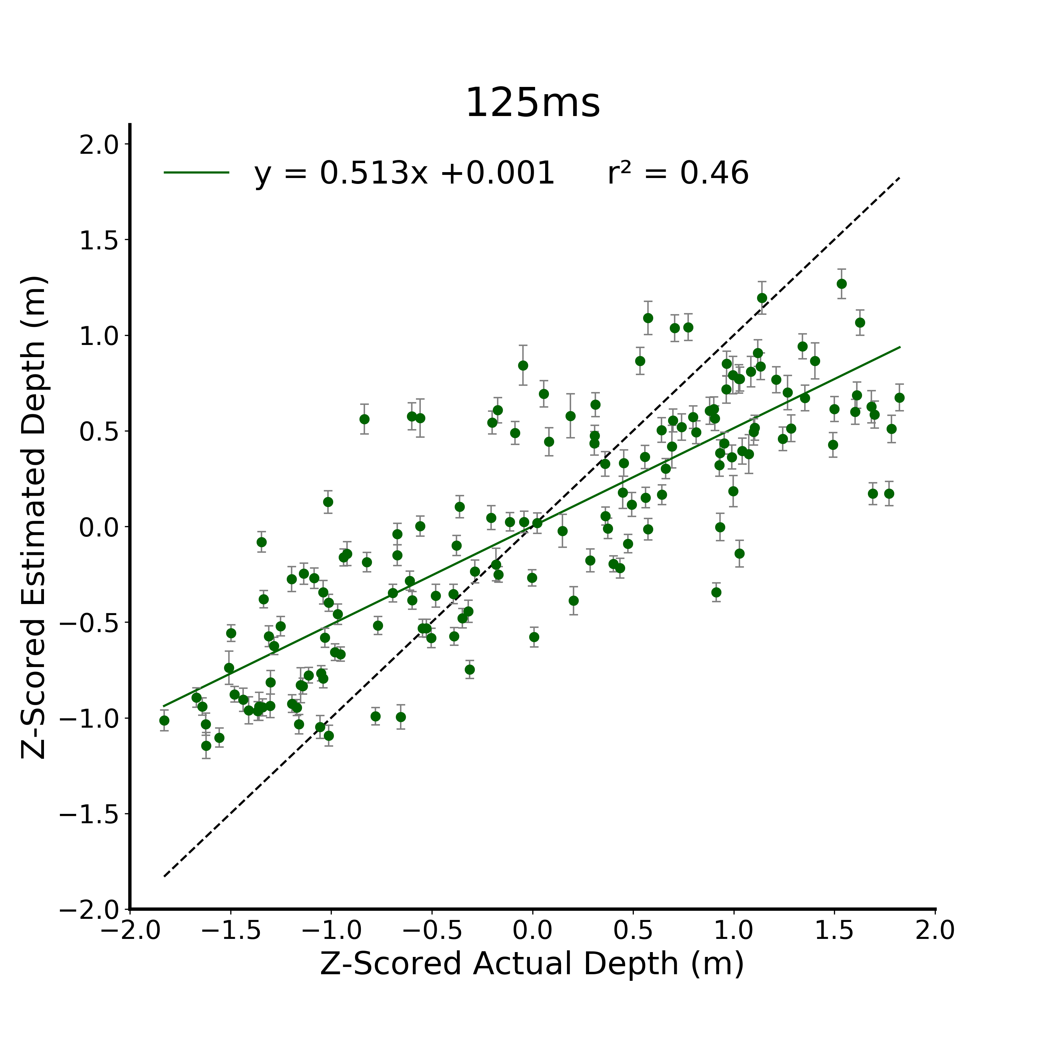
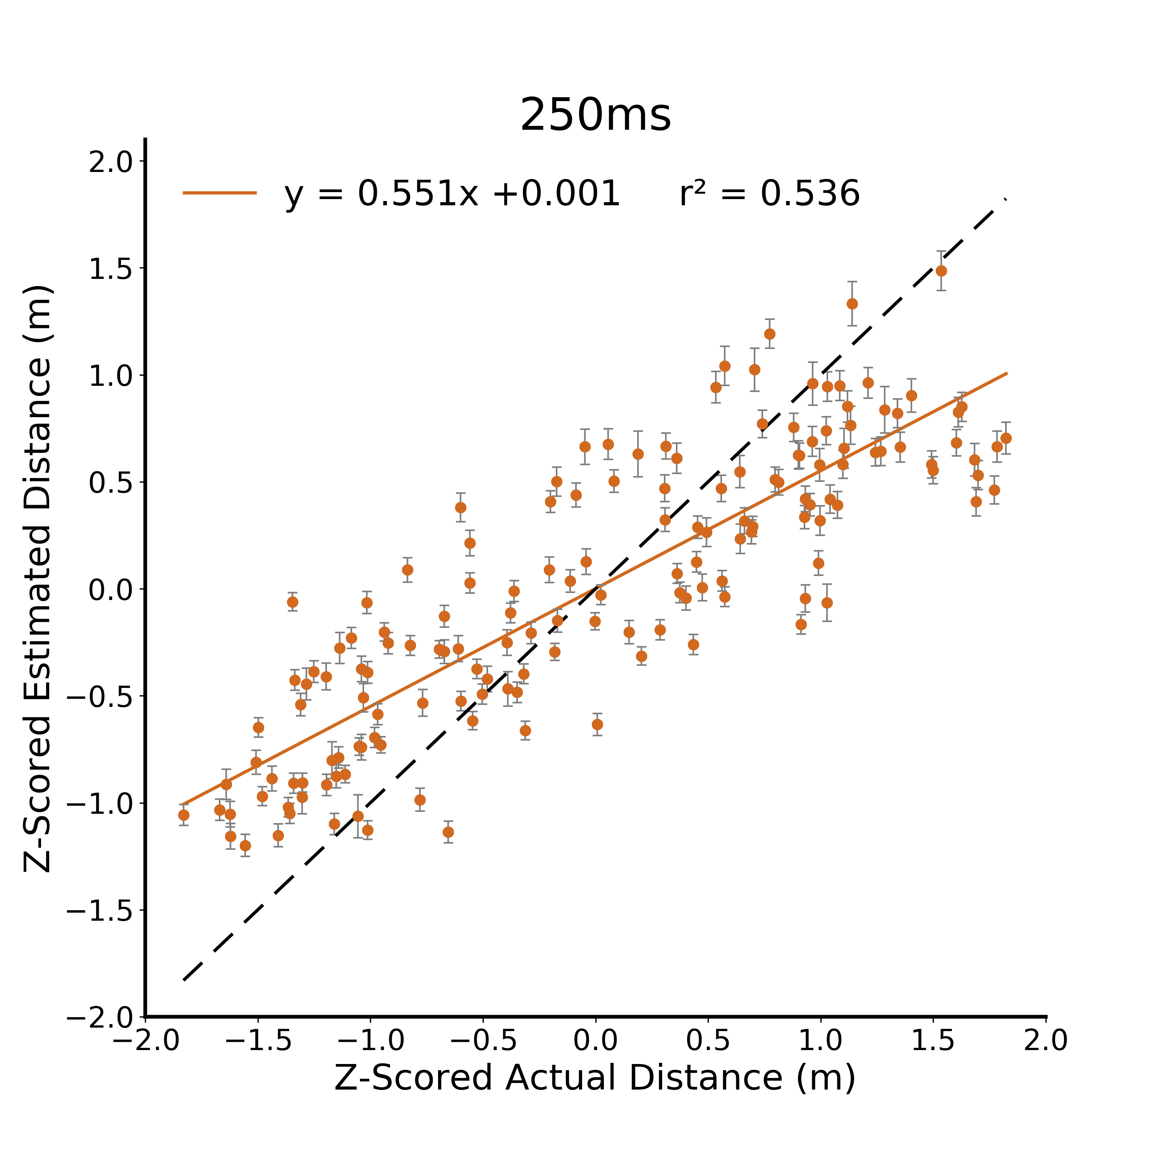
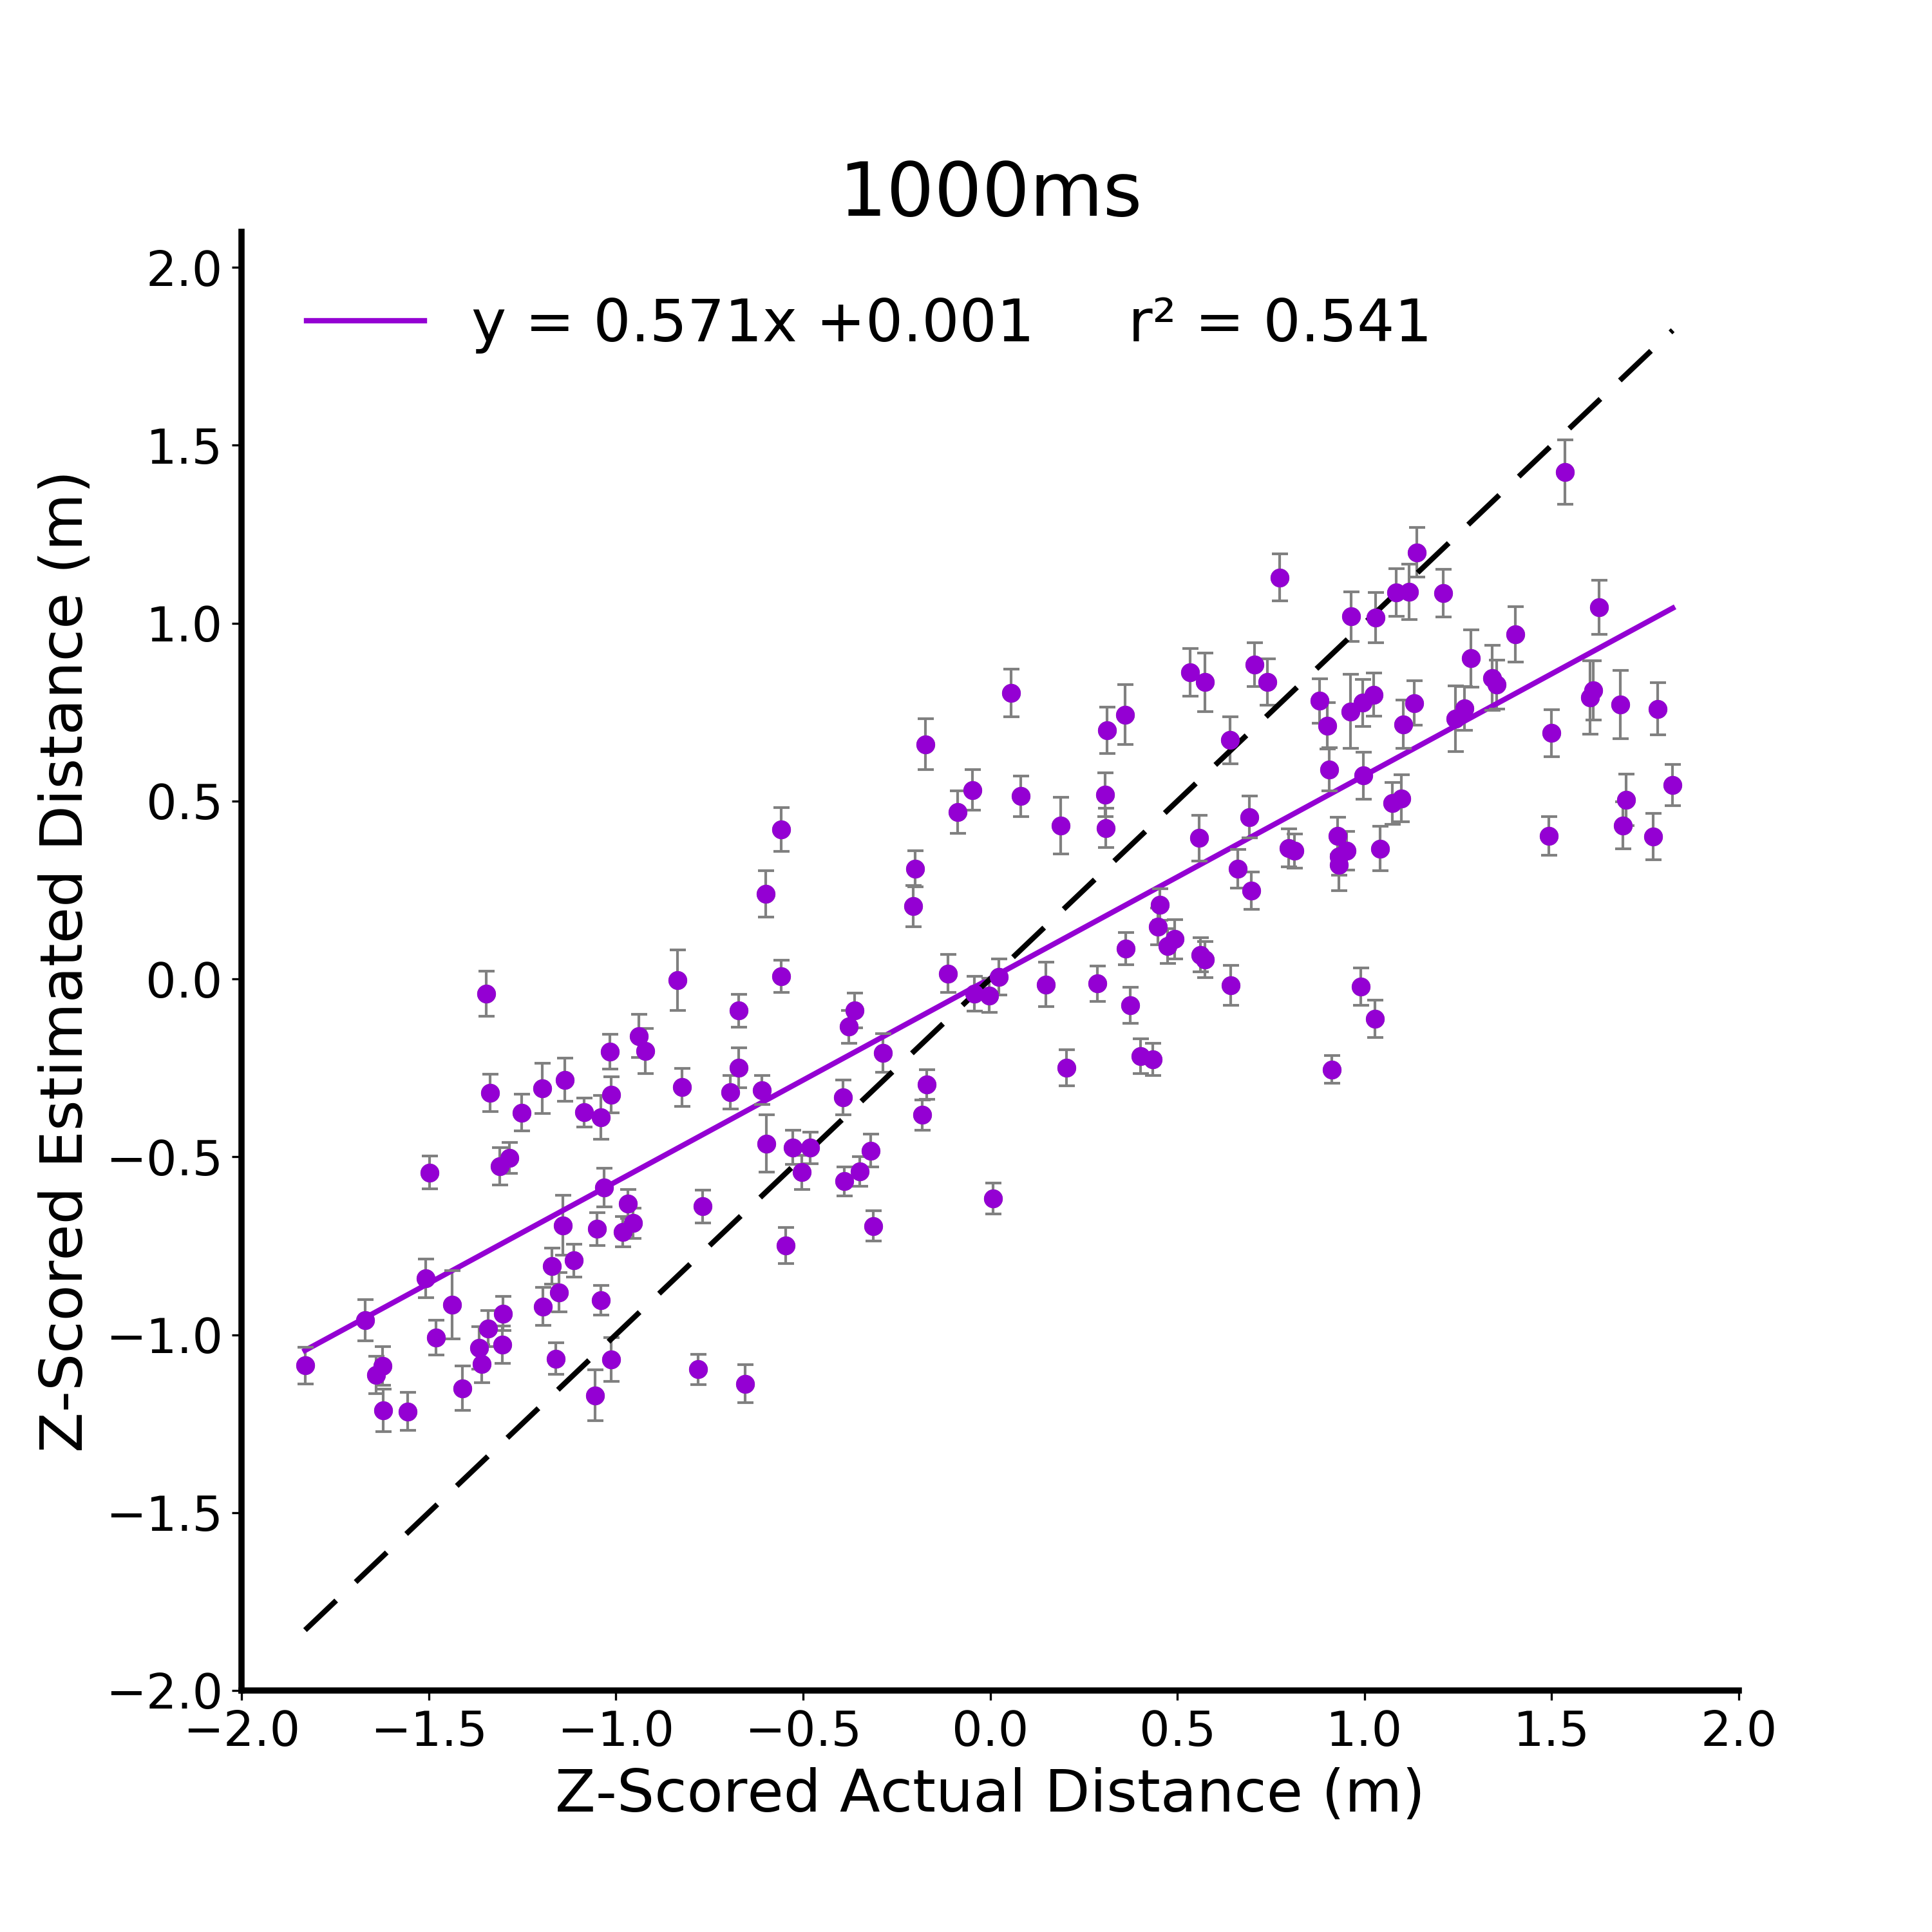

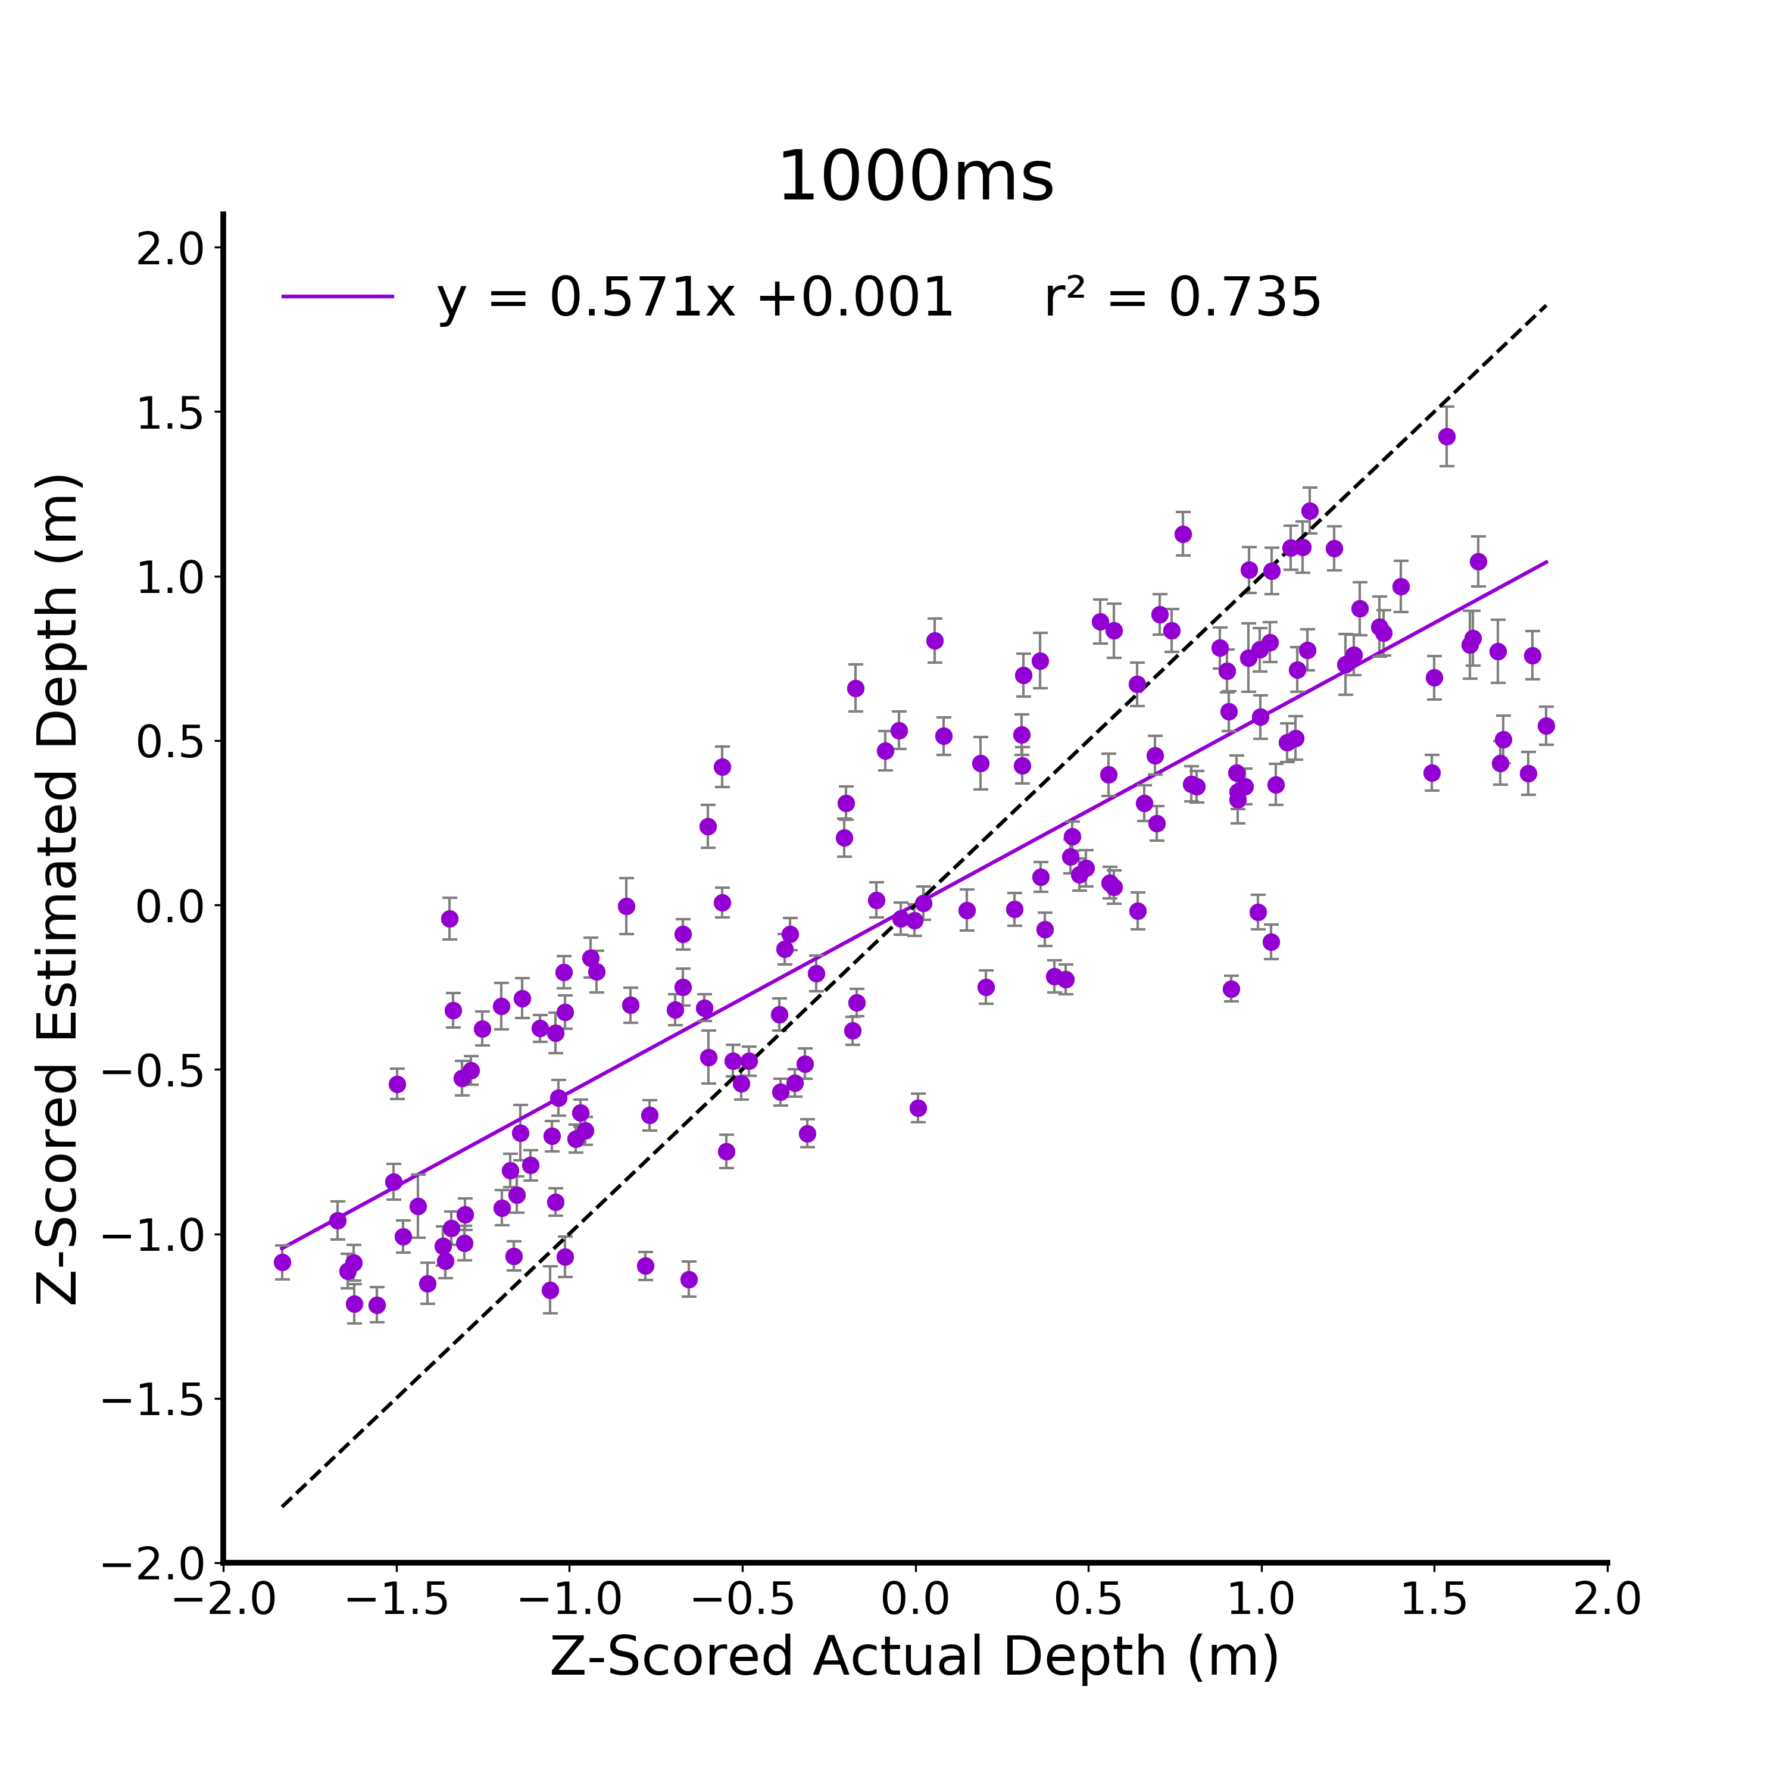


A.
B.
C.
D.
Notes:
DONE

Slide 3
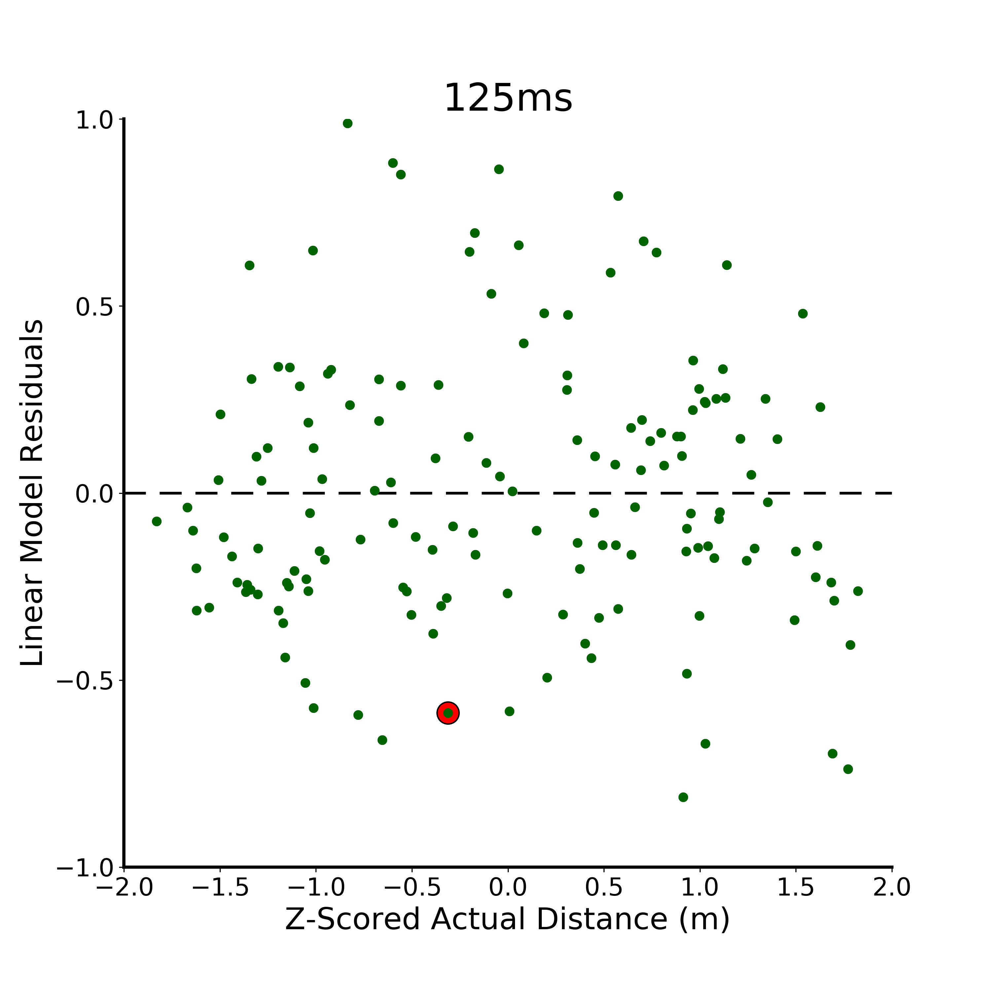
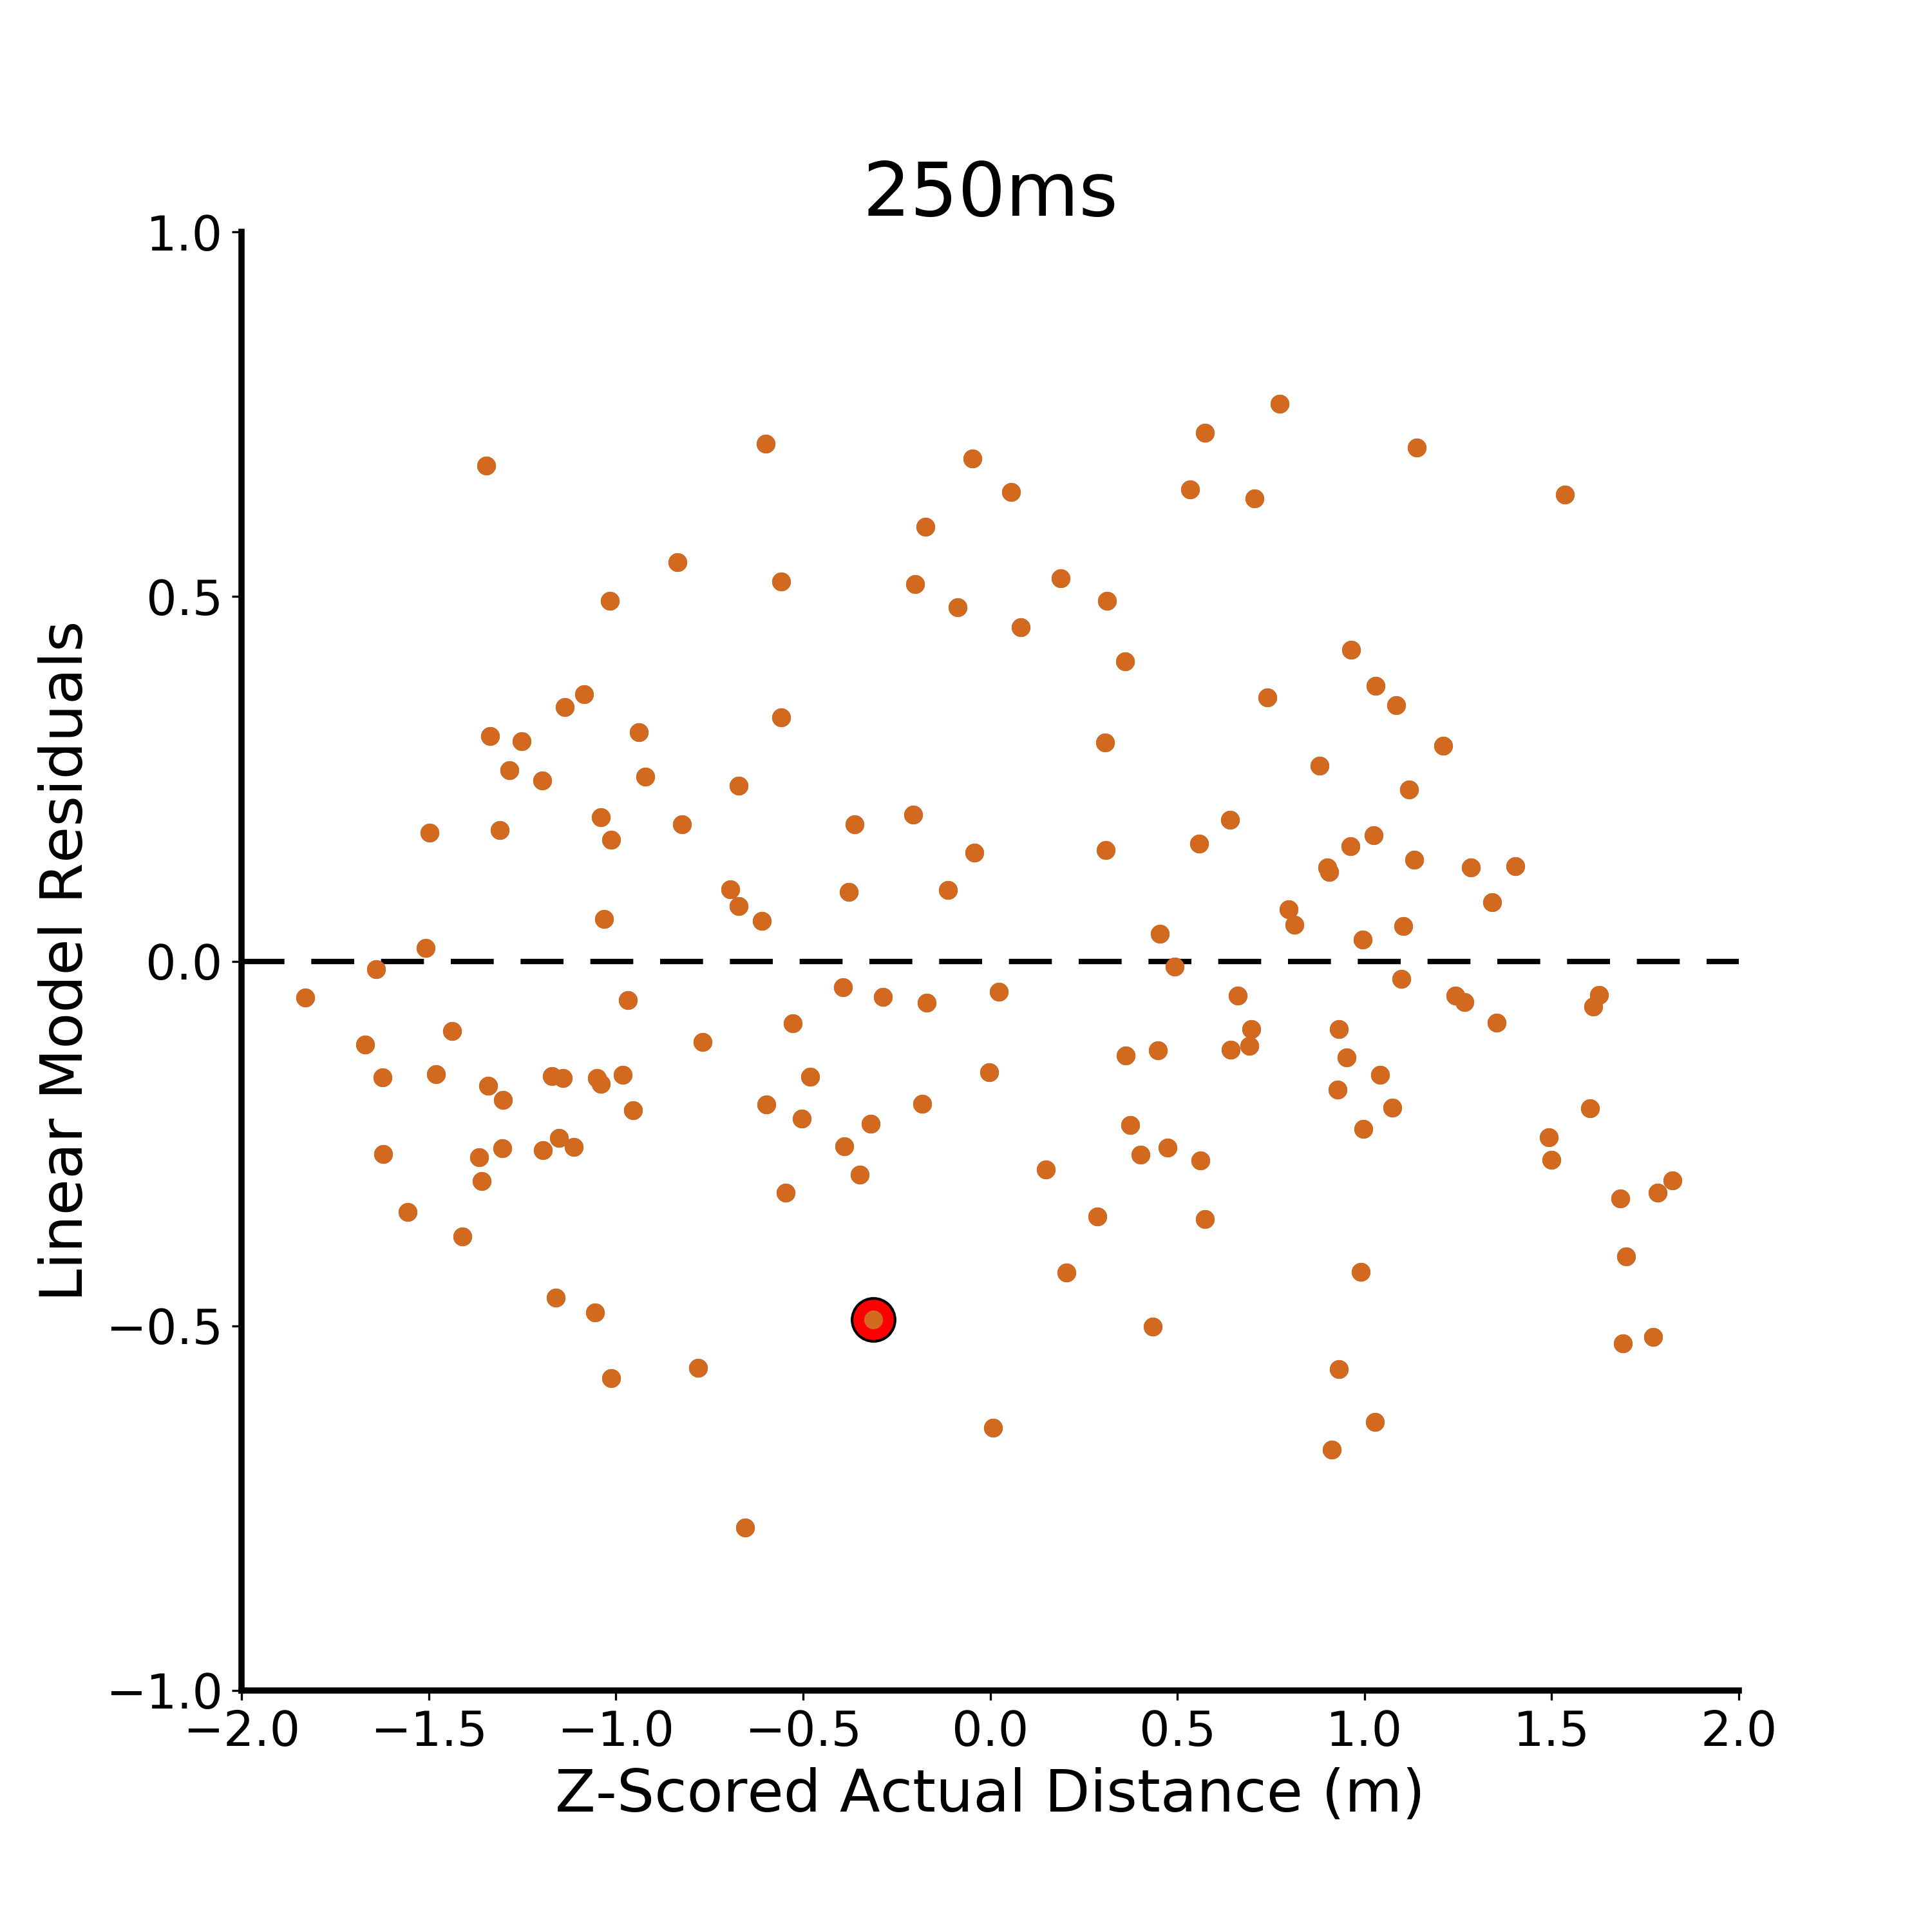
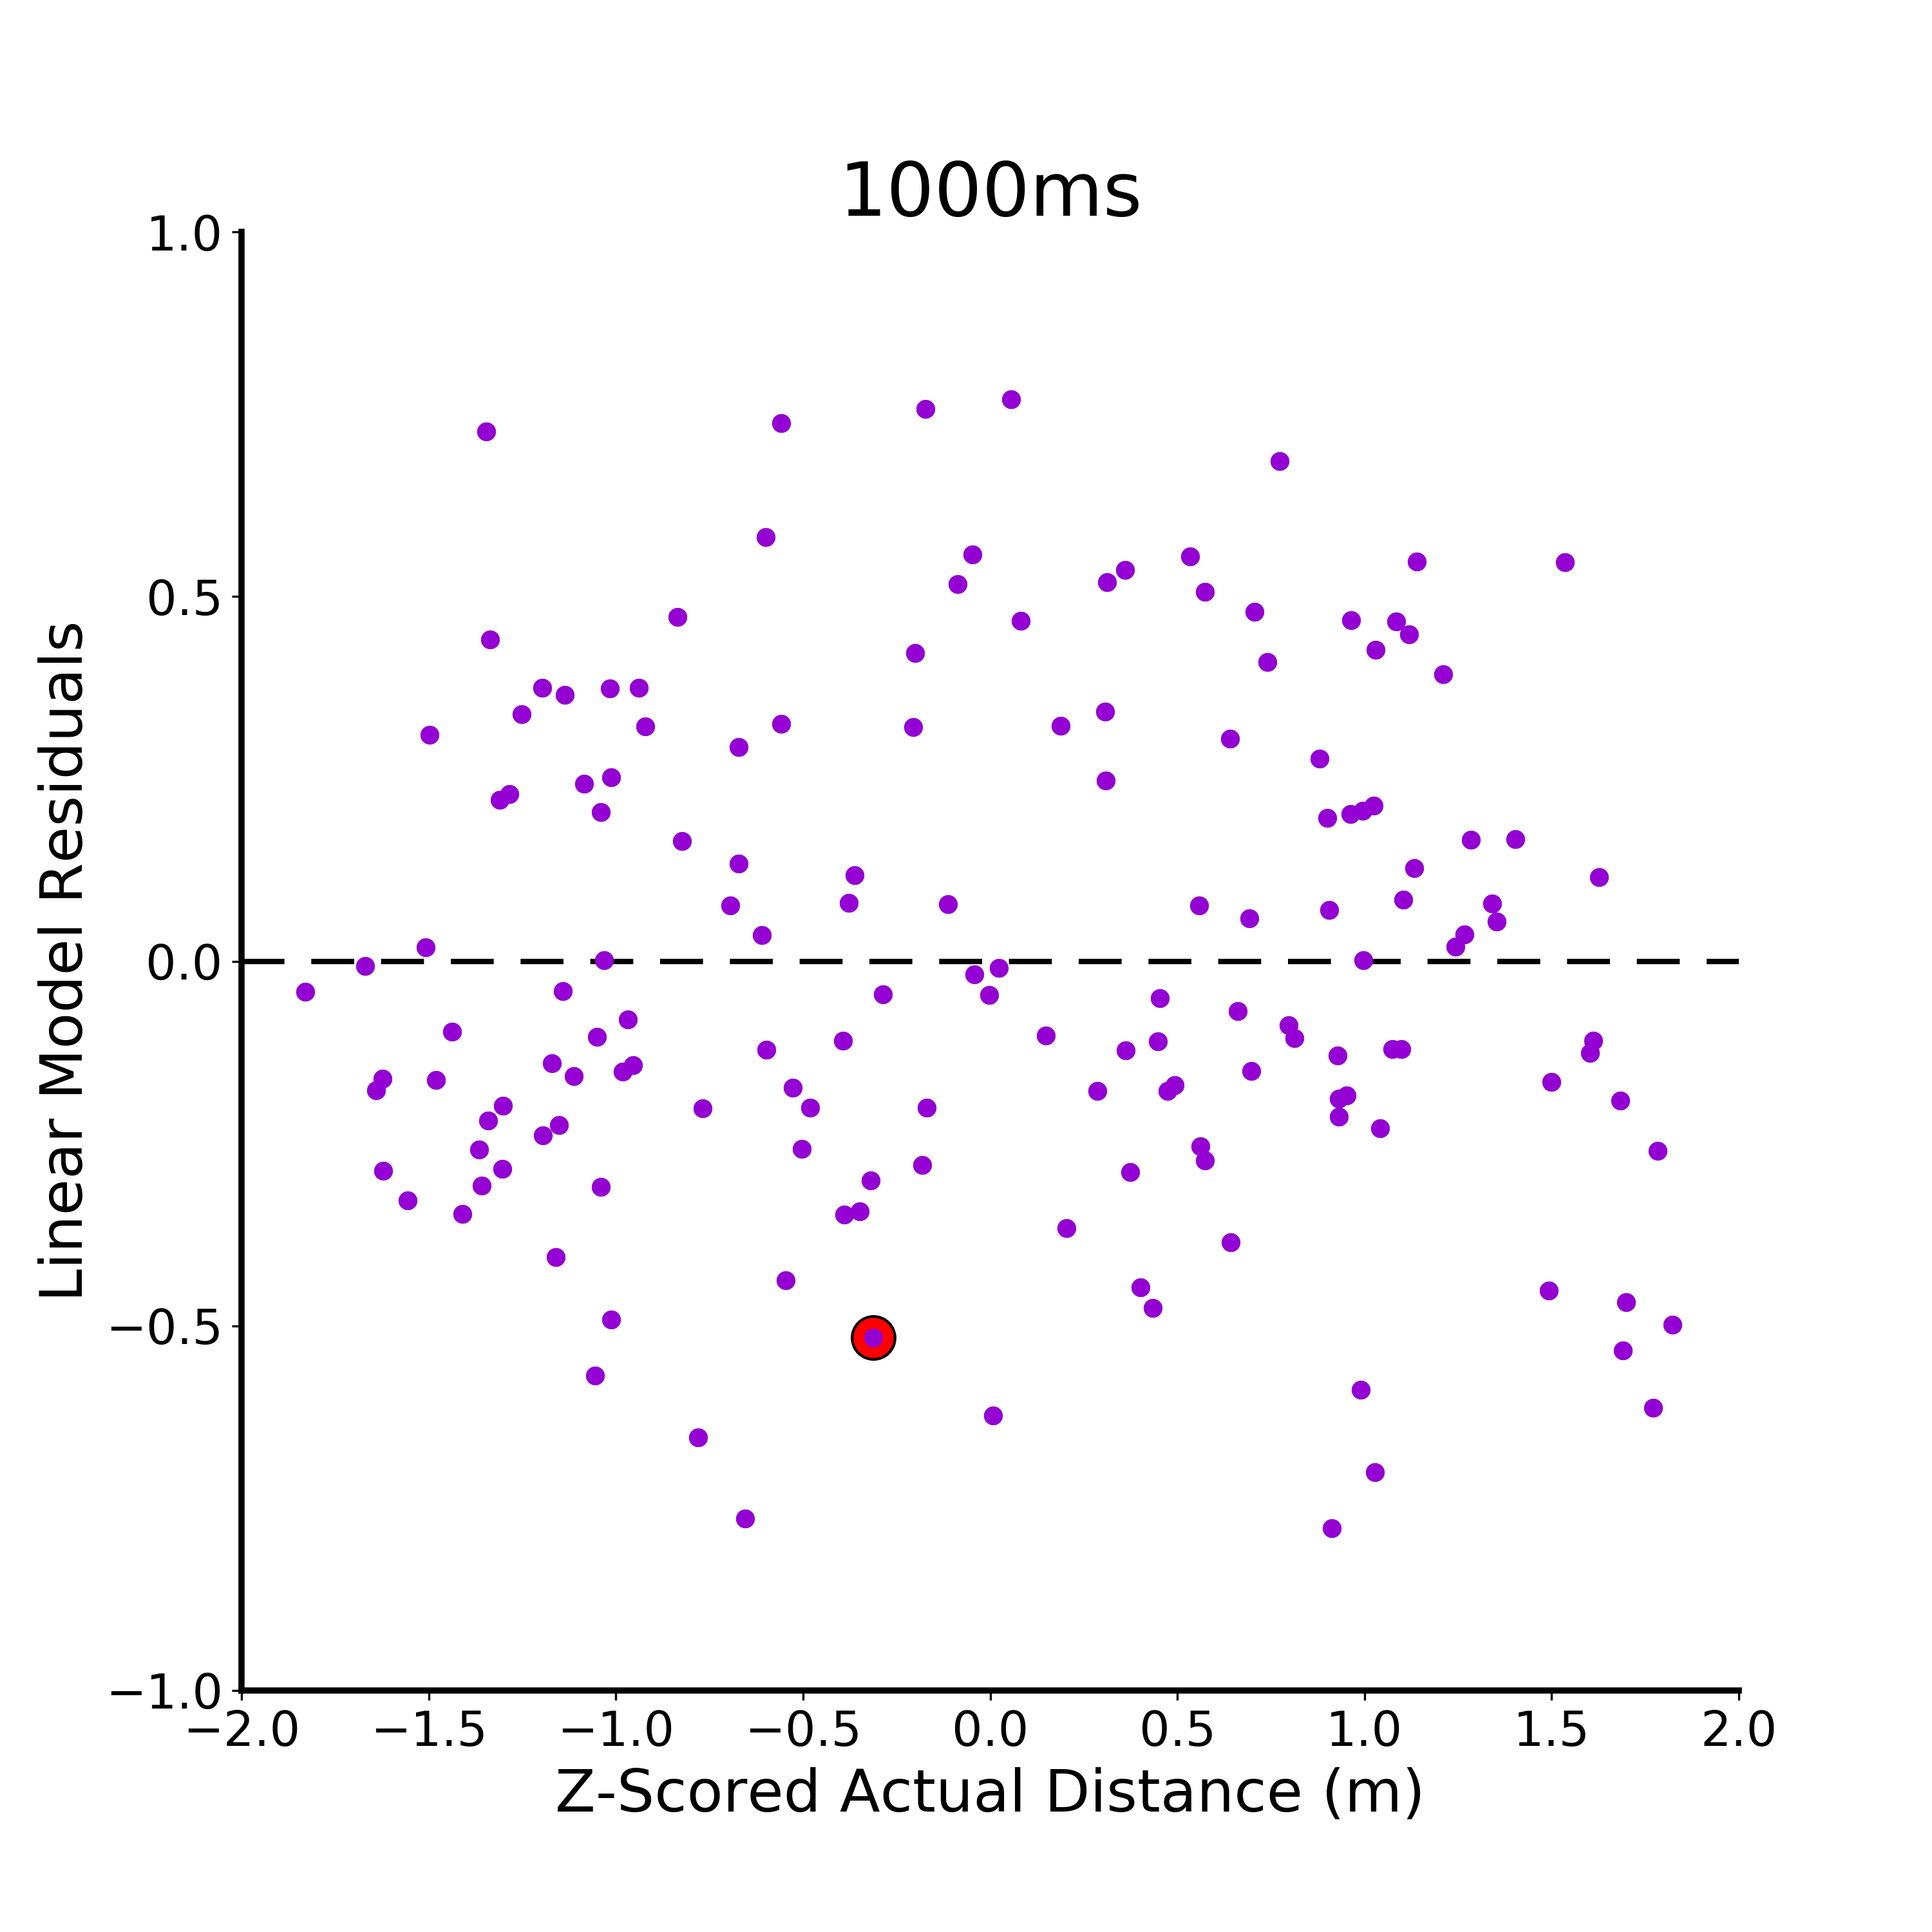
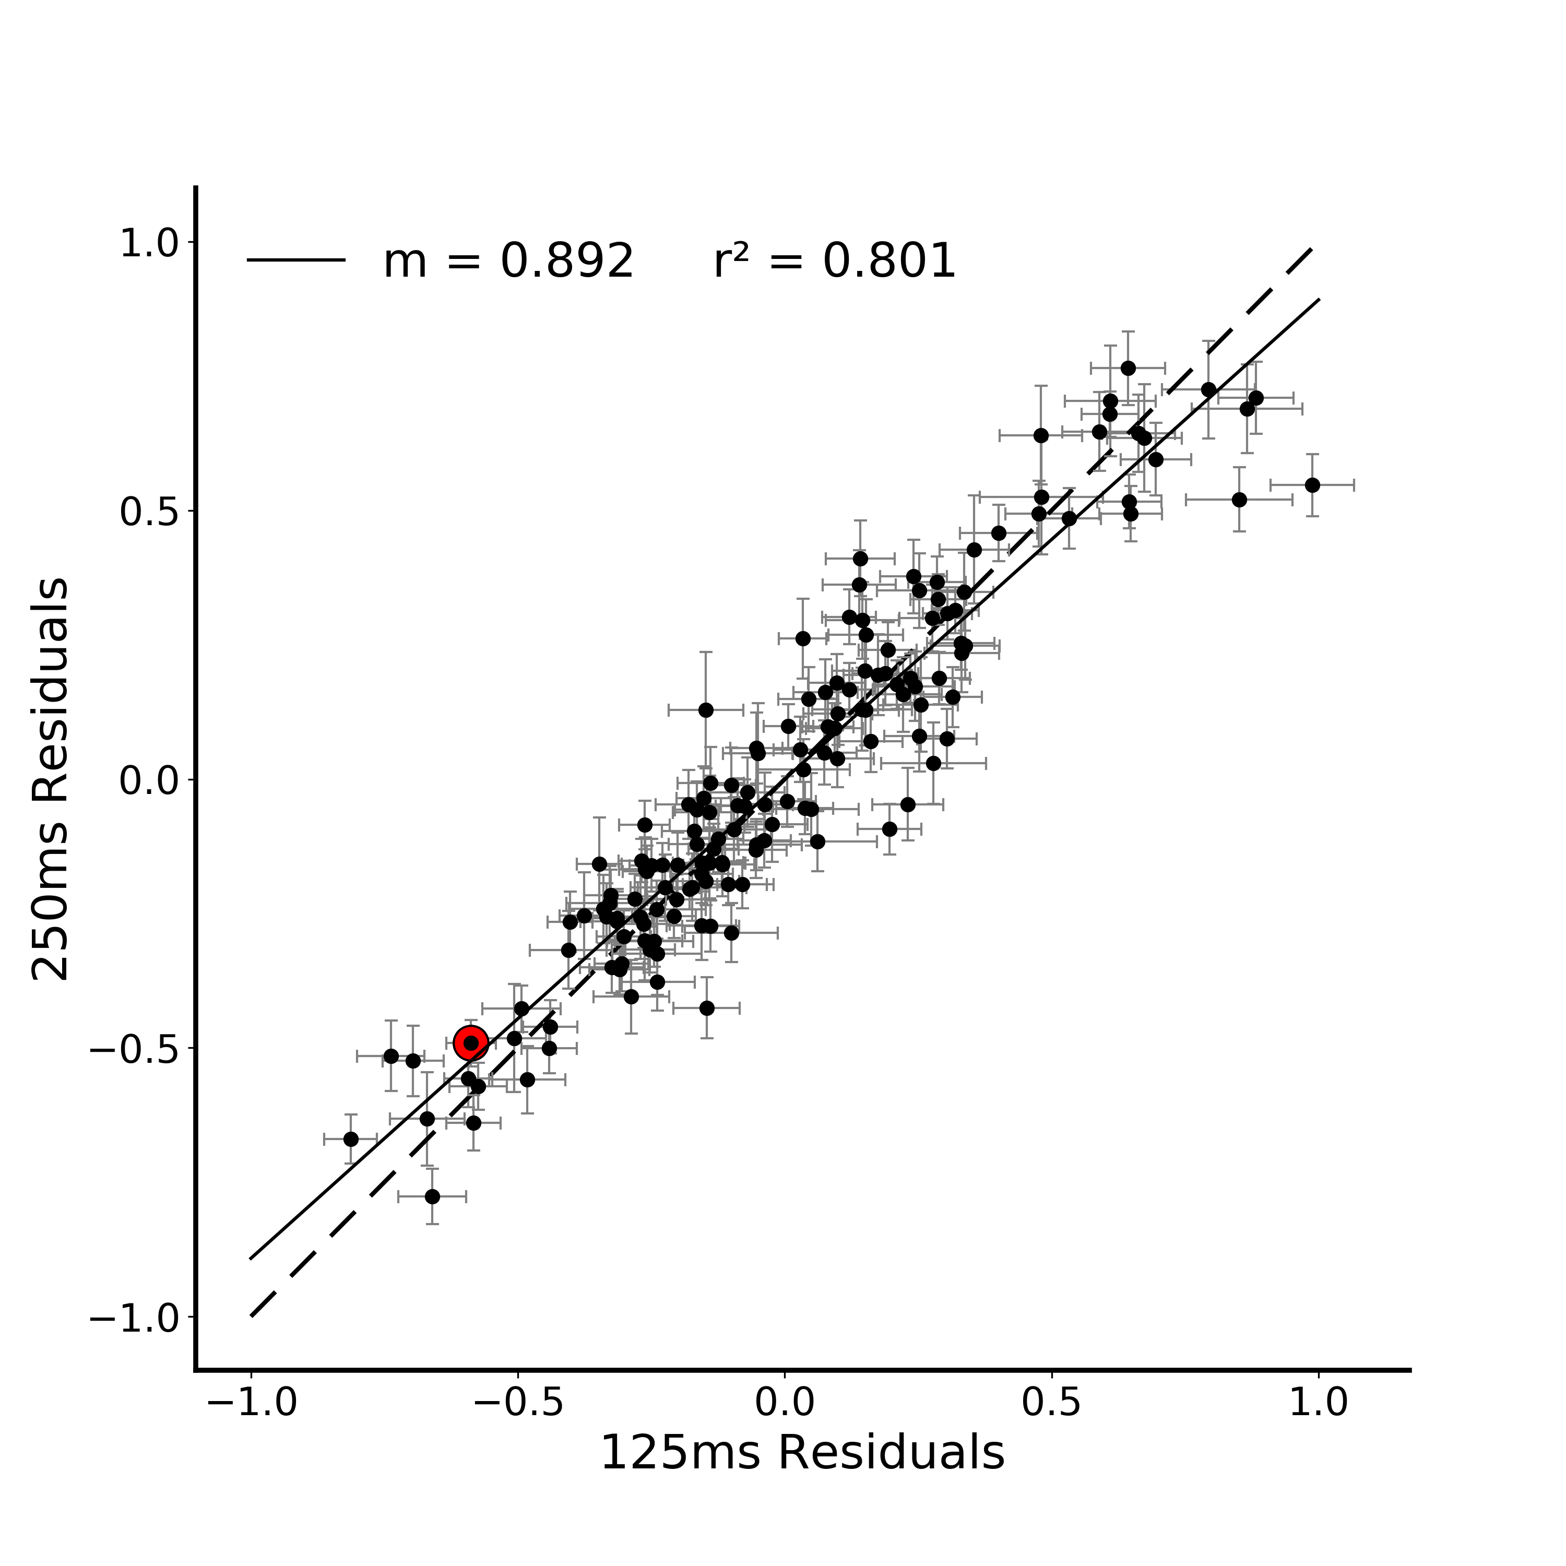
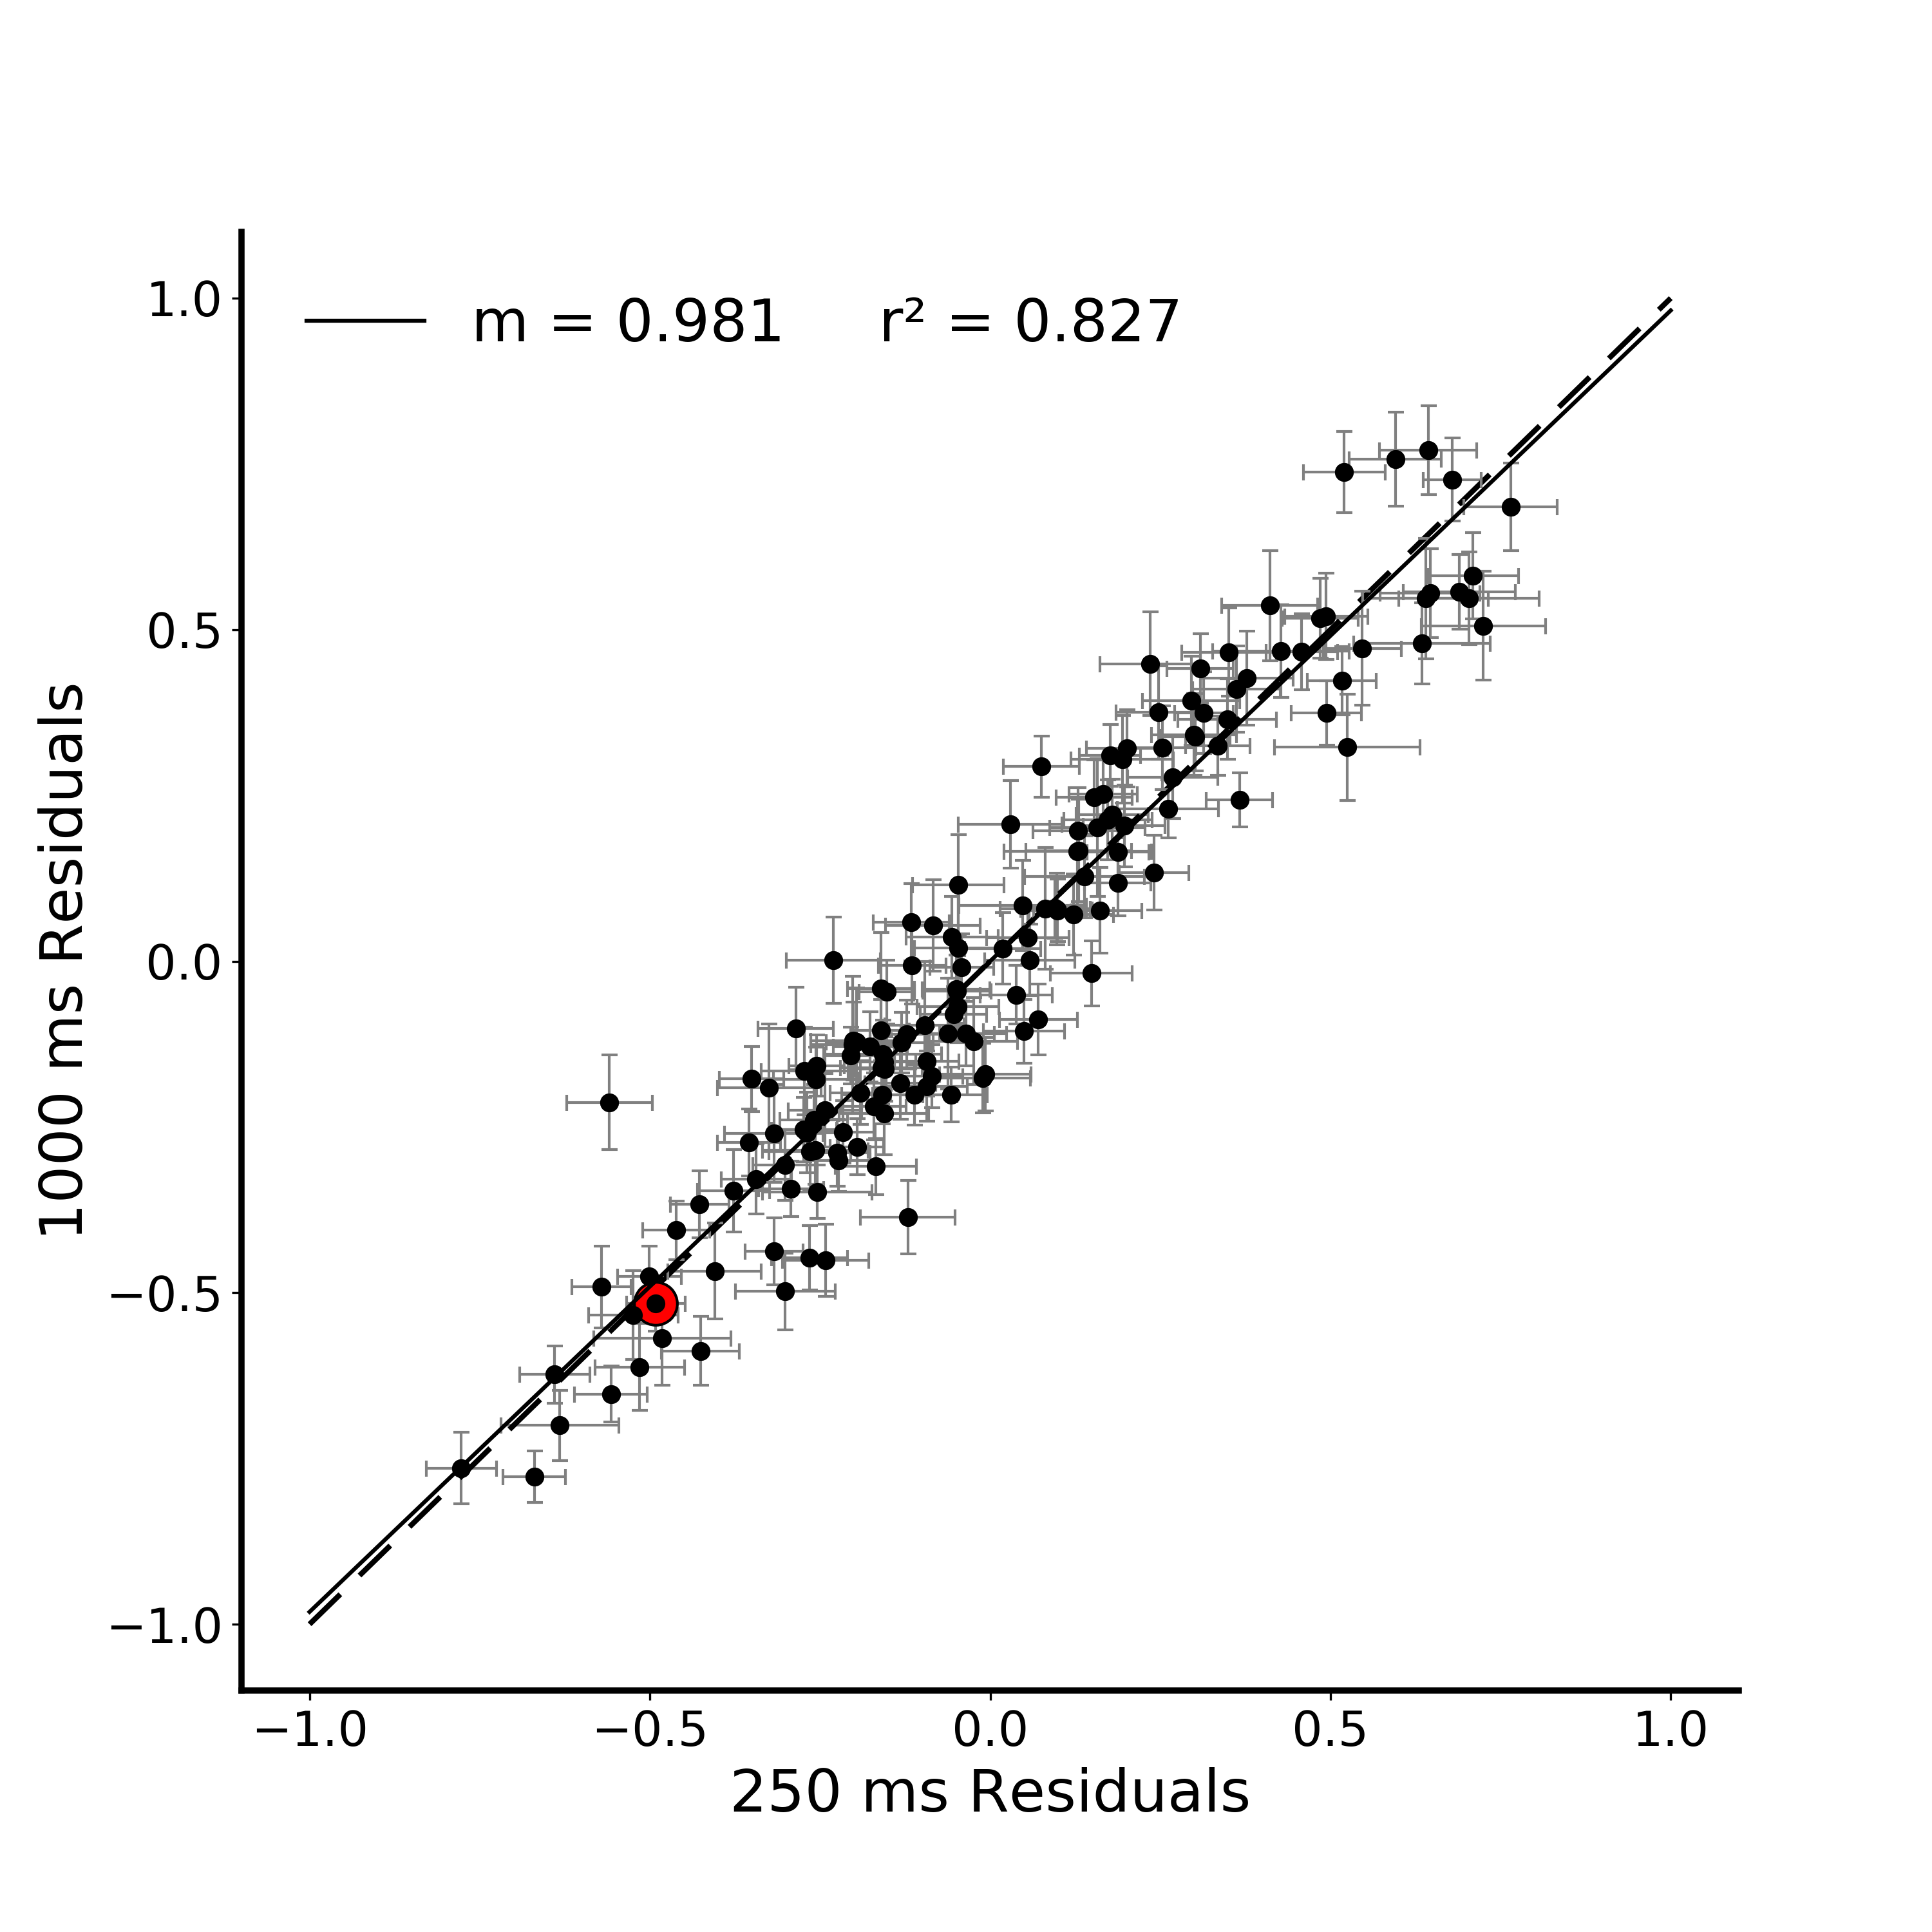
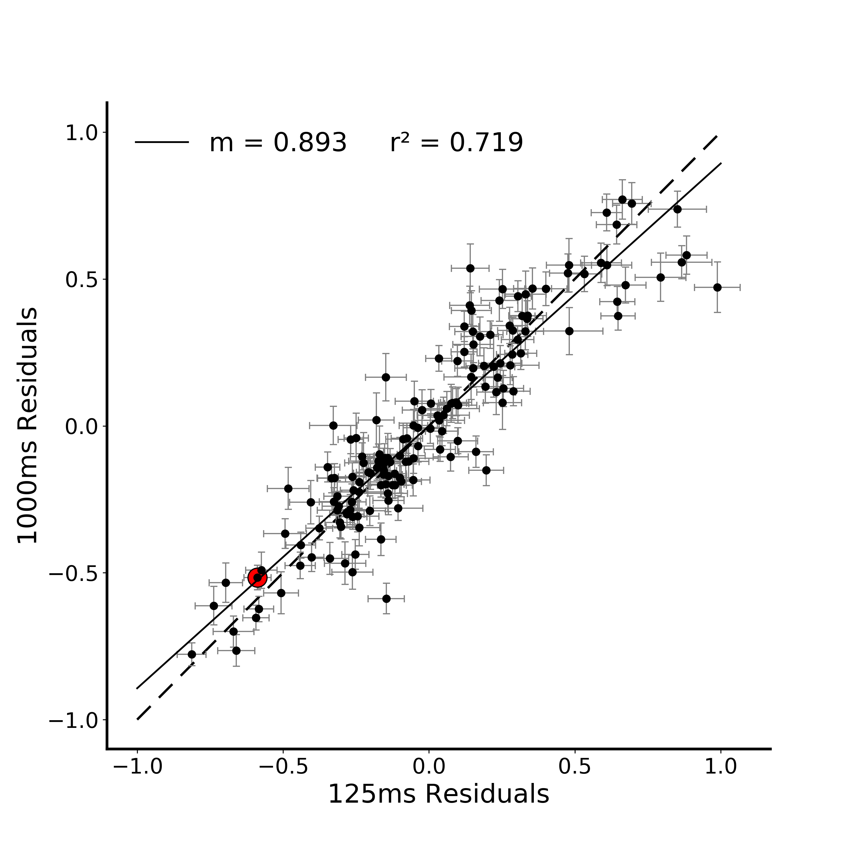
A.
*
B.
**
Notes:
DONE
Note temporal evolution here (250 and 1000 are basically identical)
Pairwise compareisons between the plots – Fischers r to z transform (linearlizes the r values)
http://vassarstats.net/rdiff.html

Slide 4
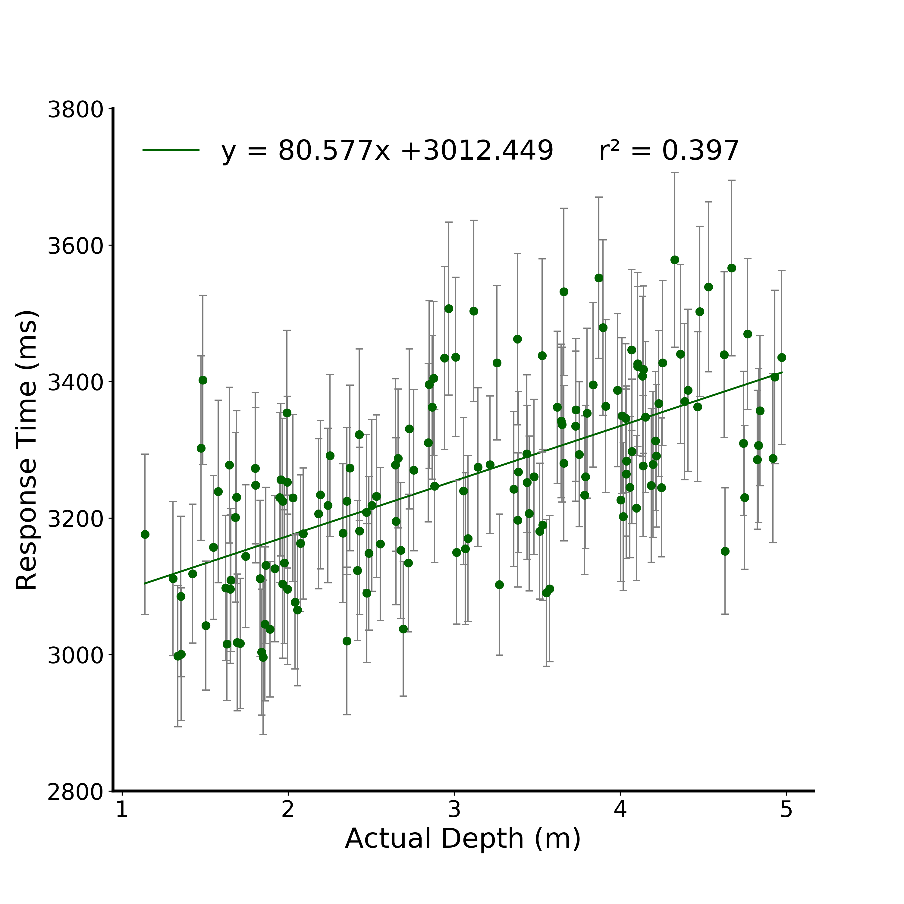


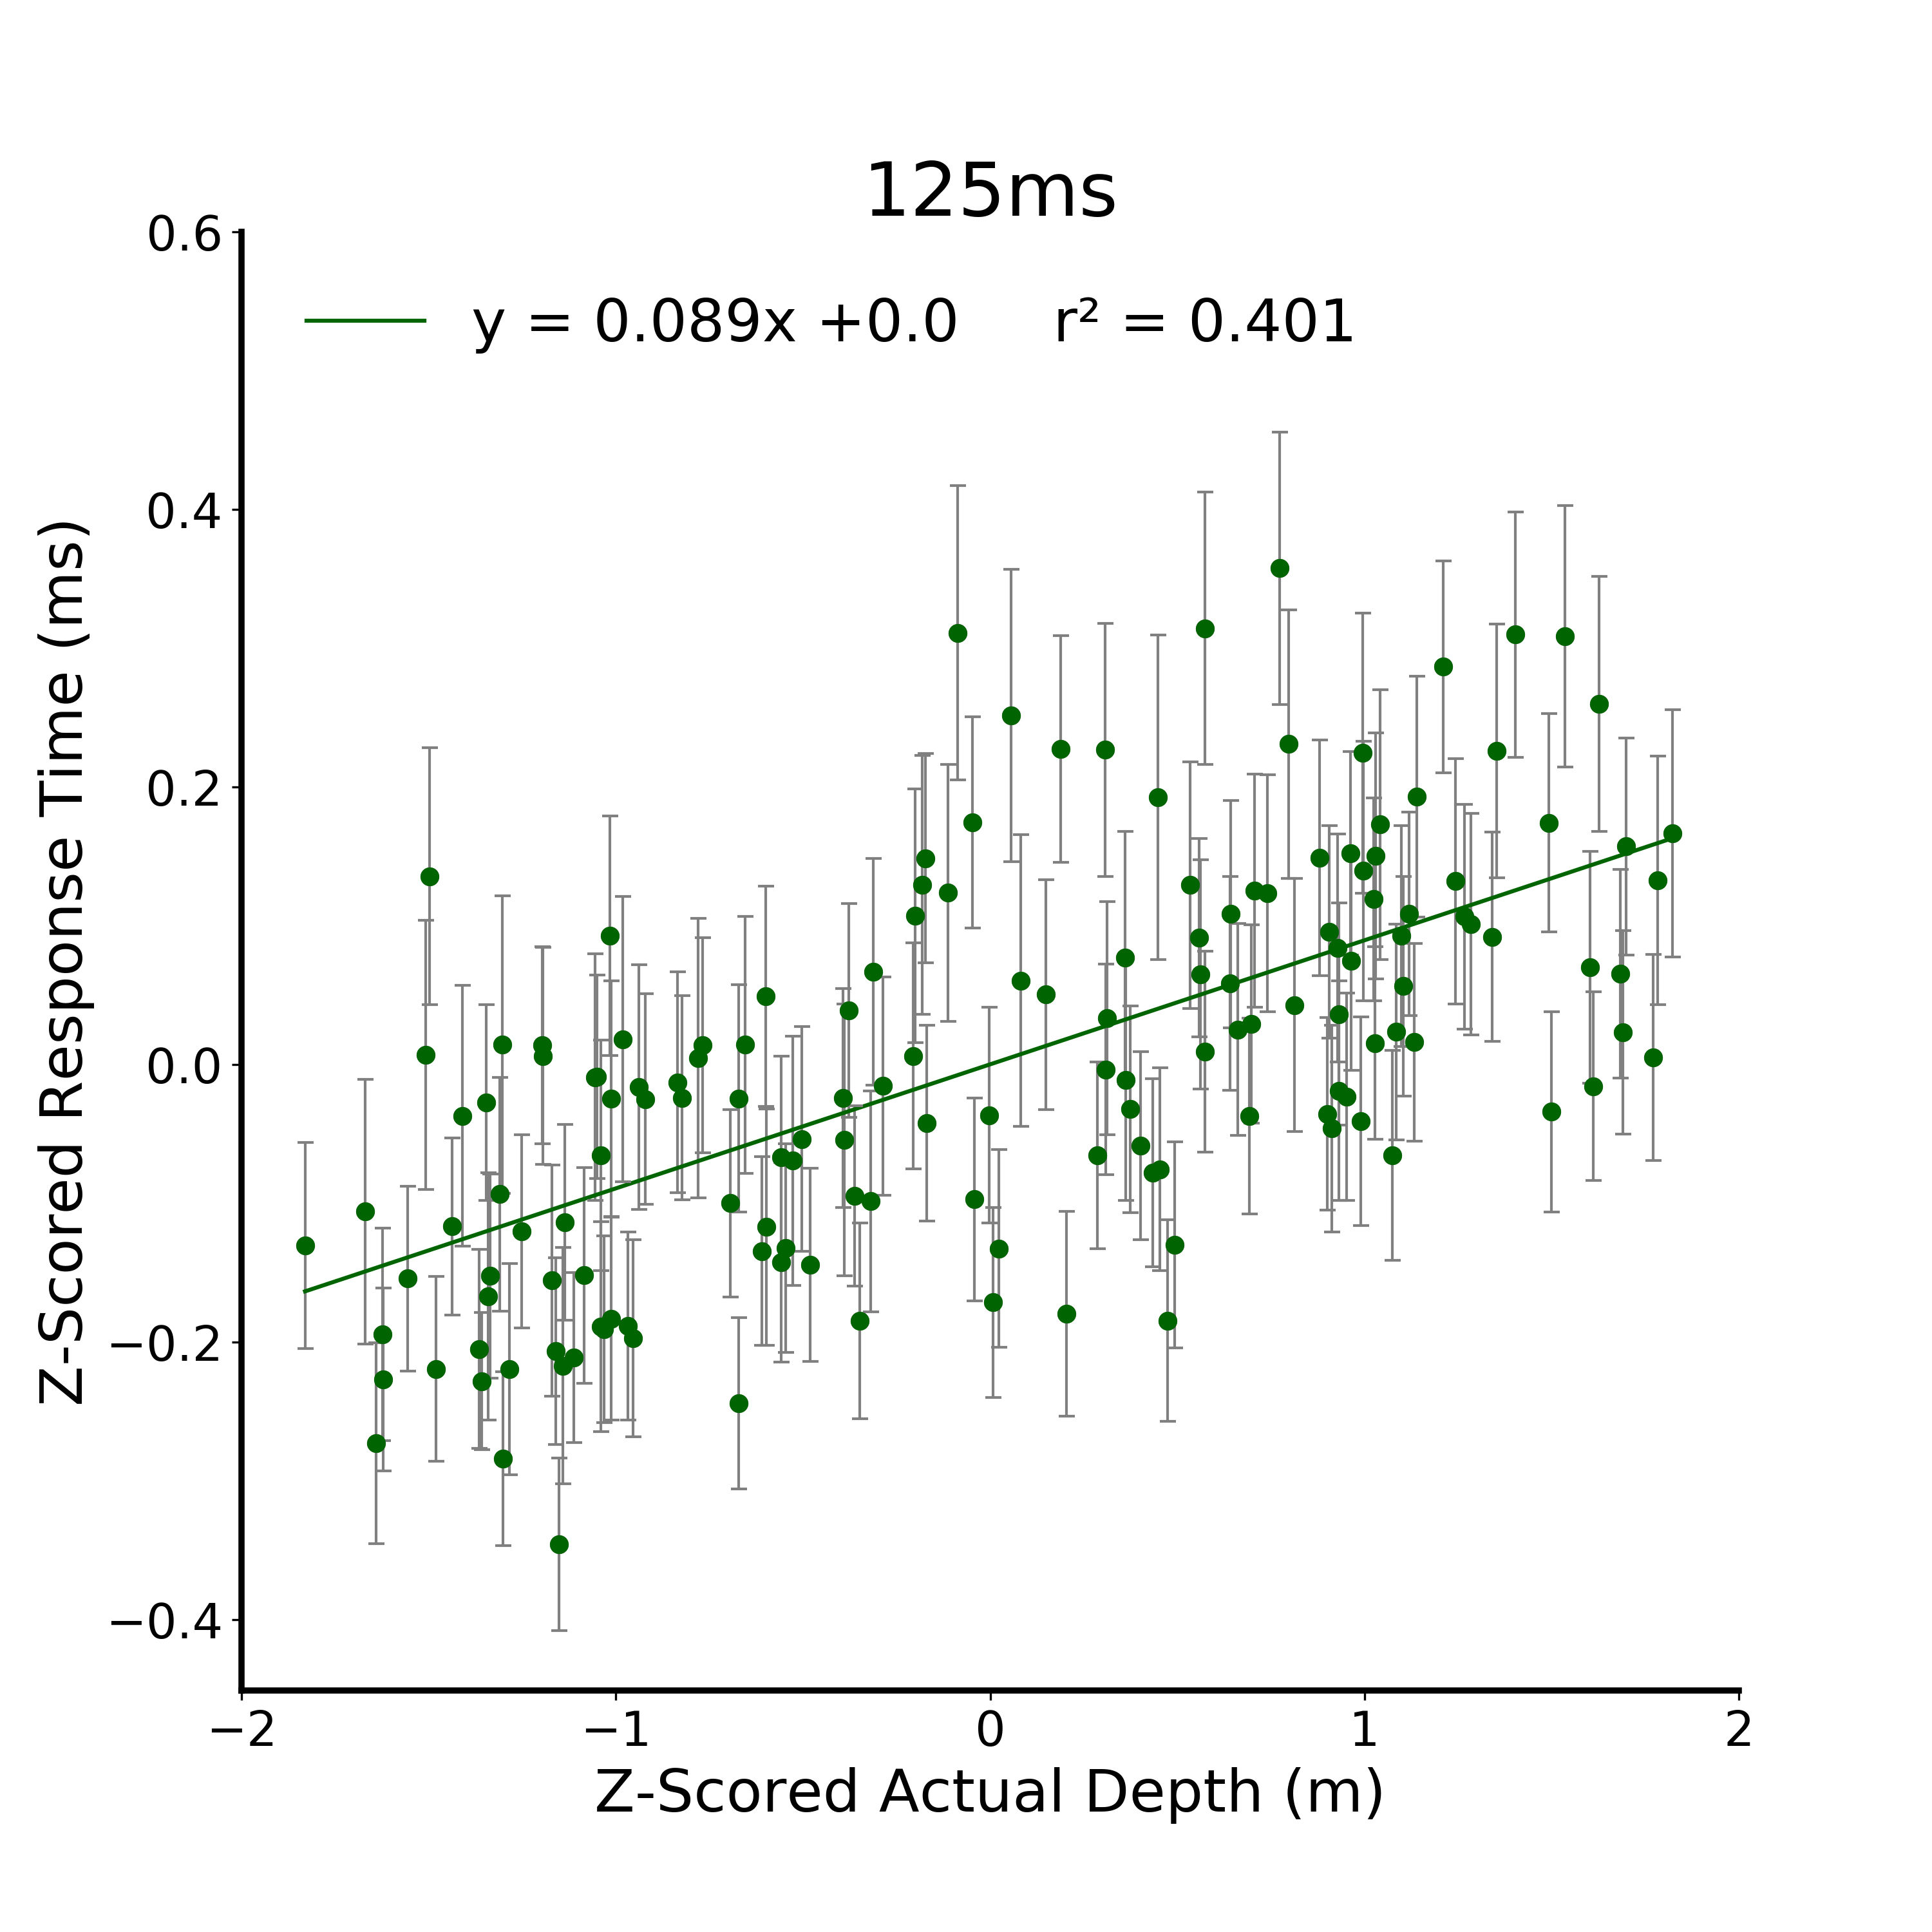
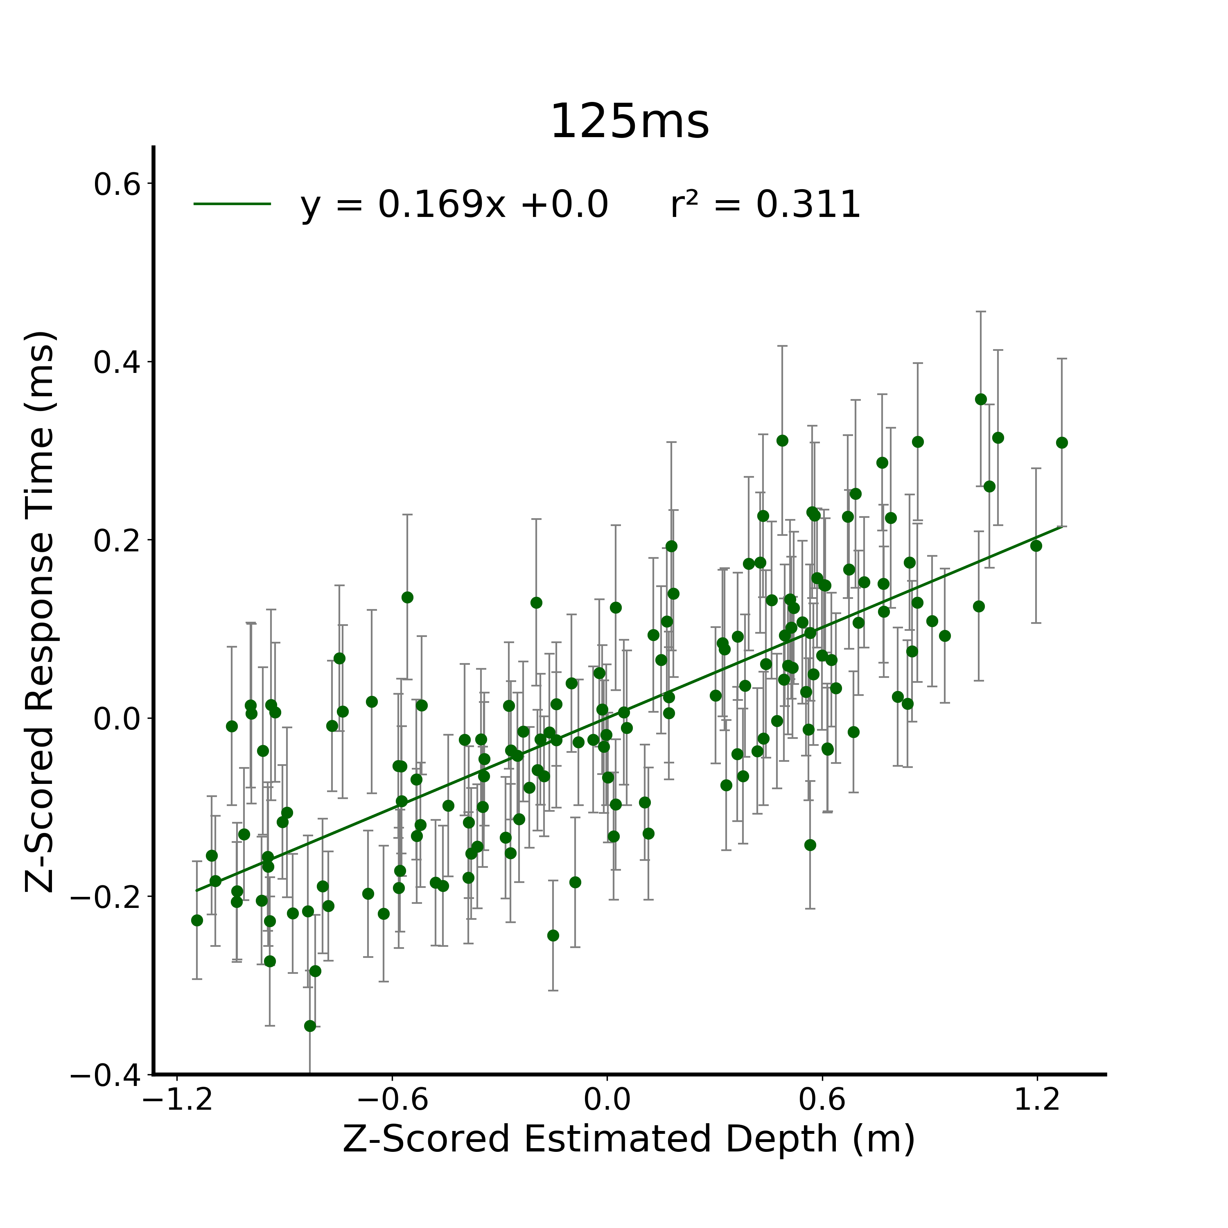

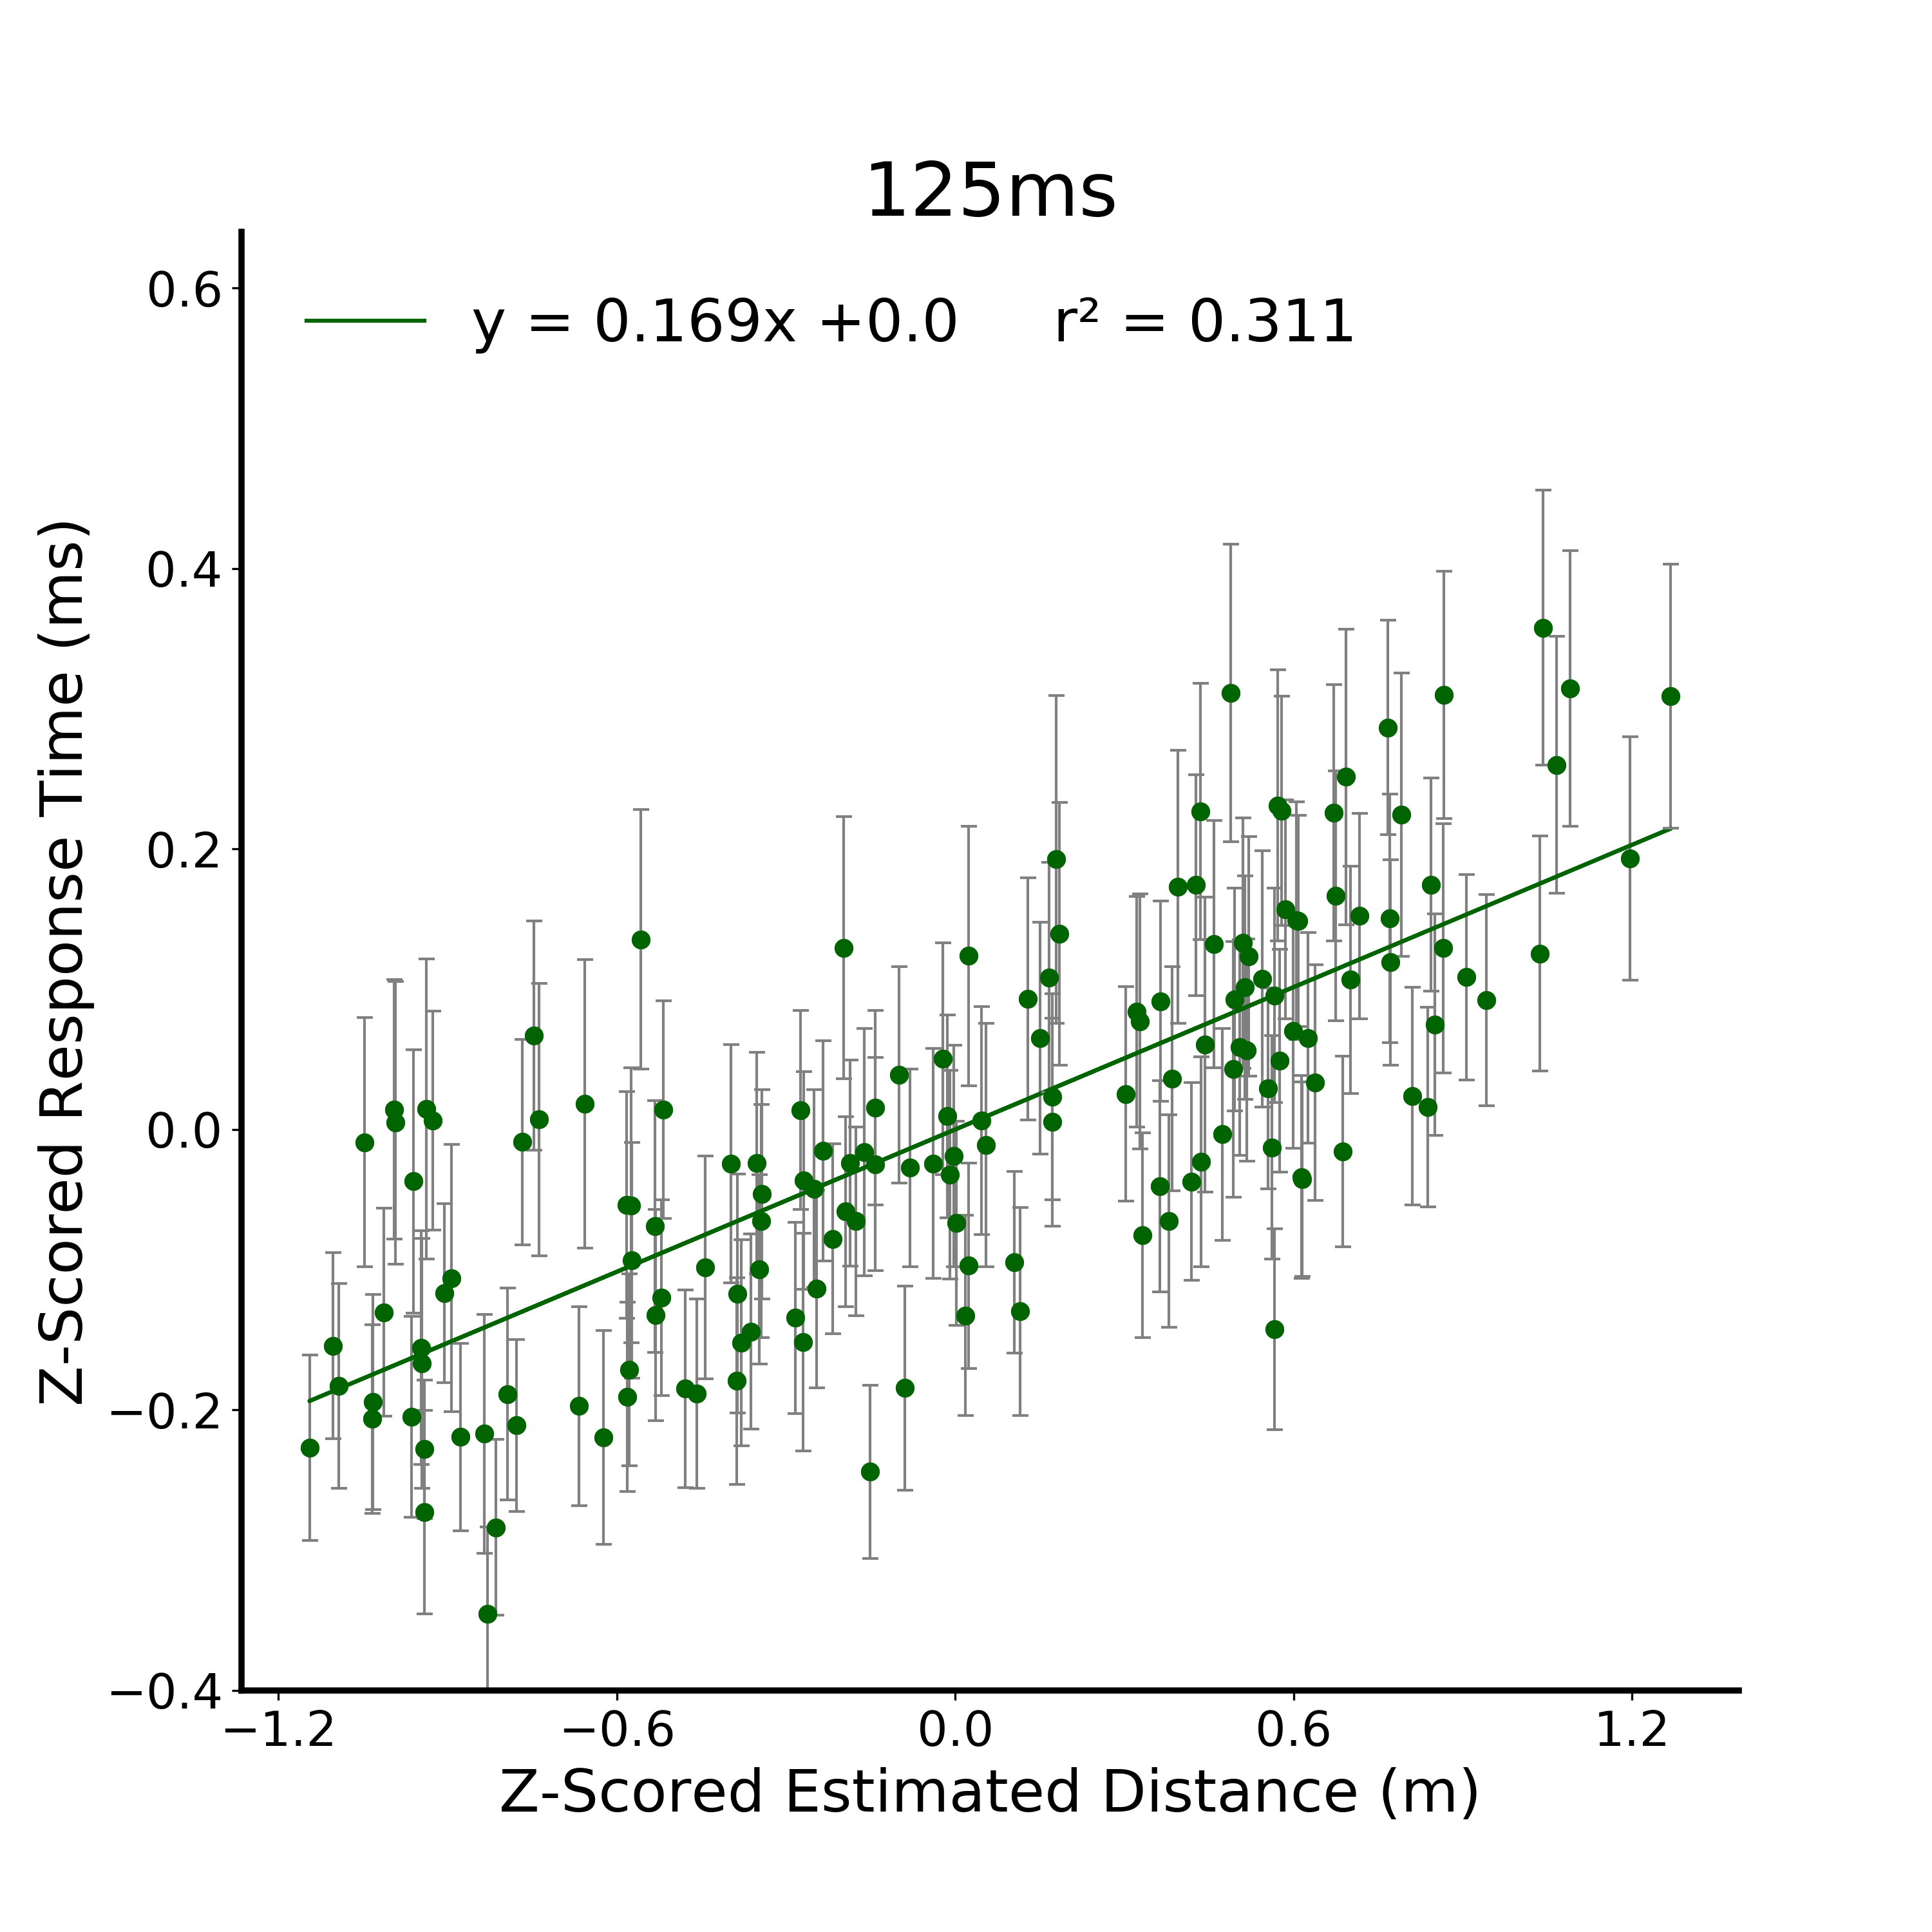
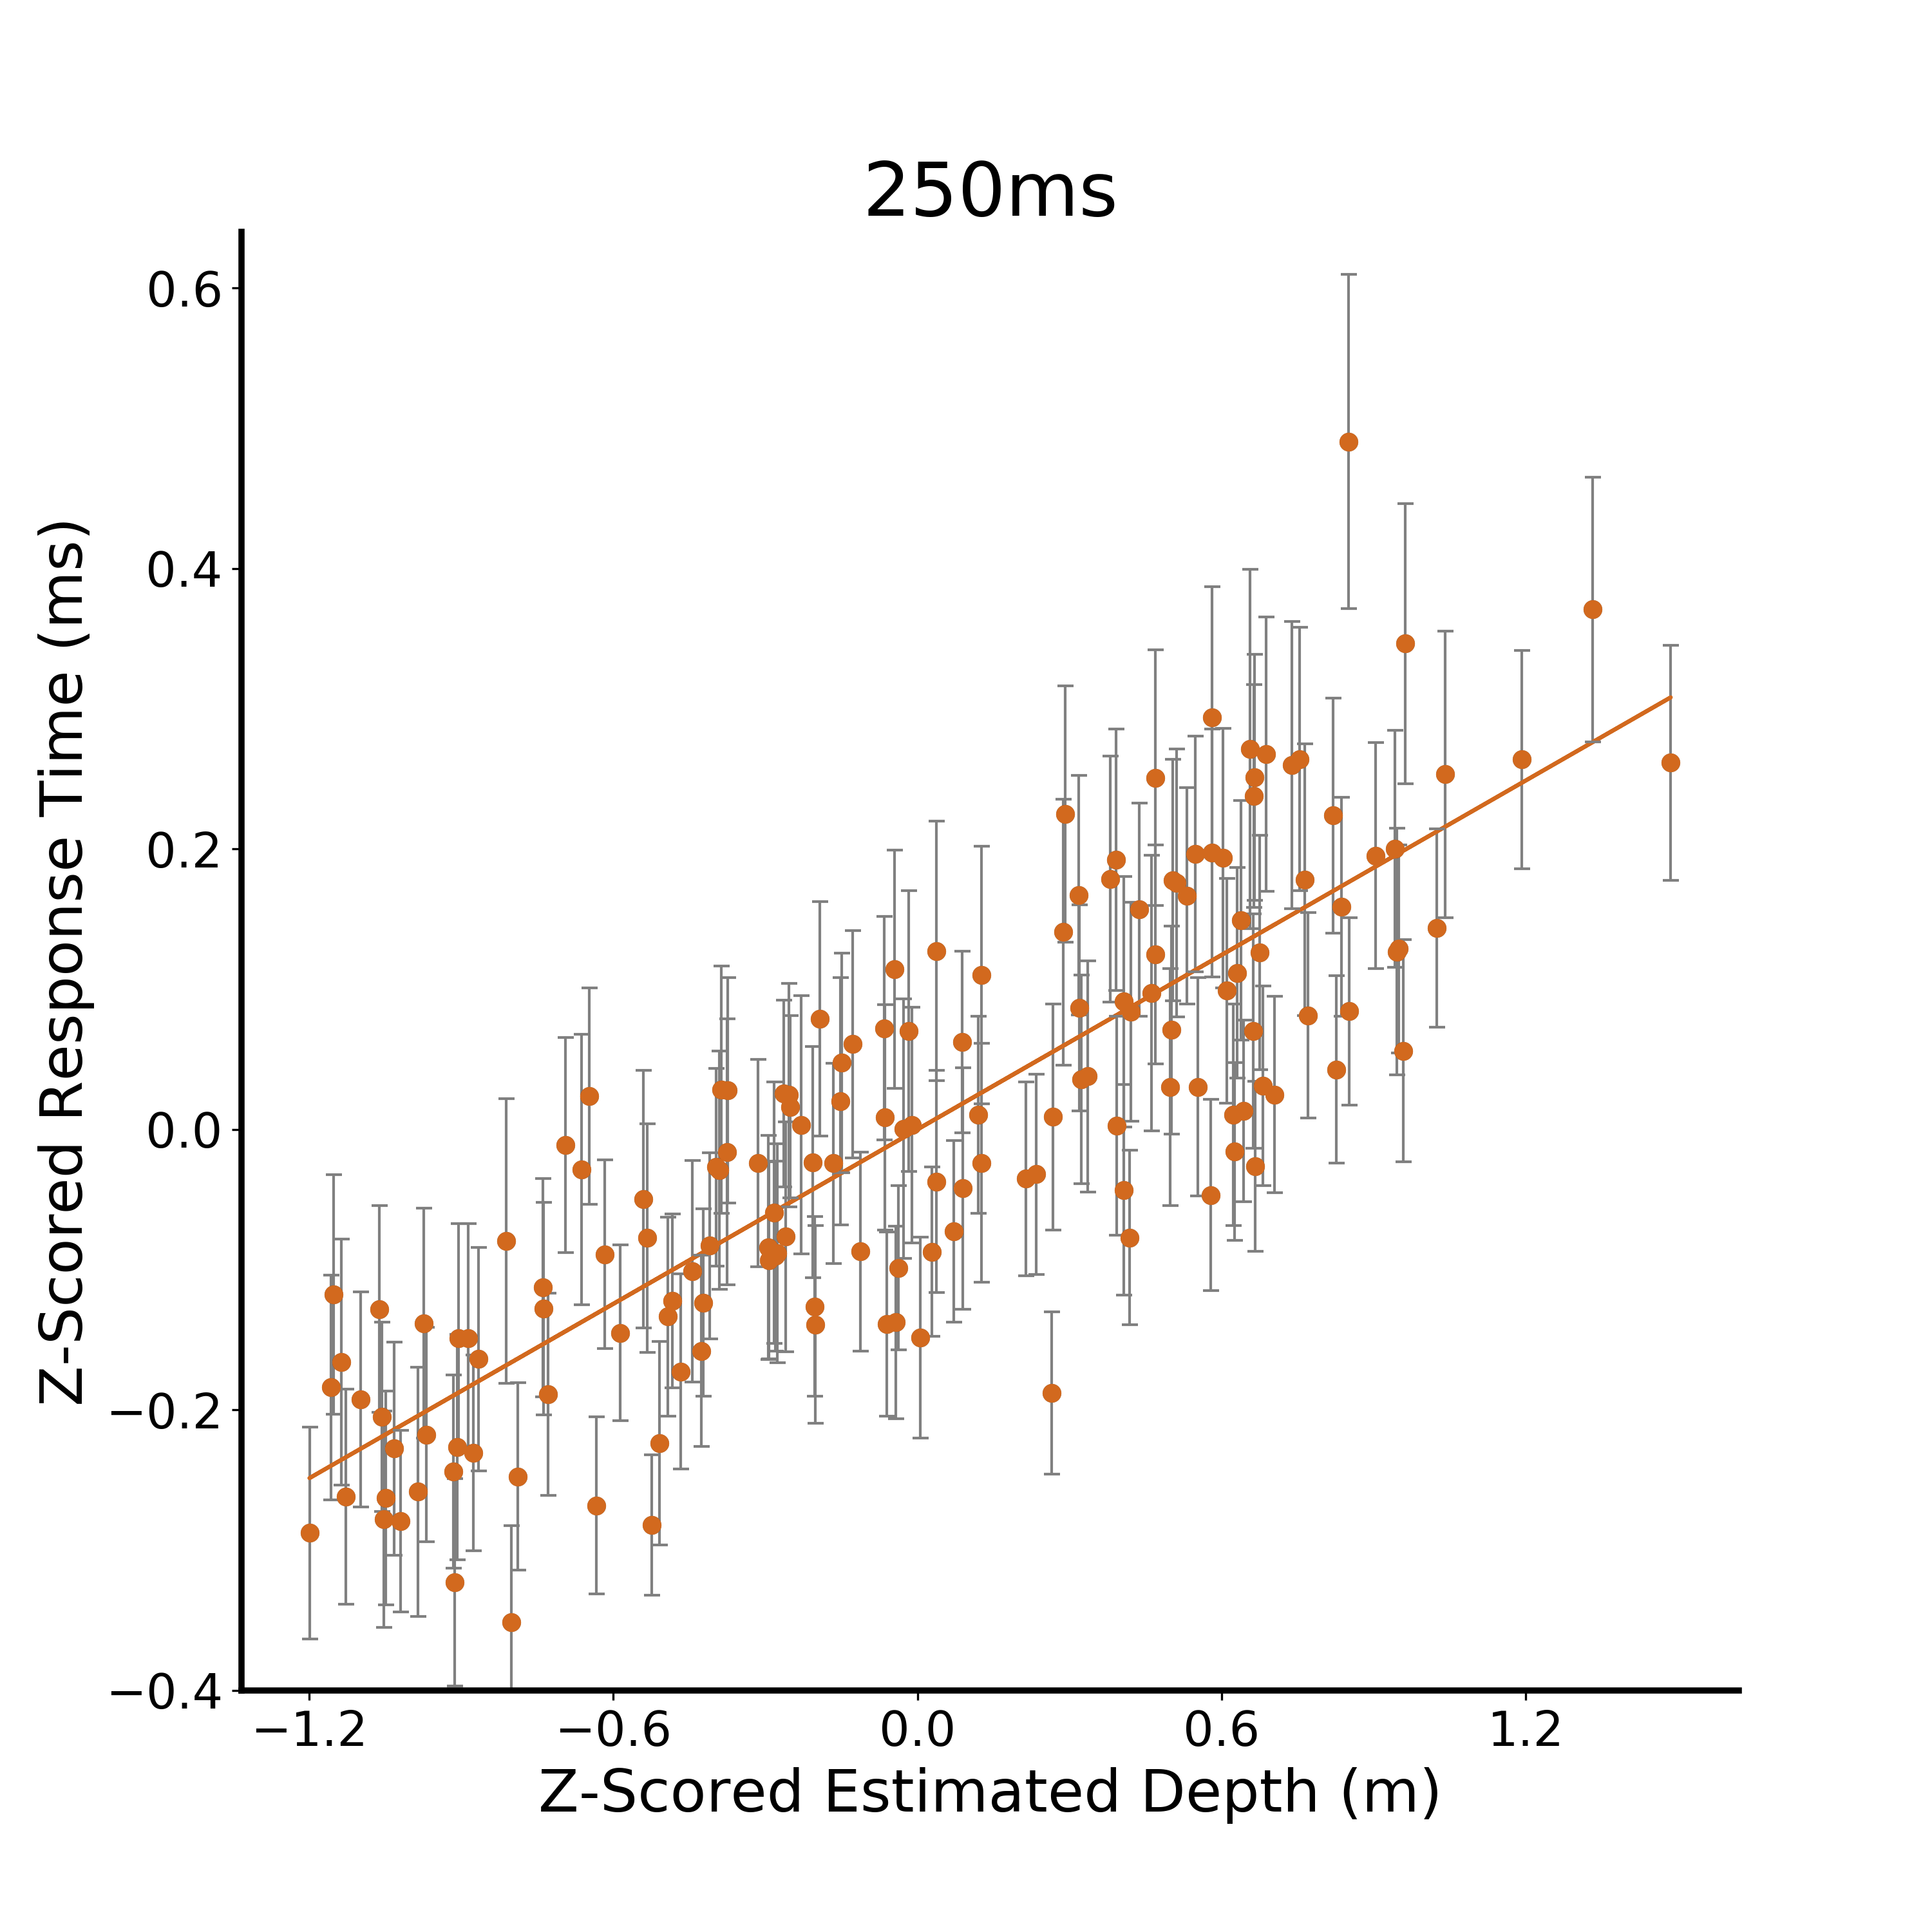
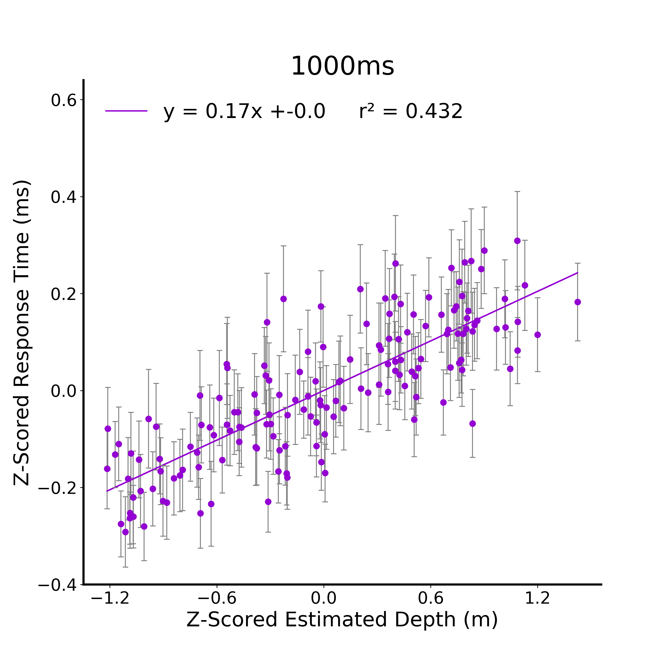
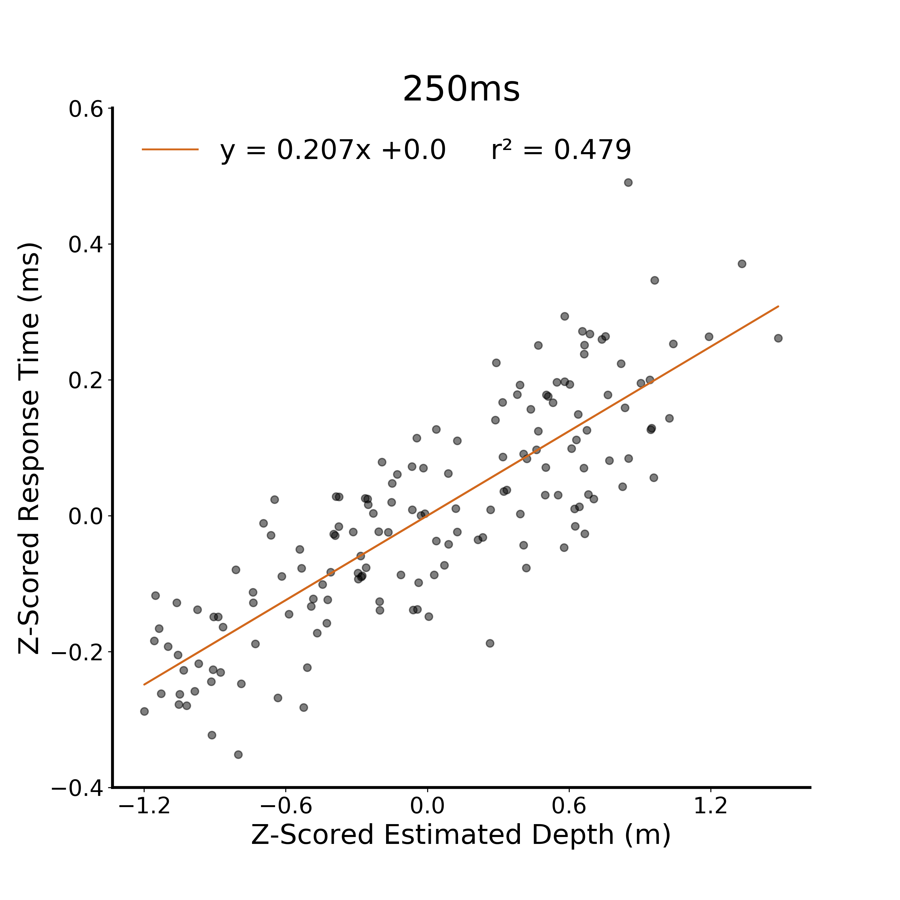
A.
B.
C.
D.
E.
Notes:
DONE

Slide 5
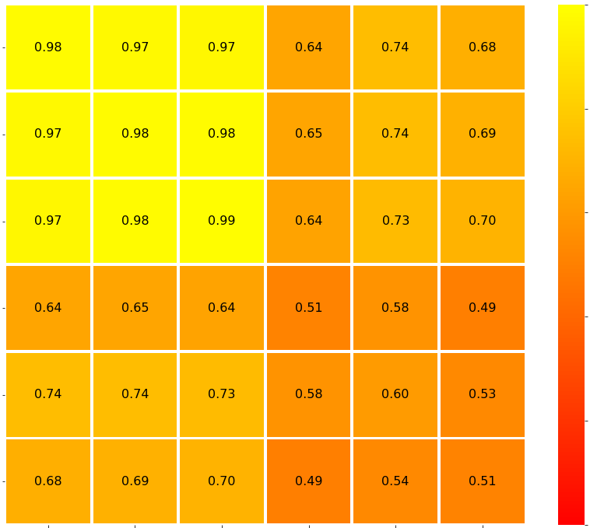
1
125
250
0.8
Distance Estimate
1000
0.6
Correlation (r)
125
0.4
Response Time
250
0.2
*
0.16
1000
125
250
1000
125
250
1000
0
Distance Estimate
Response Time
Notes:
DONE

Slide 6
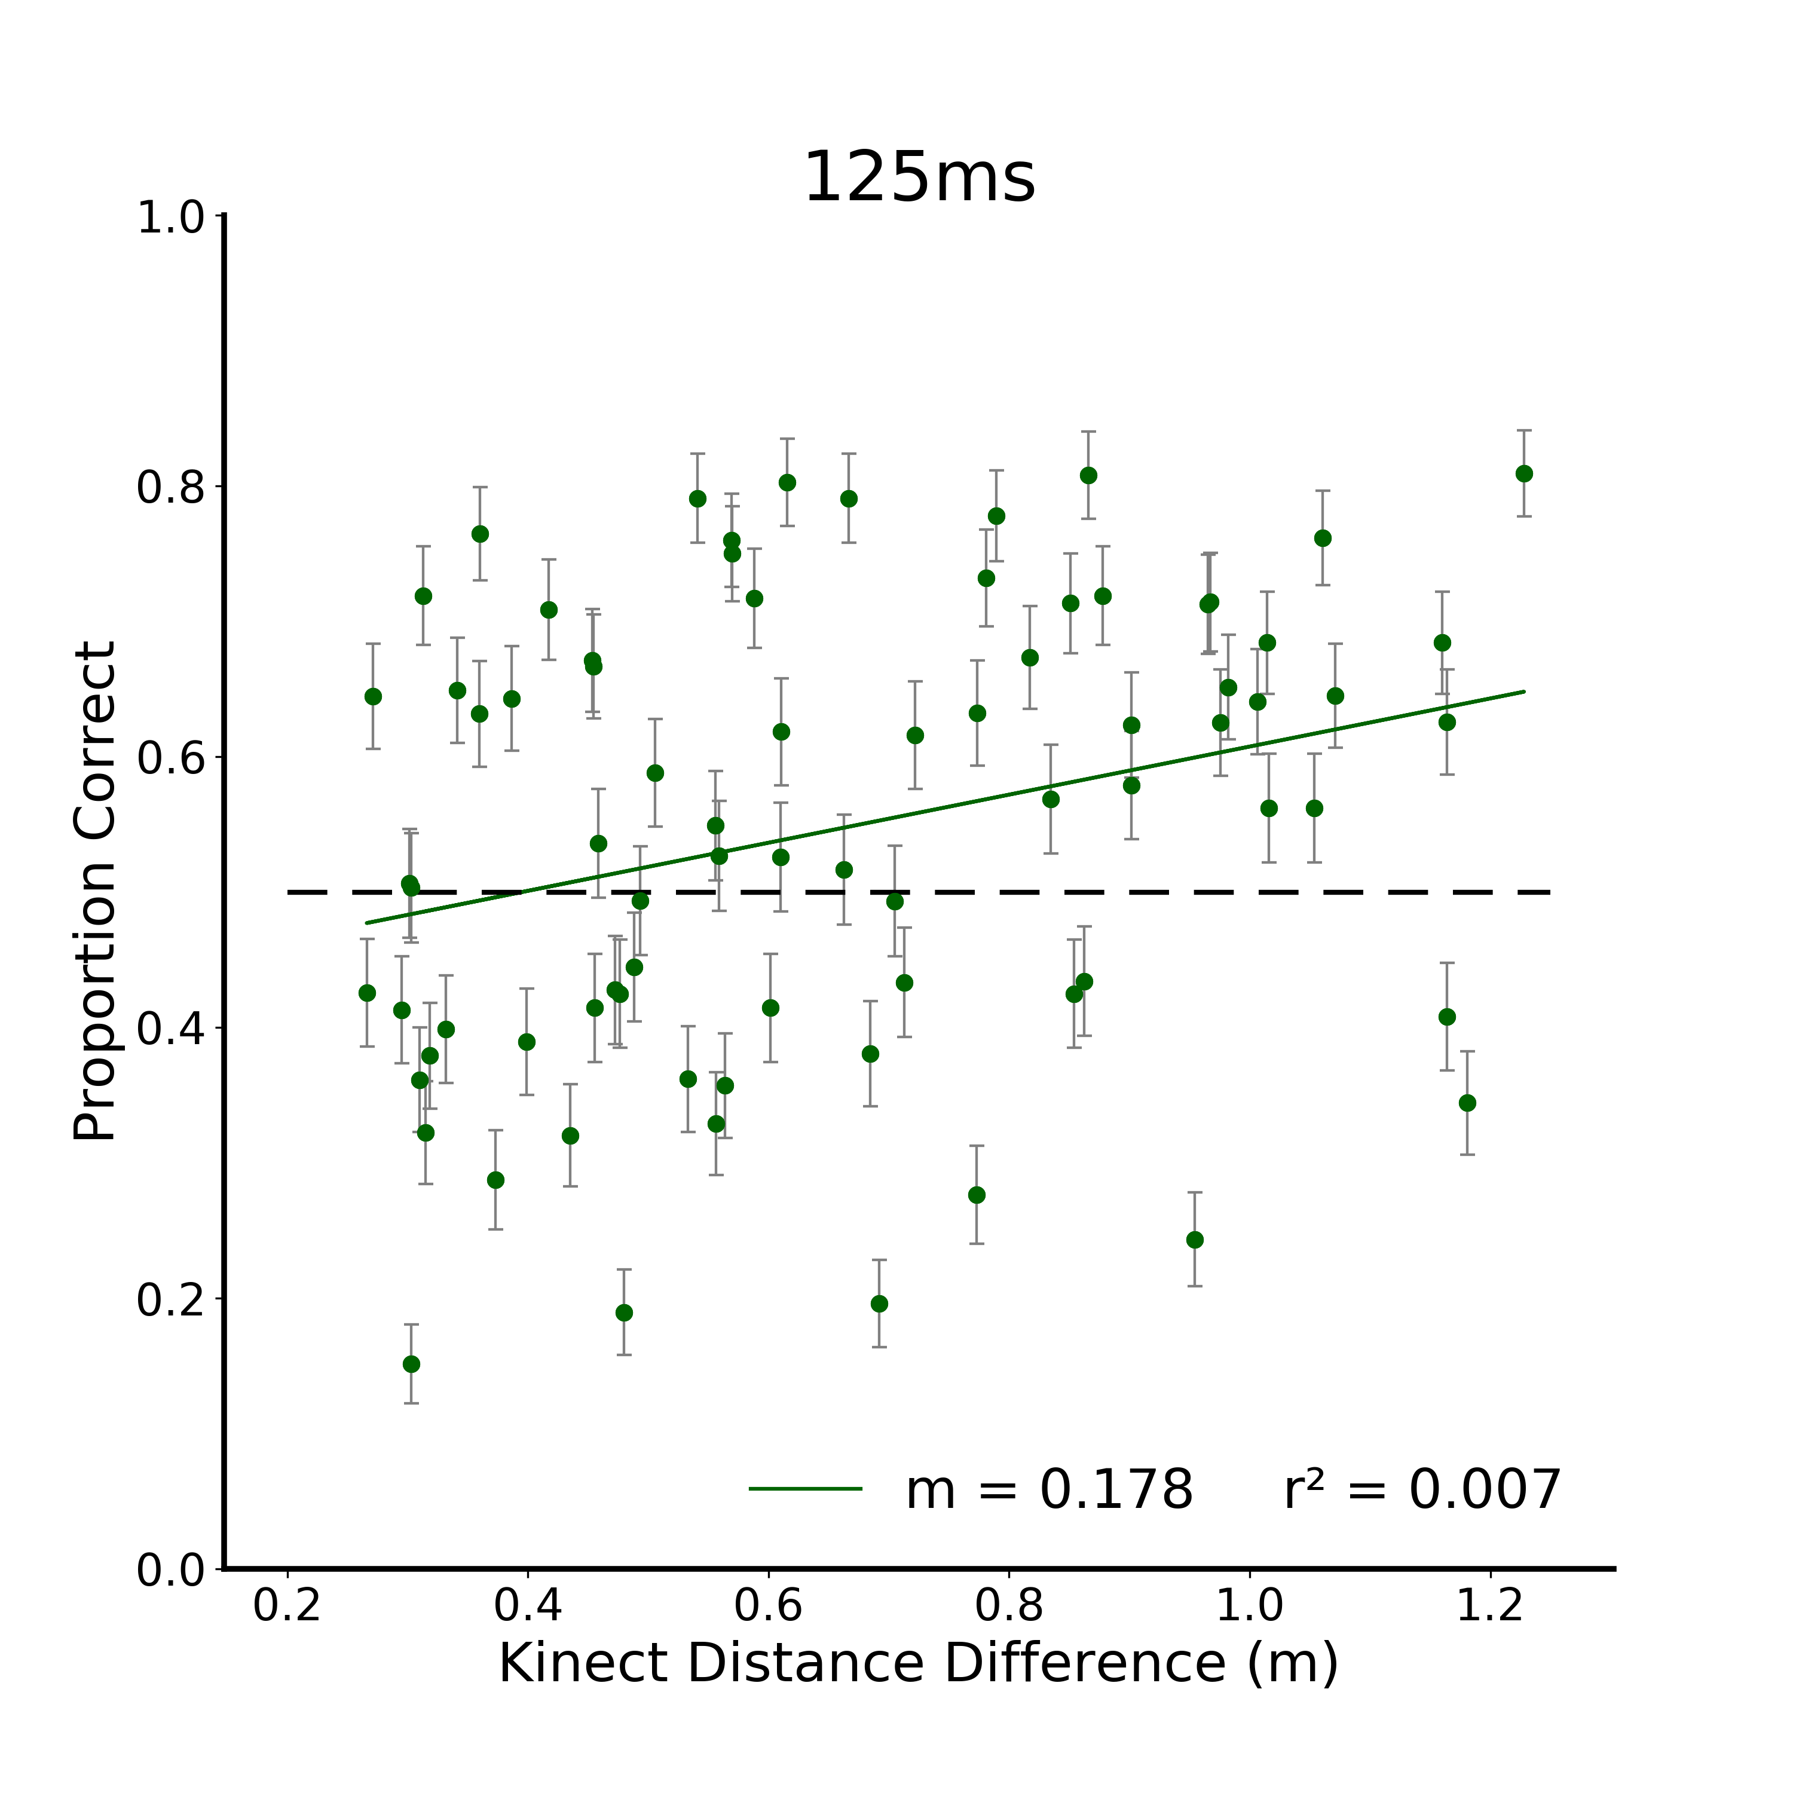
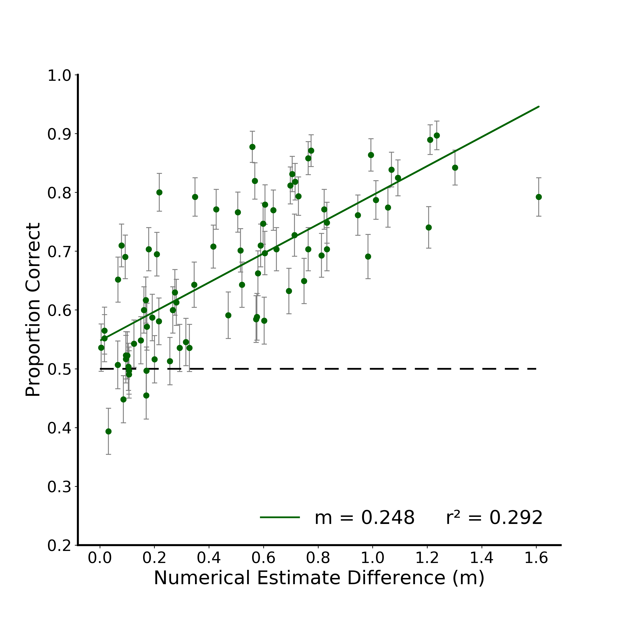

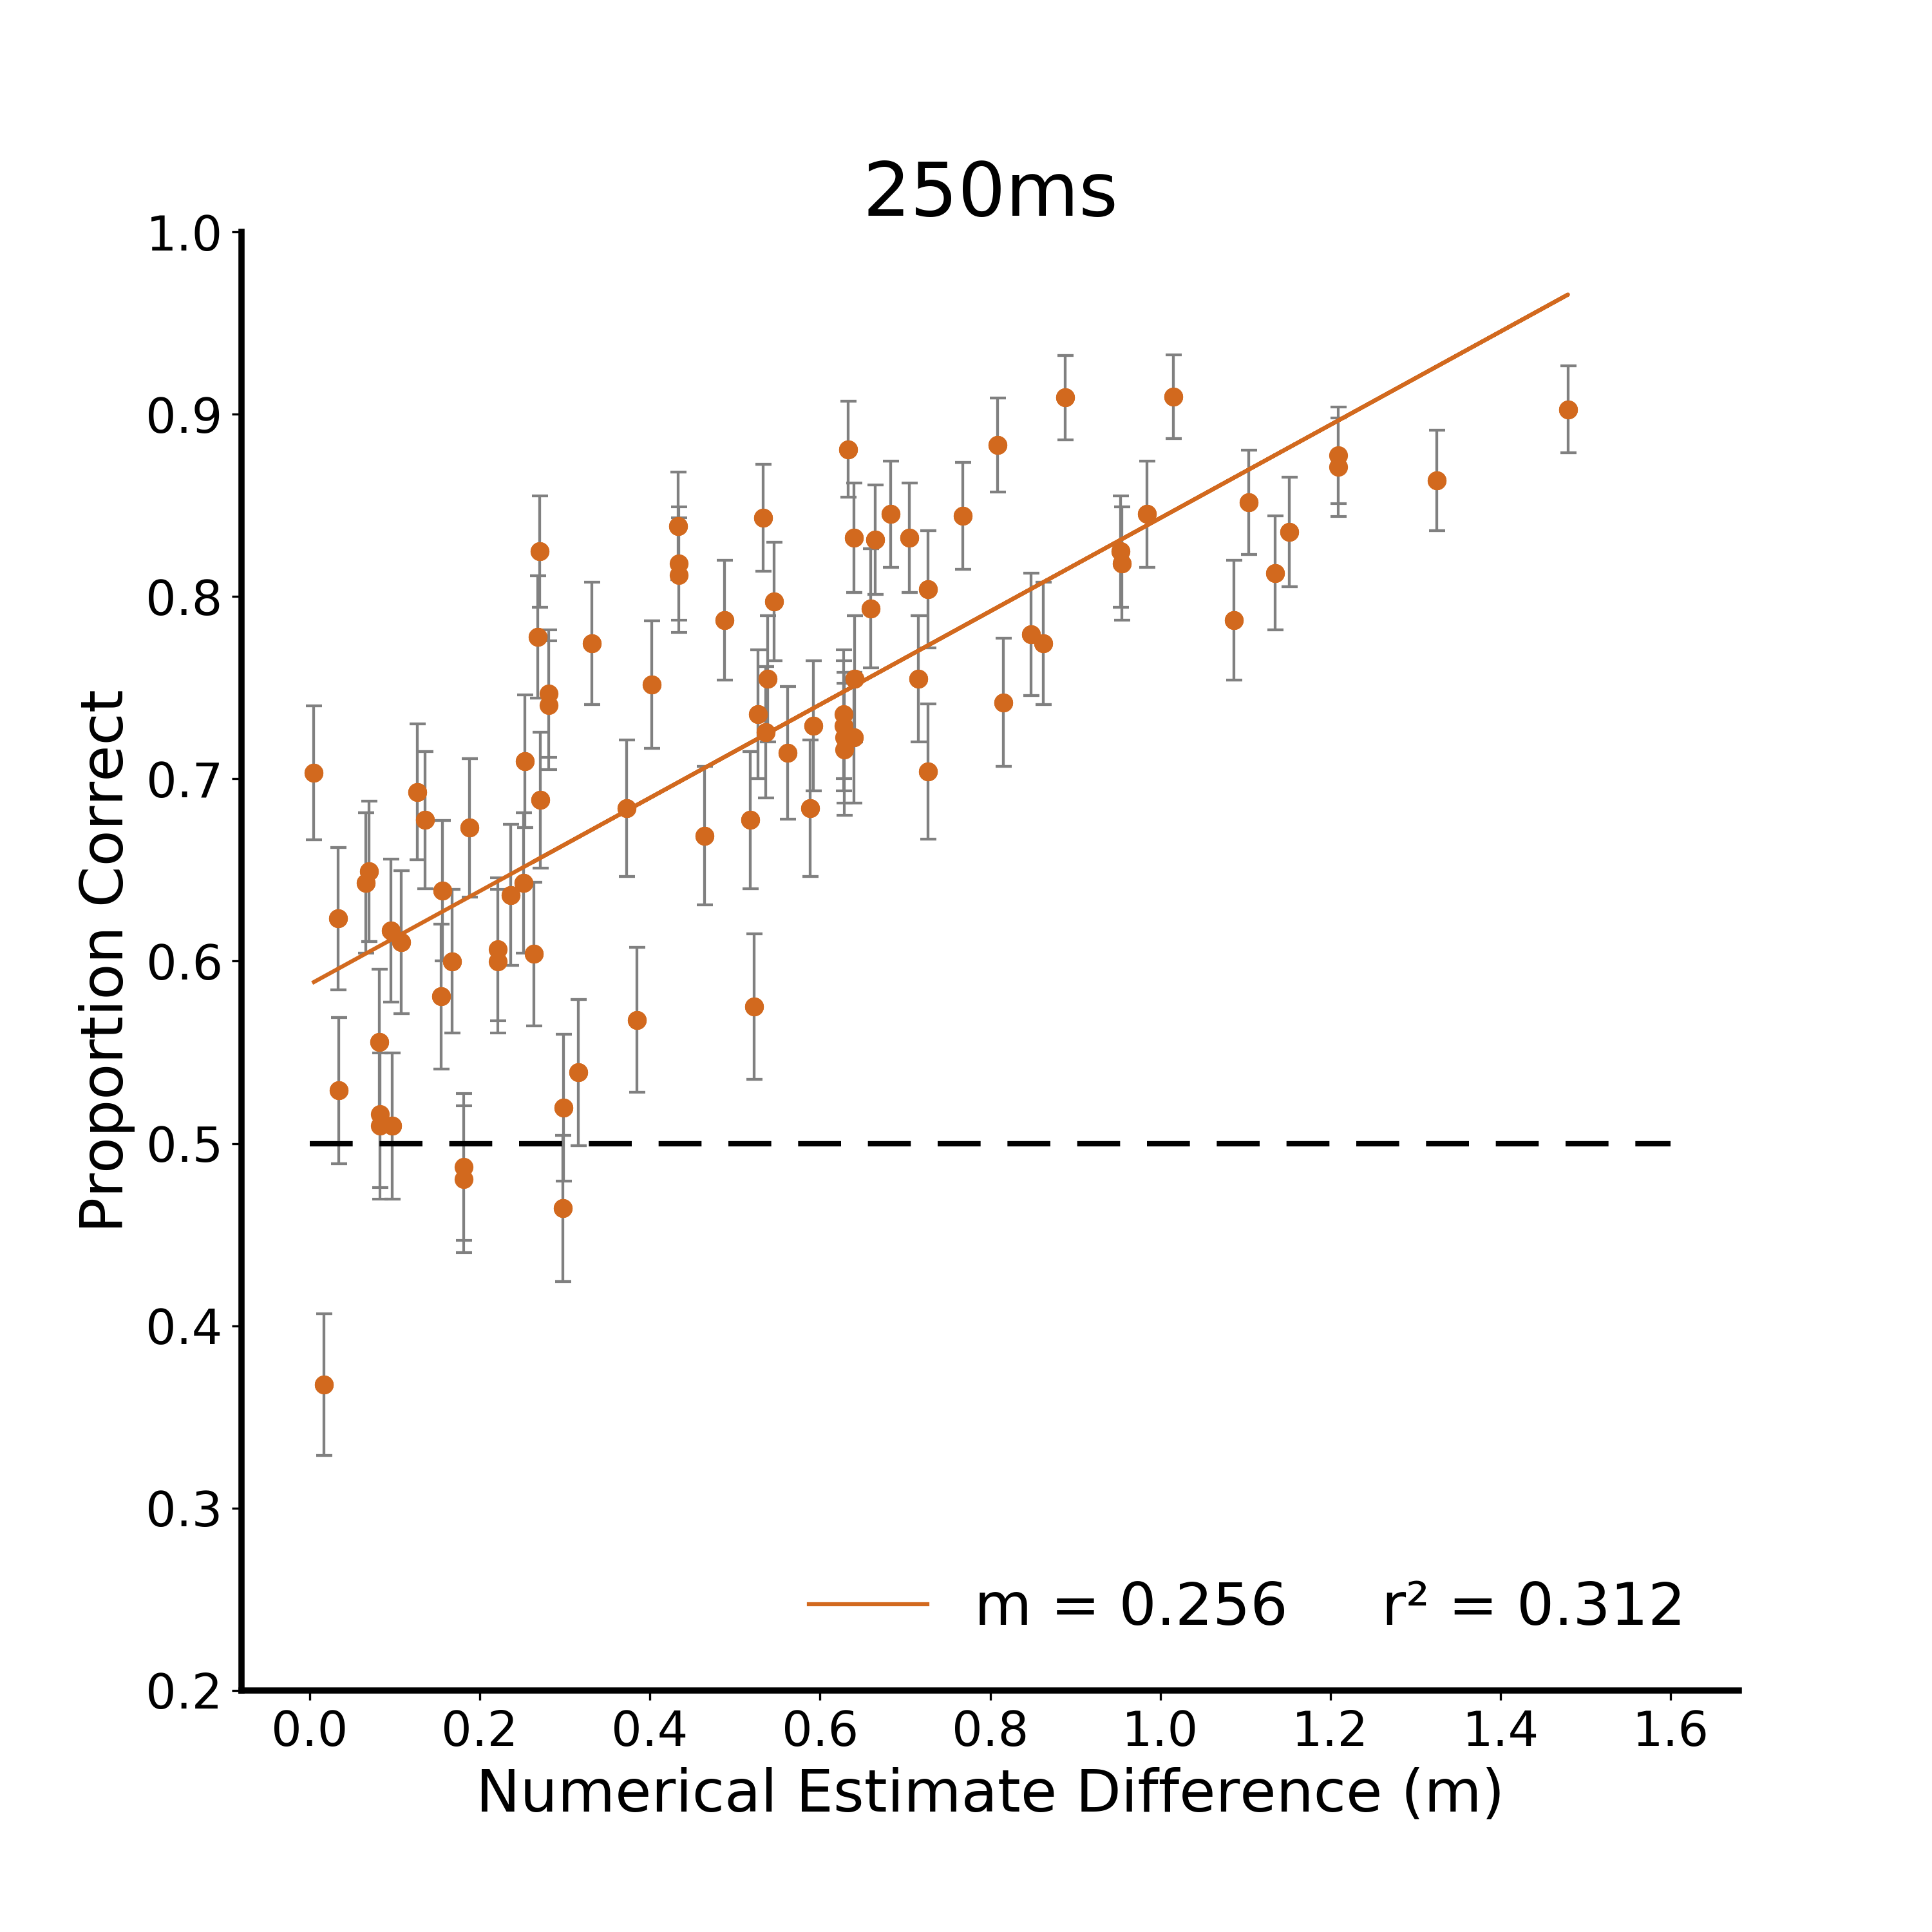
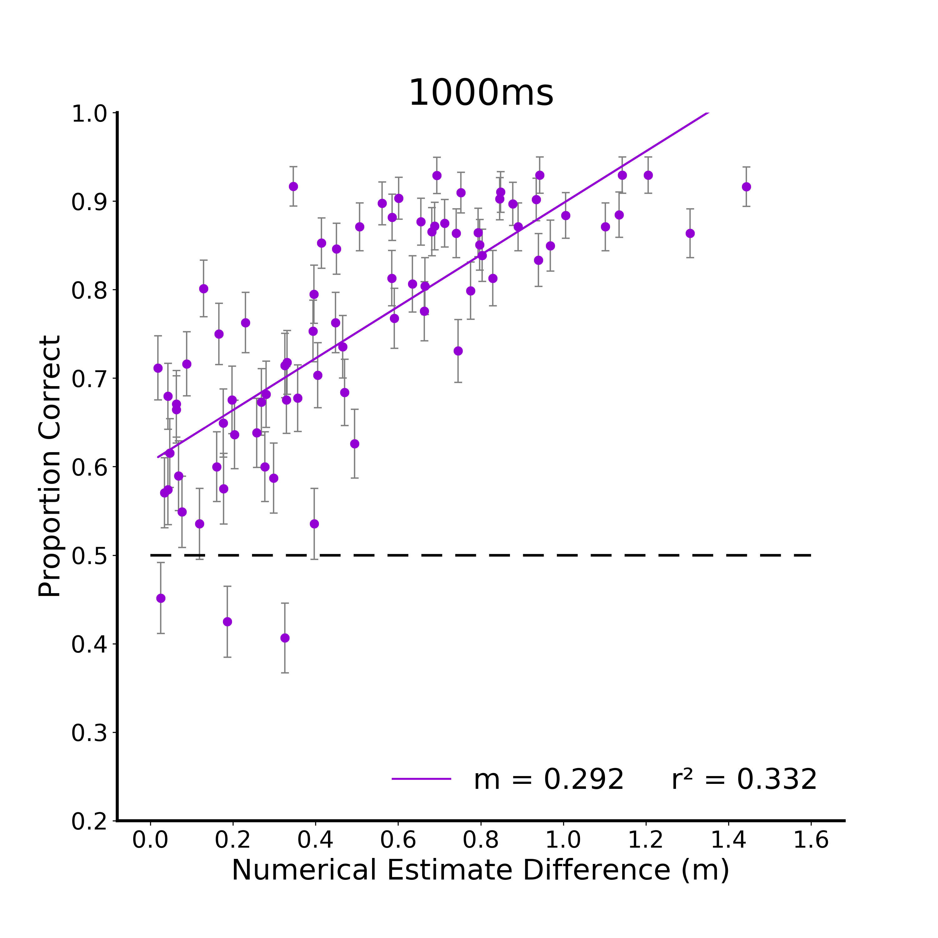
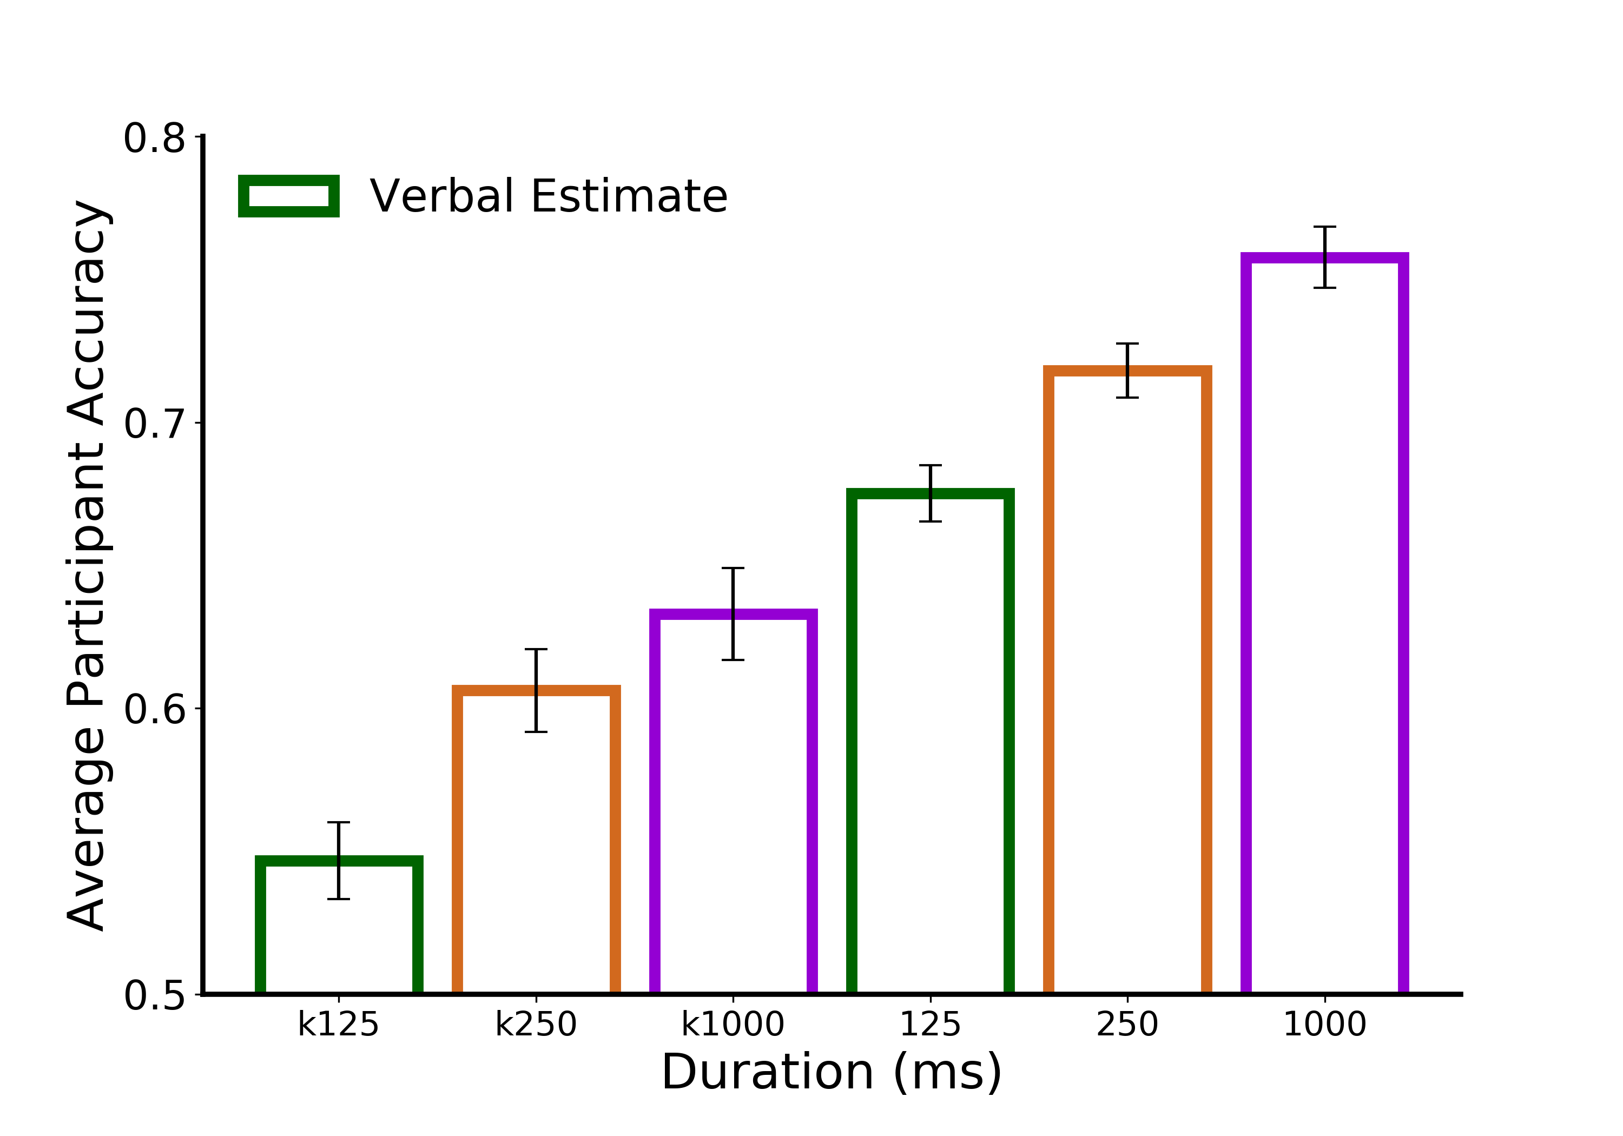
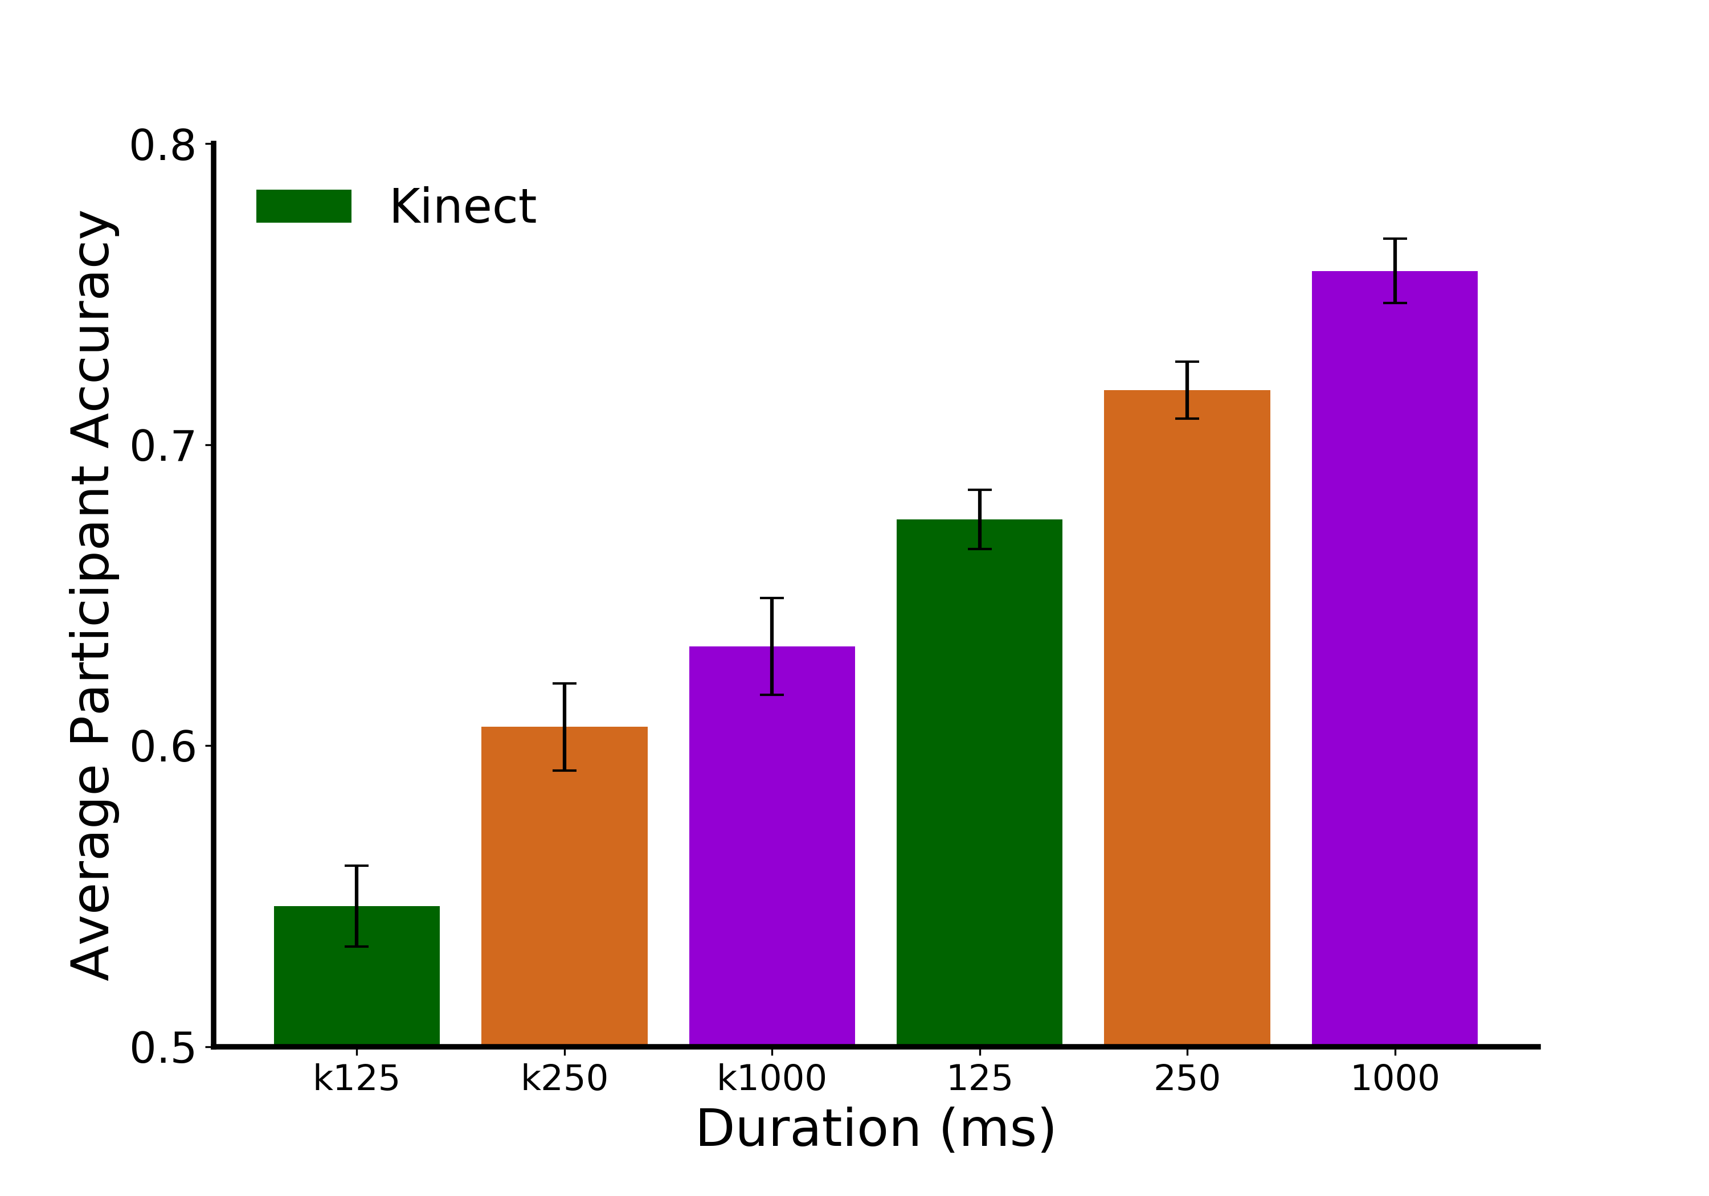
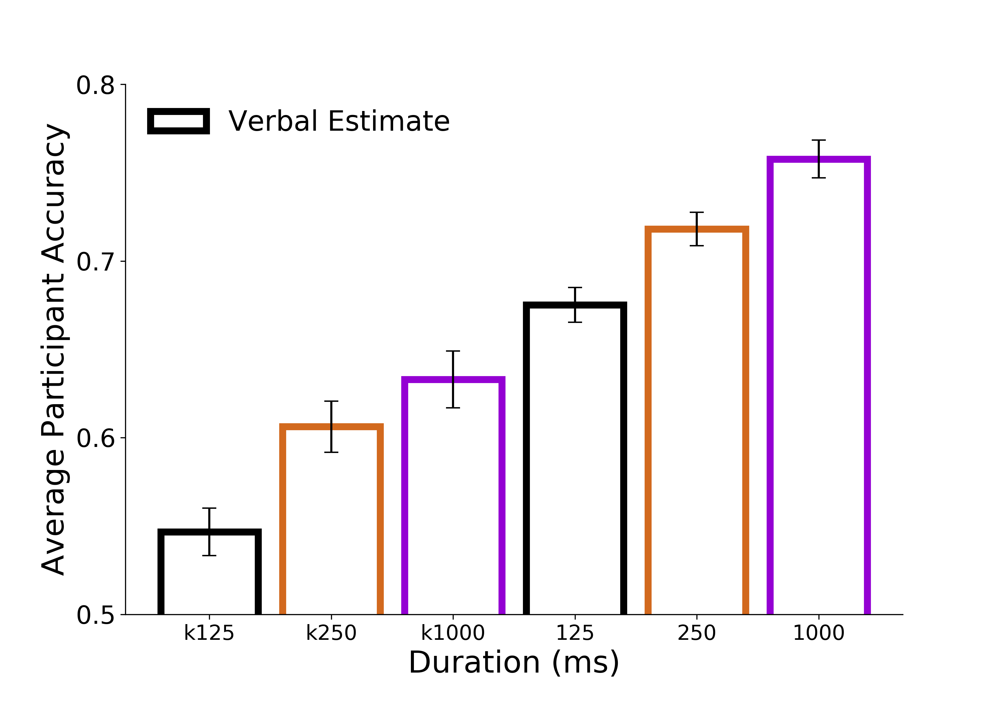
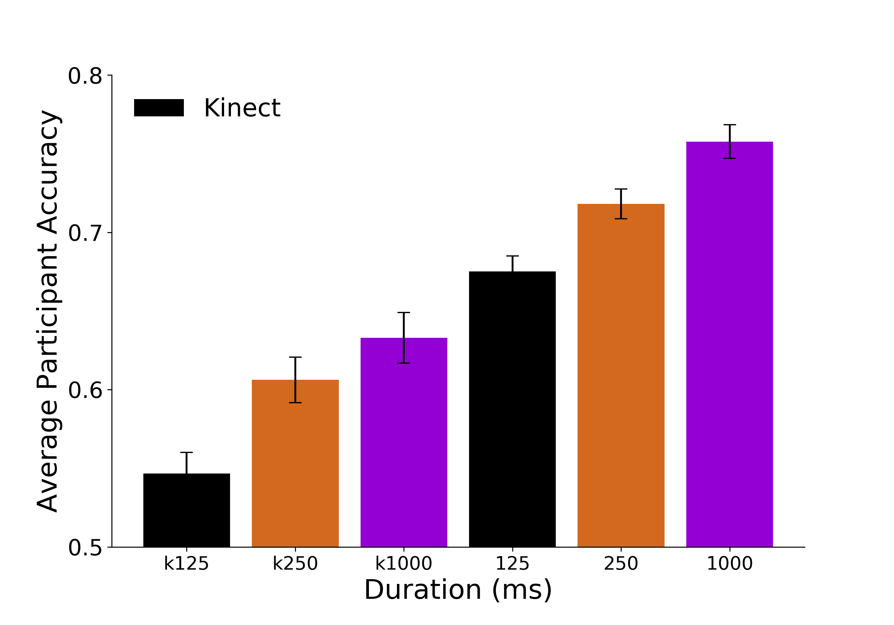
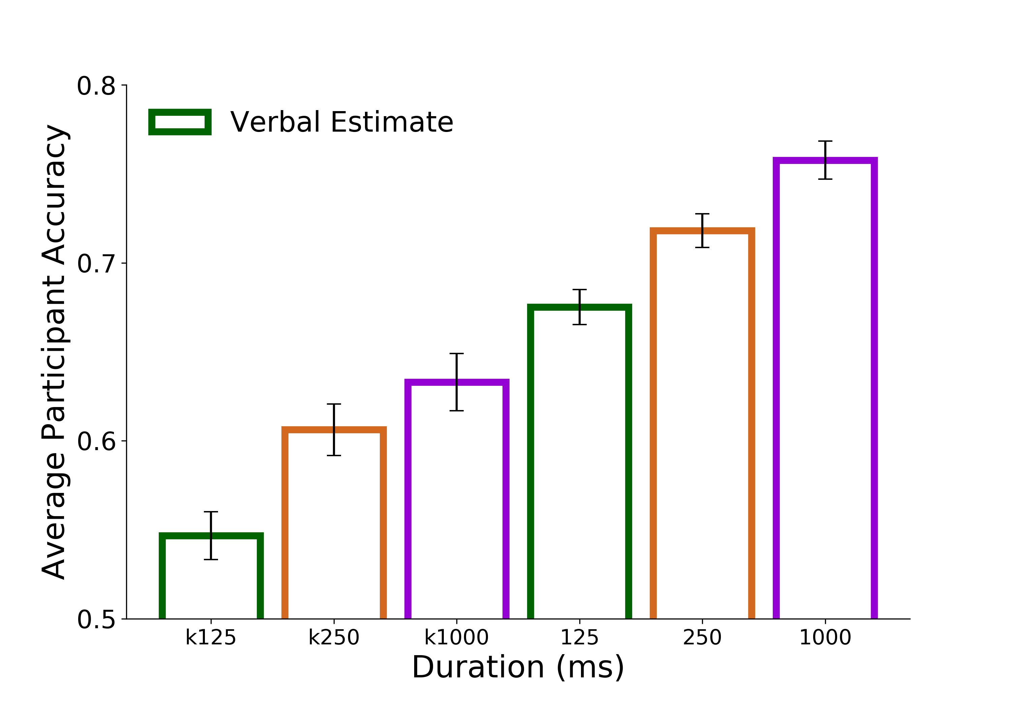
A.
B.
C.
D.
E.
***
*
**
***

Slide 7
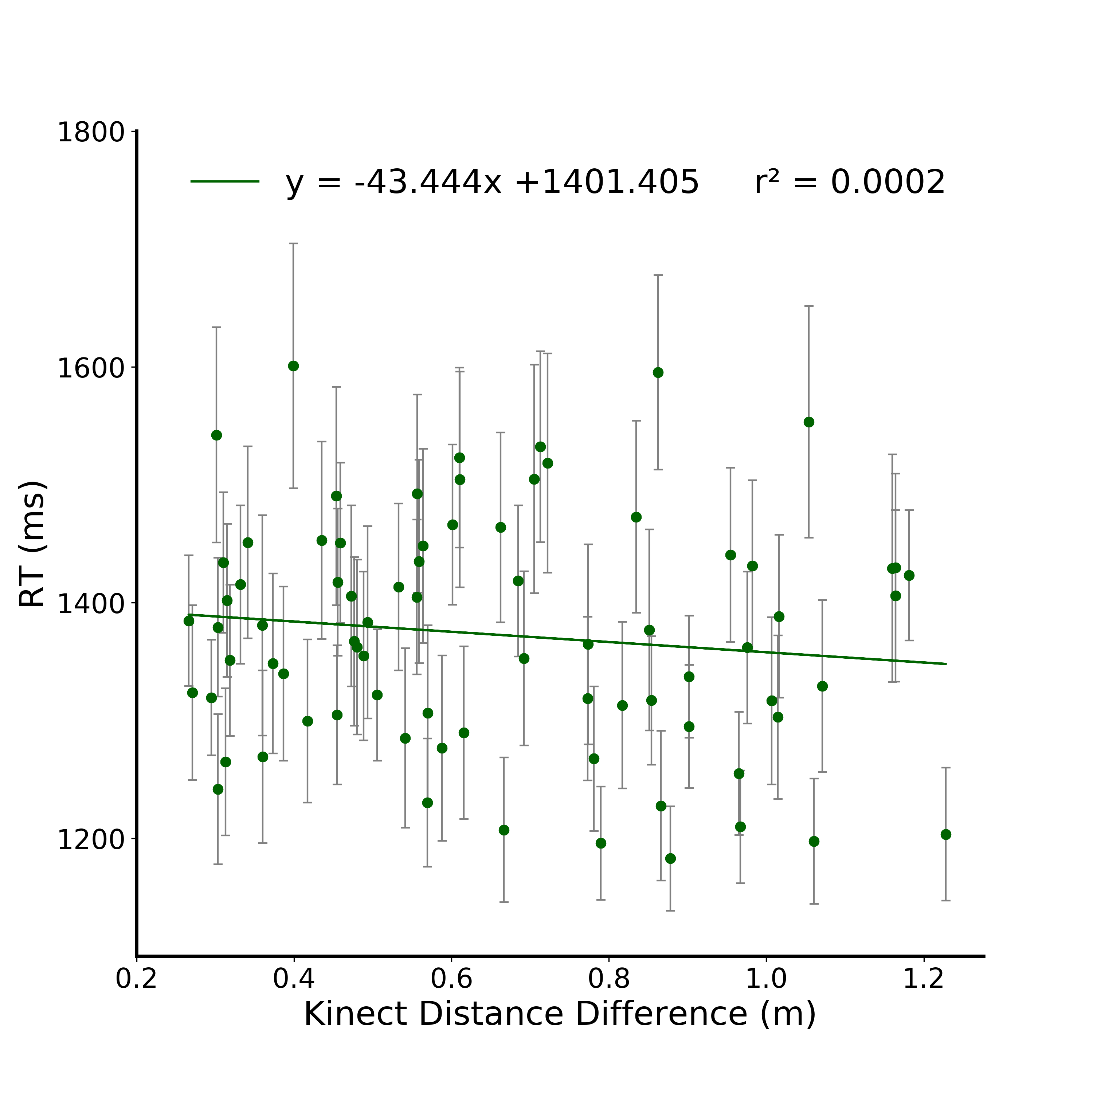
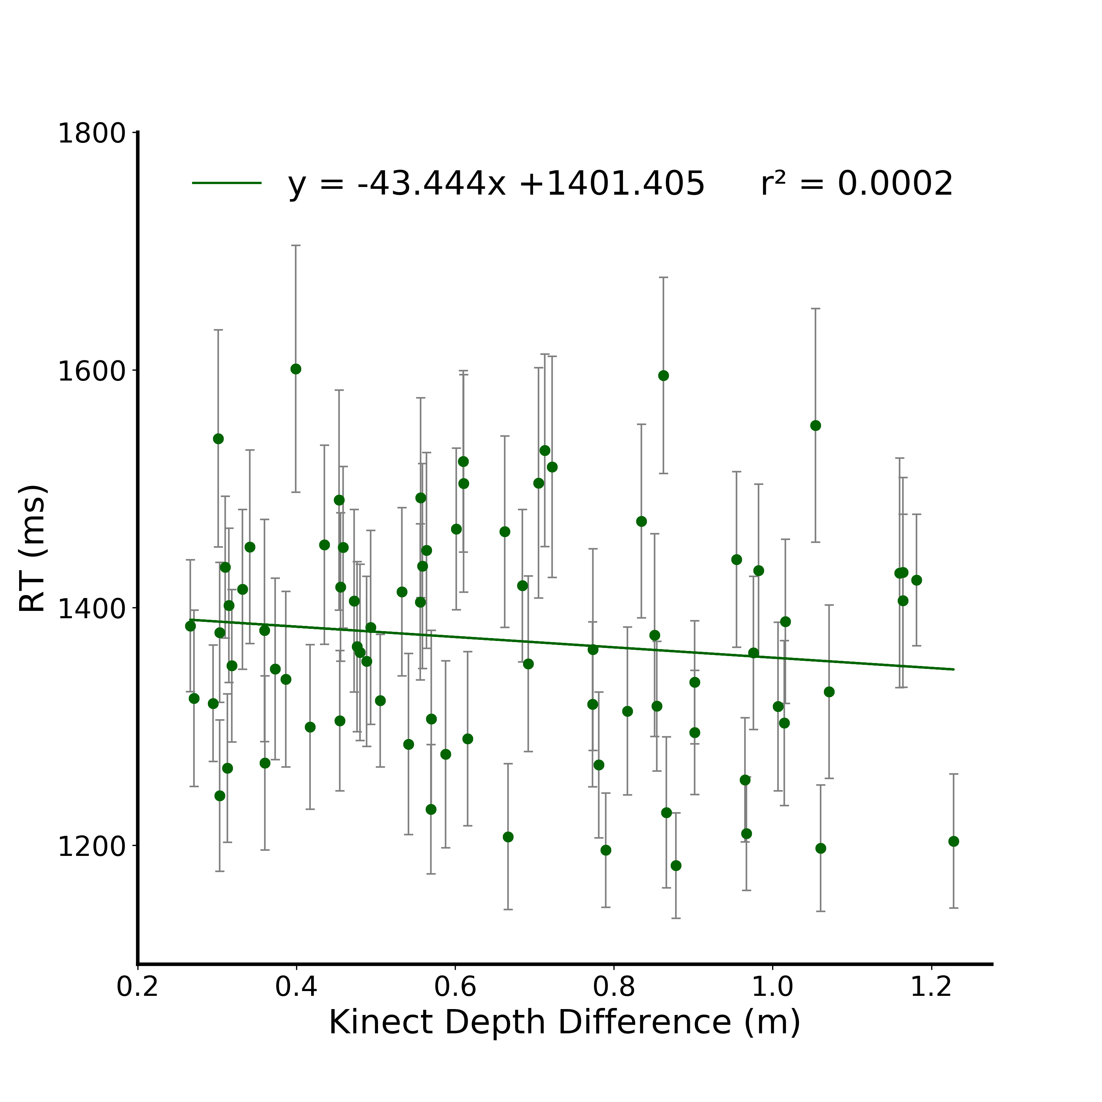
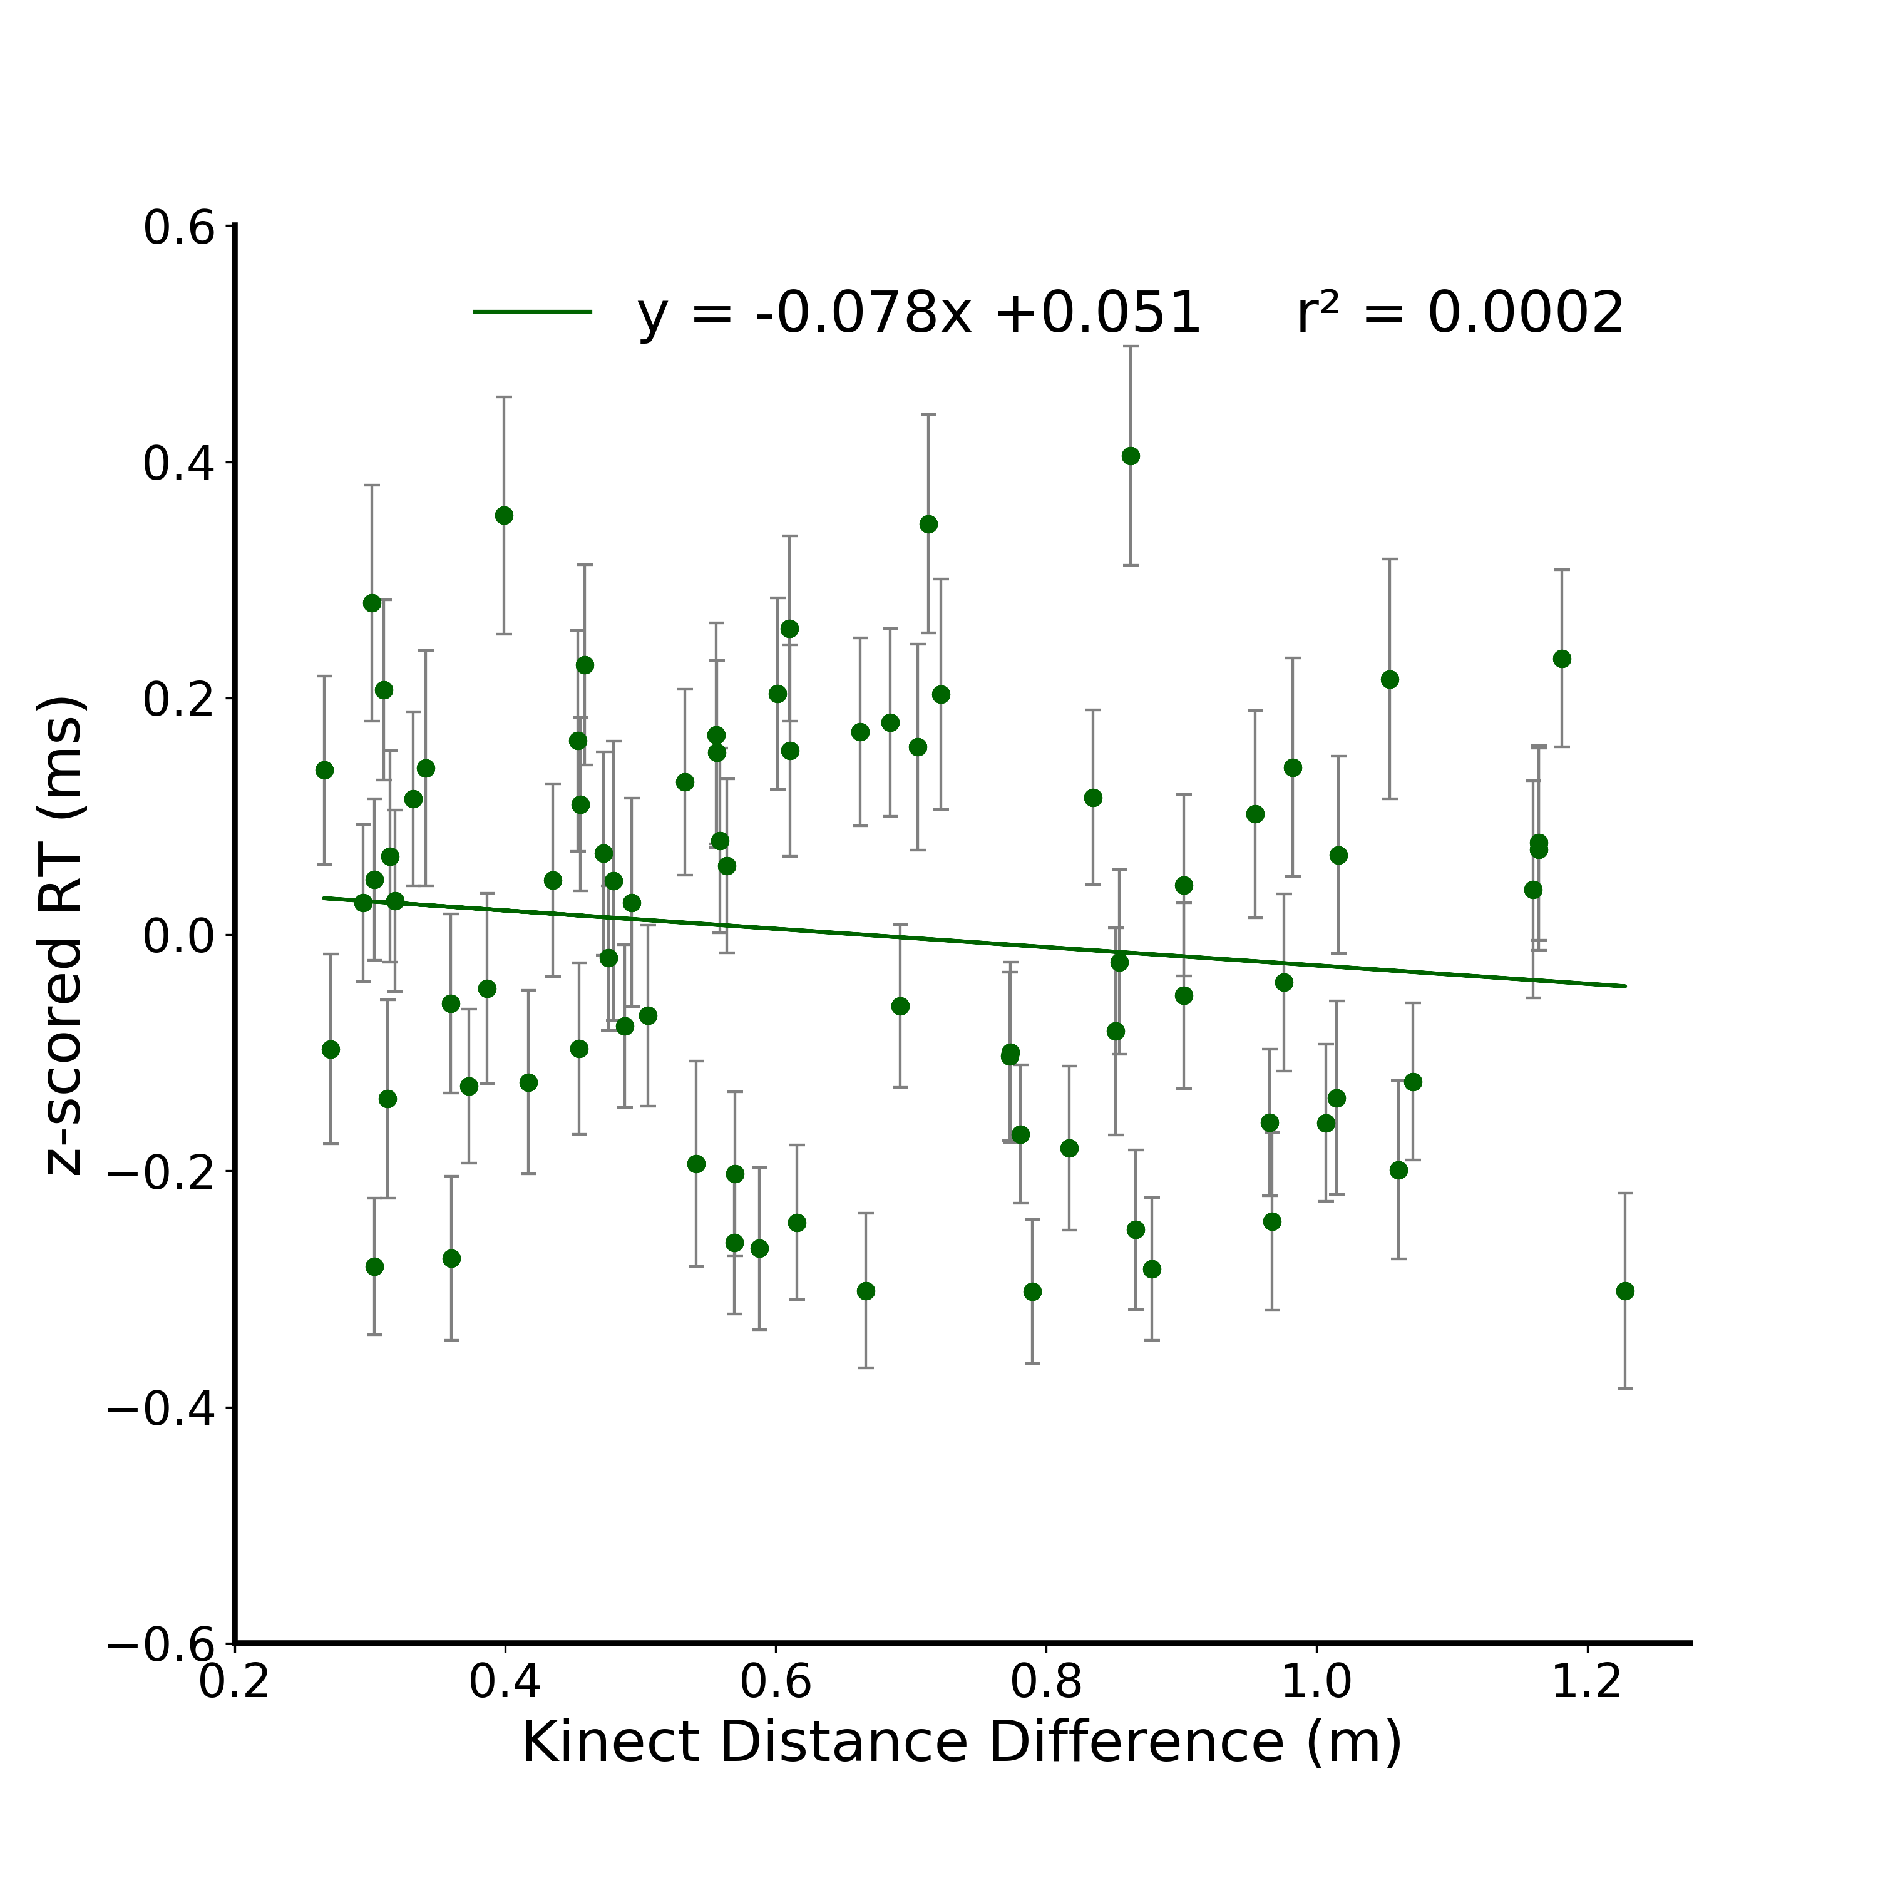
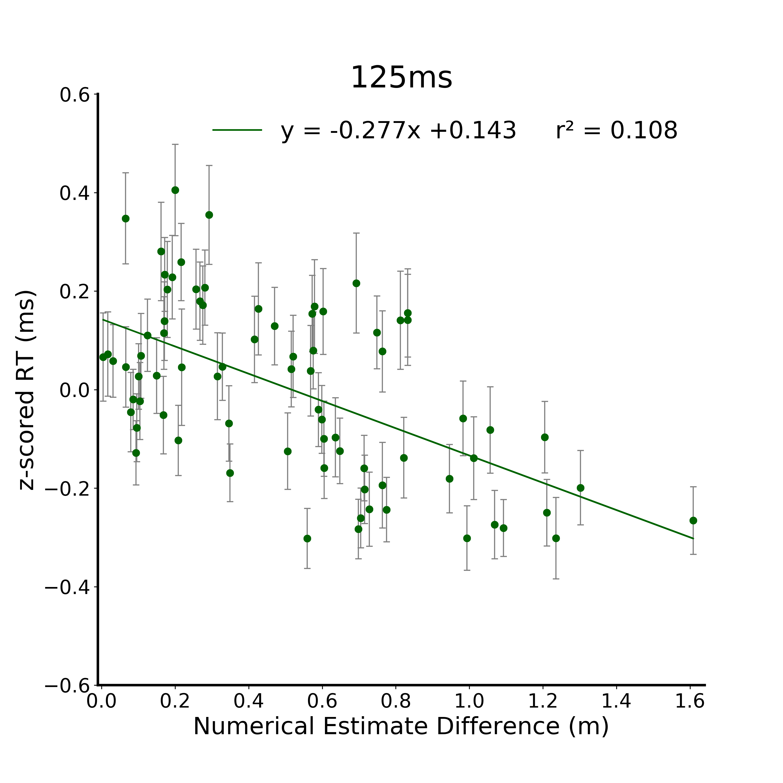

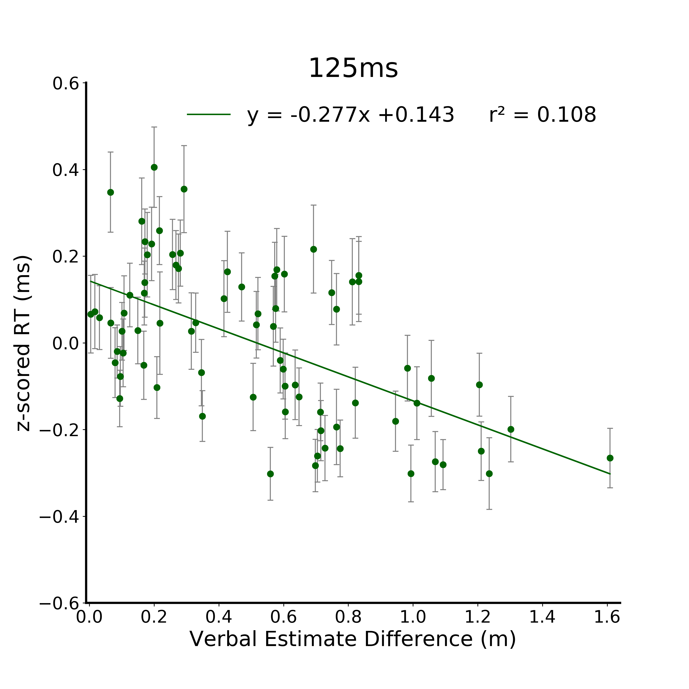
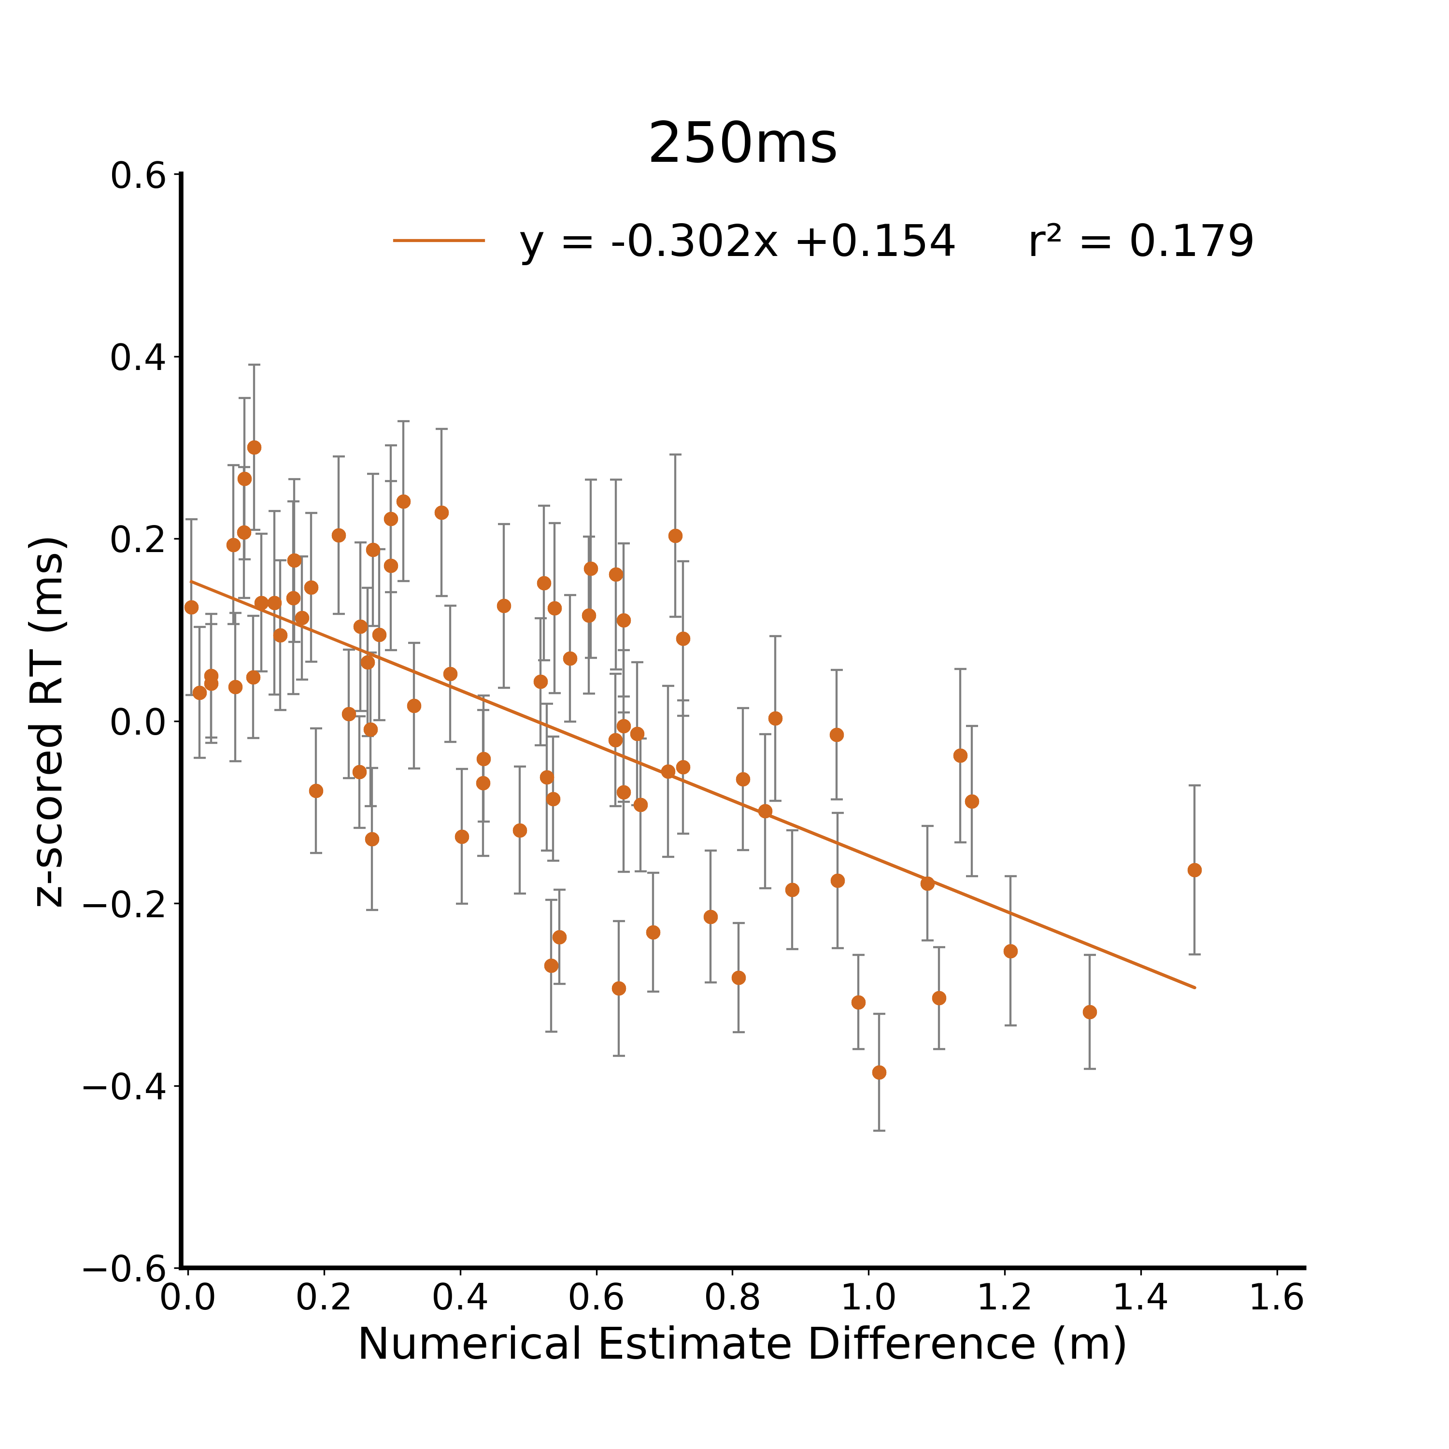
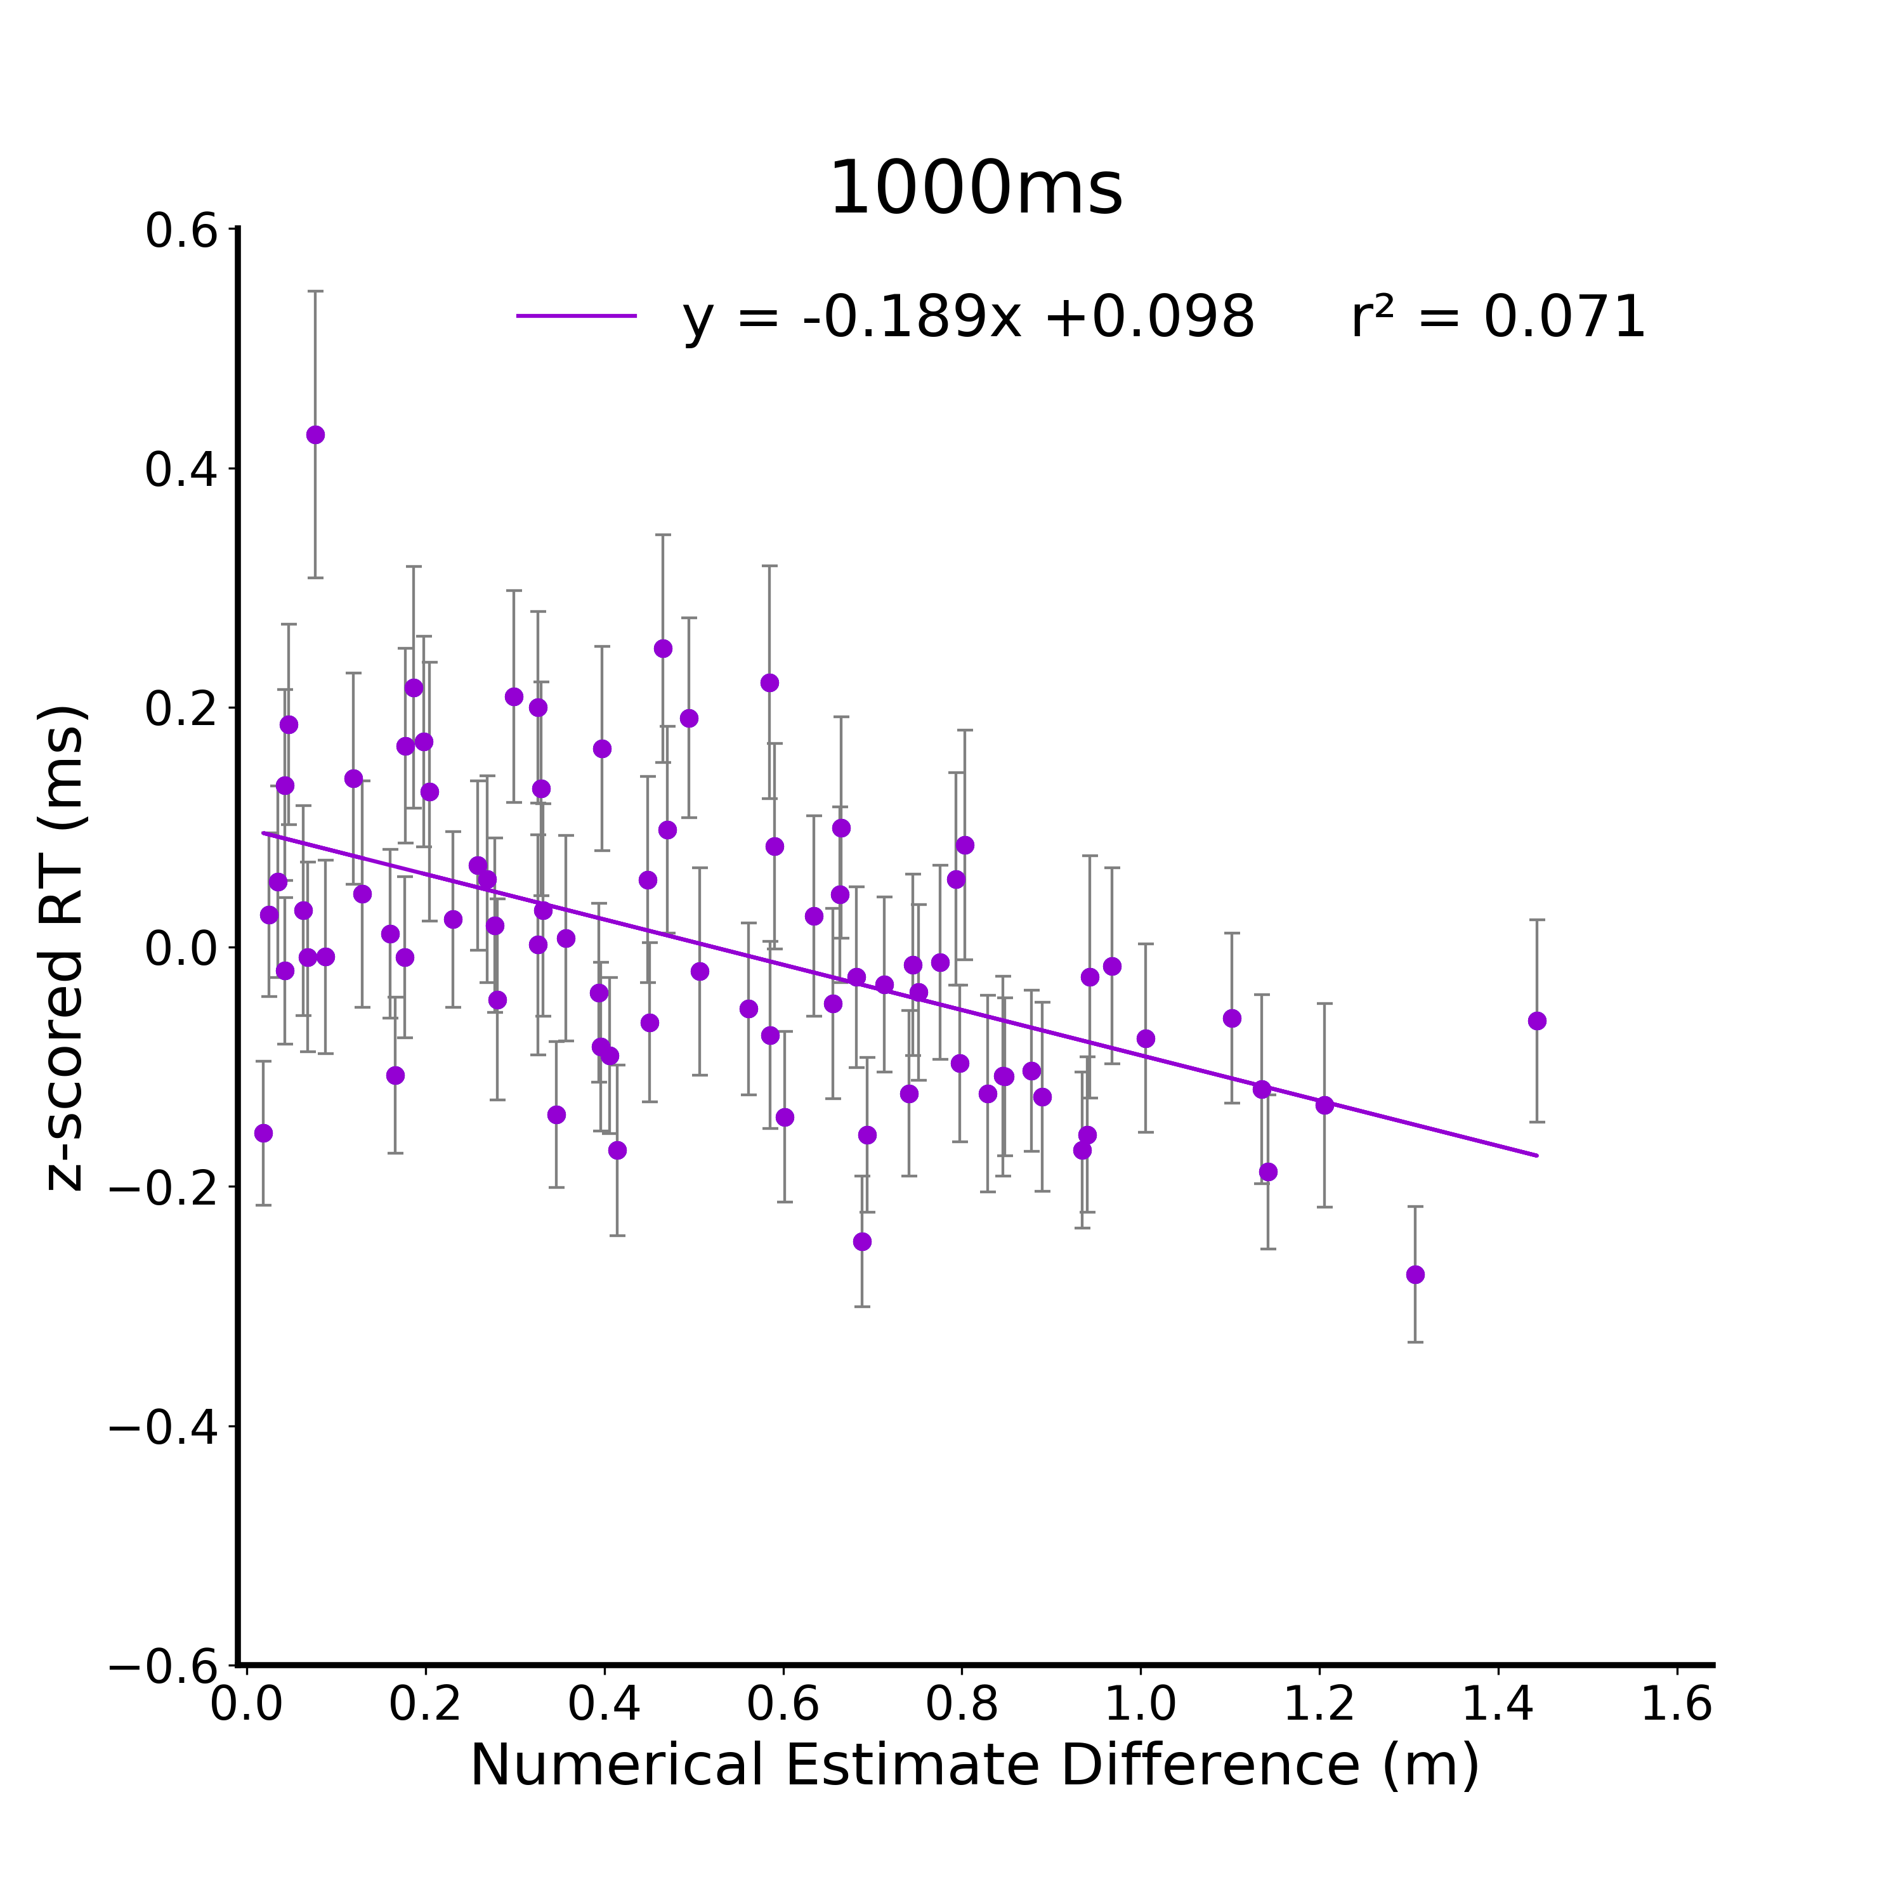
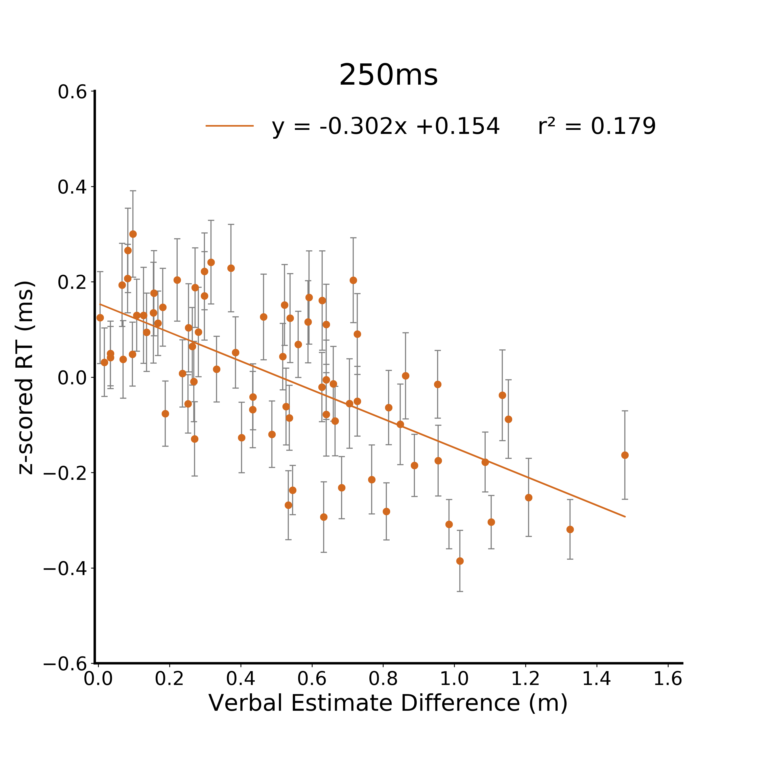

A.
B.
C.
D.
E.

Slide 8
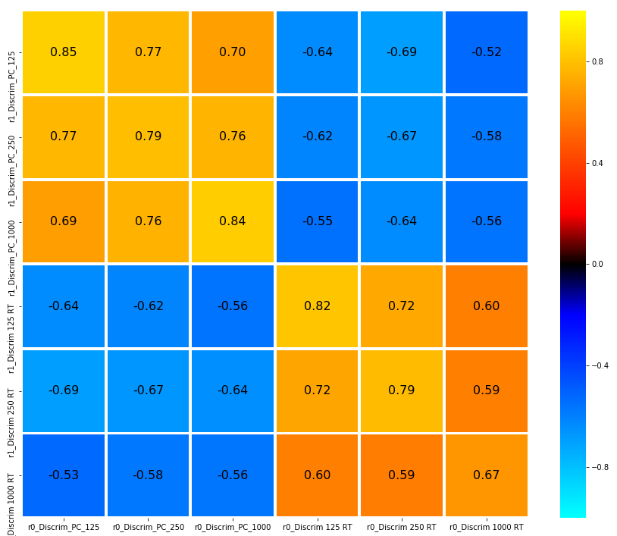
125
0.8
Percent Correct
250
0.4
1000
0.16
*
Correlation (r)
0
125
- 0.16
*
Response Time
- 0.4
250
1000
- 0.8
125
250
1000
125
250
1000
Percent Correct
Response Time
Notes:
DONE
Within duration cmparisonas are stronger than between

Slide 9


125
0.8
250
Percent Correct
0.4
1000
0.16
*
Correlation (r)
Numerical Estimate
0
125
- 0.16
*
250
- 0.4
Response Time
1000
- 0.8
125
250
1000
125
250
1000
Percent Correct
Response Time
Discrimination

Slide 10



A.
B.
2.64 m²
4.41 m²
(x_{res}, y_{res}, depth)
9.82 m²
1.76 m²
N1
N2
4.58 m²
POI
Visible ground plane: 7.95 m²
Complete ground plane: 13.247 m²
C.
D.
E.
Abs(Residuals) (z)
Residuals (z)
Residuals (z)
Complete Ground Plane (m²)
Complete Ground Plane (m²)
Complete Ground Plane (m²)

